Slide 1
HOW BABCOCK UNIVERSITY IS IMPLEMENTING THE ‘’I WILL GO’’ STRATEGIC PLAN
Presented by
Ademola S. Tayo
President /Vice-Chancellor
Babcock University, Nigeria

Slide 2
KPI 1.1: Increased number of church members participating in both personal and public evangelistic outreach initiative with a goal to Total Member Involvement(TMI) | ACTIVITIES OF BU IN ITS IMPLEMENTATION 2022 Summer Internship which led to 93 baptism Prison Ministry reinvigoration Post-Covid. Dedicated trained Chaplains for Hospital Ministry (Patients)and their families Establishment of virile Student Association of Literature Evangelists(SALE) and Gospel Literature Acquisition Distribution Accord (GLADA) with thousands of literatures and tracts distributed

Slide 3
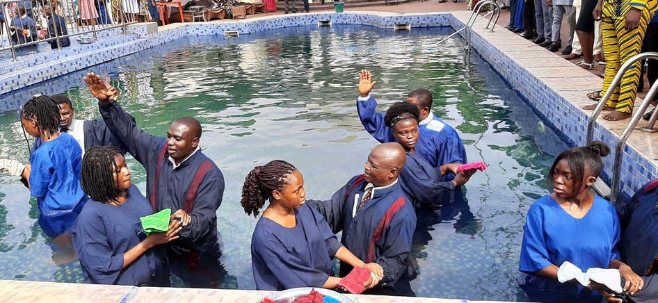
168 persons baptized so far in 2022

Slide 5
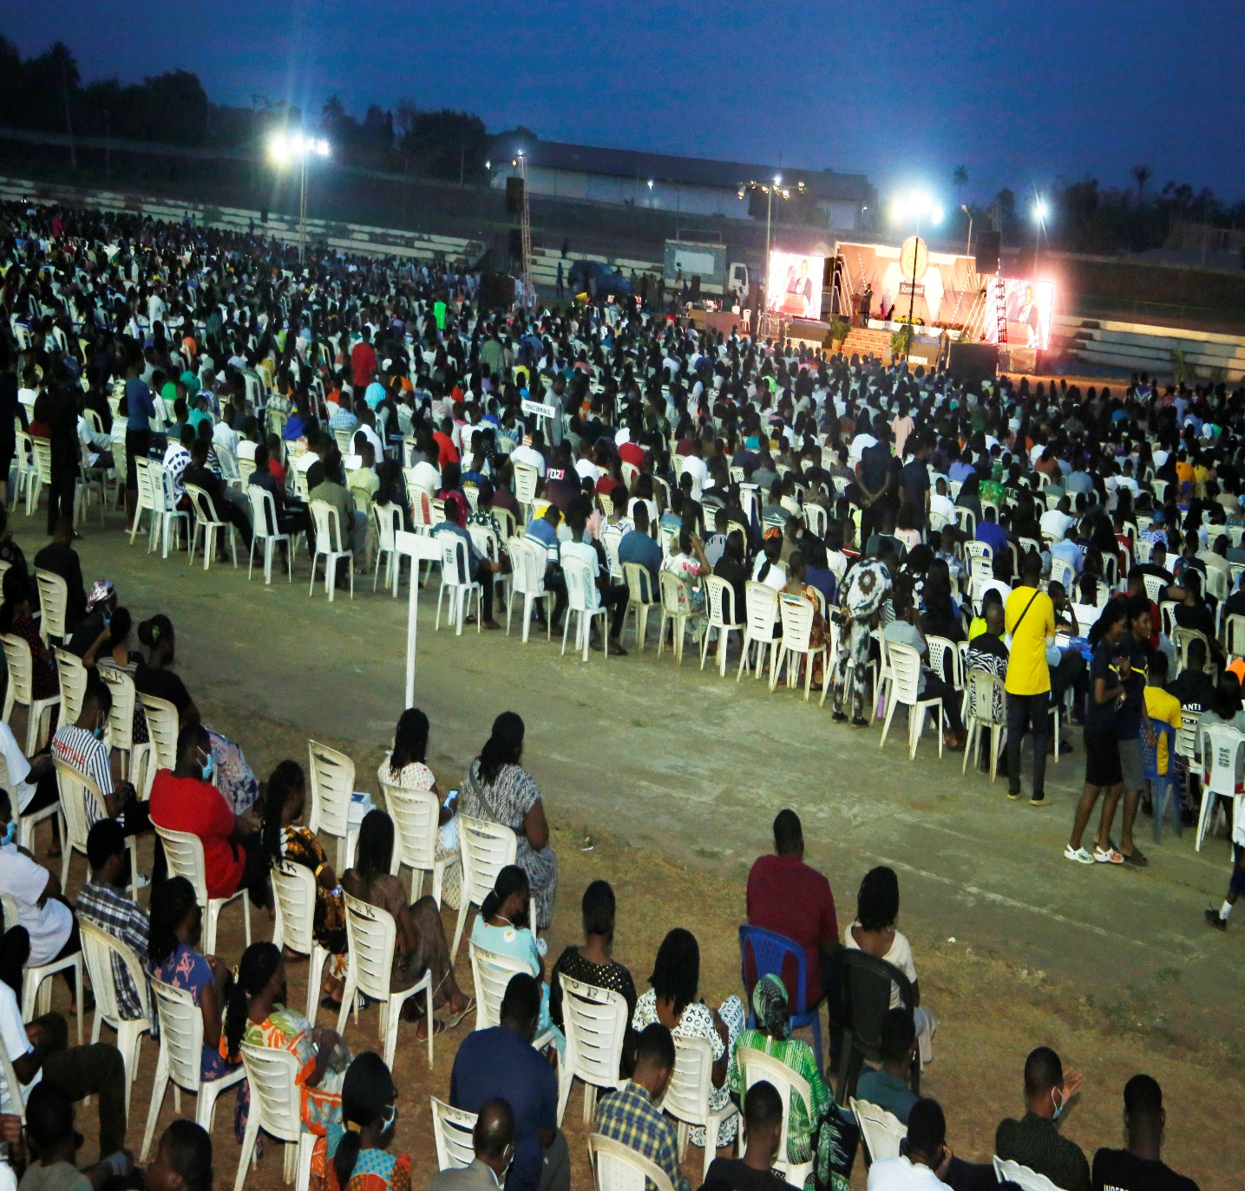

Slide 6
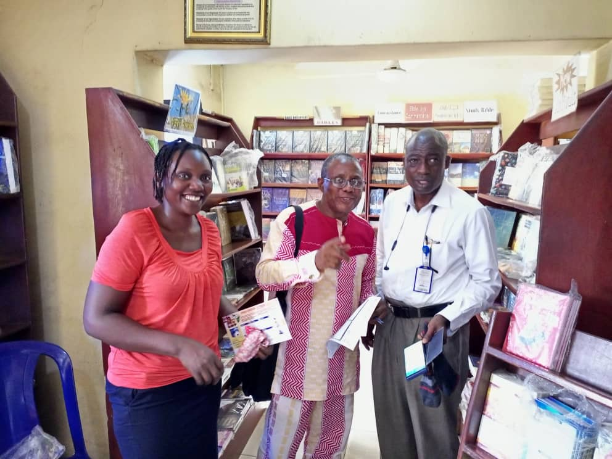

Slide 8
Hospital Ministry

Slide 9
KPI 4.2: Adventist tertiary institutions increase the proportion of missiologists teaching mission, all of whom are faithful to biblical missional principles, Adventist educated, and endorsed by IMTE | ACTIVITIES OF BU IN ITS IMPLEMENTATION Intentional Recruitment of Theology Faculty in the area of Mission and doctoral training of a staff at Adventist University of Africa Pastor Muyi Oyinloye-Doctoral Candidate in Mission at Andrews University Mrs Harriet Osaretin Ikhane-Doctoral Student in Improved Mission at AUA IBMTE Credential of Theology faculty

Slide 10
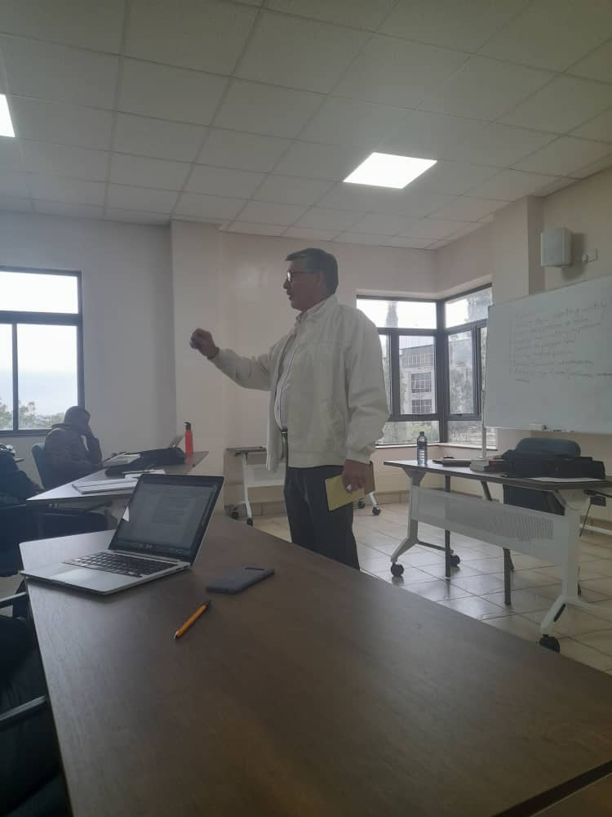
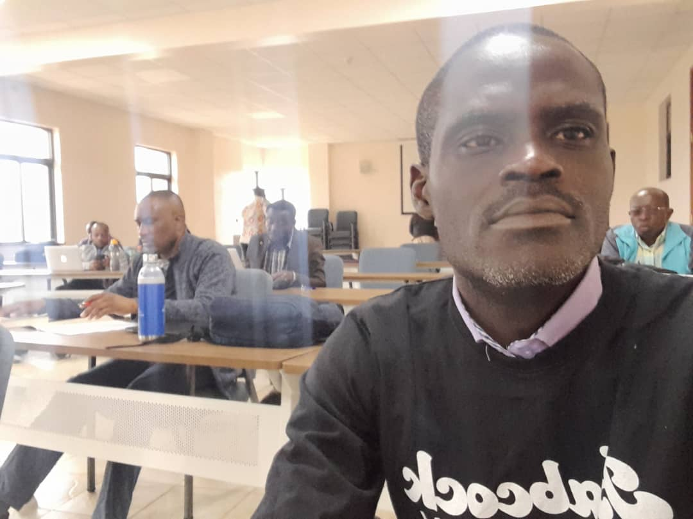
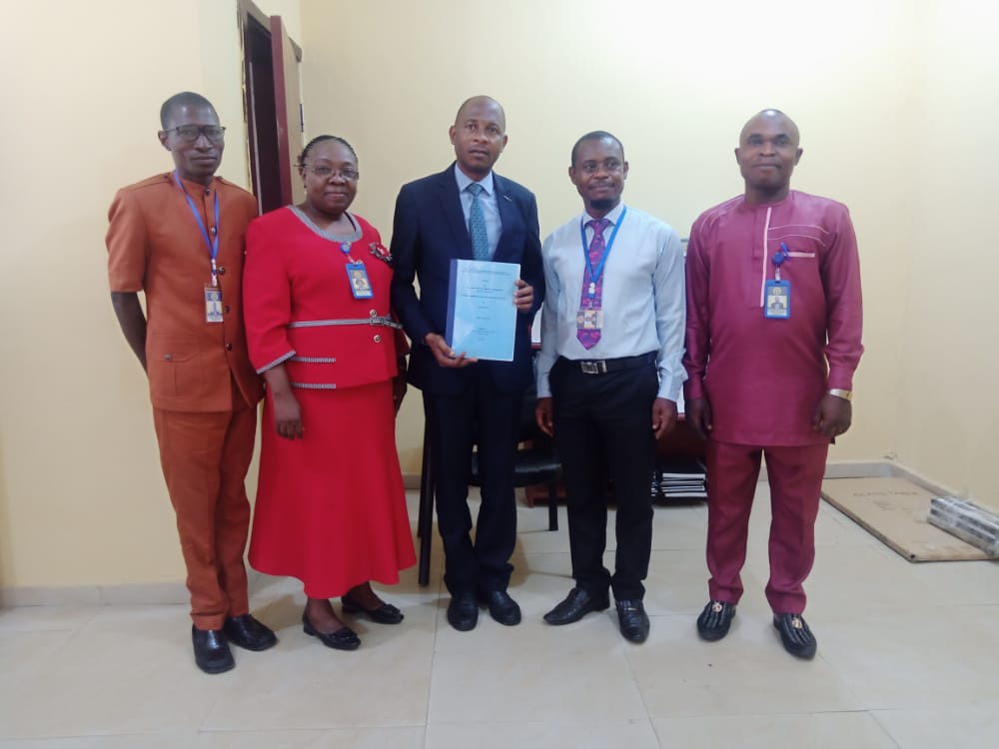
Pastor Daniel Gambo, one of our Adjunct Staff completed his Doctoral Degree in New Testament Studies, September 27, 2022
Faculty Development: Pastor Oluseun Akinpelu resumes Doctoral Studies at AUA

Slide 11
KPI 5.2: Significant increase in numbers of church members and unbaptized children and youth regularly attending divine service and Sabbath School | ACTIVITIES OF BU IN ITS IMPLEMENTATION Vacation Bible School with varieties of interesting programmes like Kids on Balloon Evangelism in order to increase children and youth attendance in Sabbath School and Divine Service

Slide 12
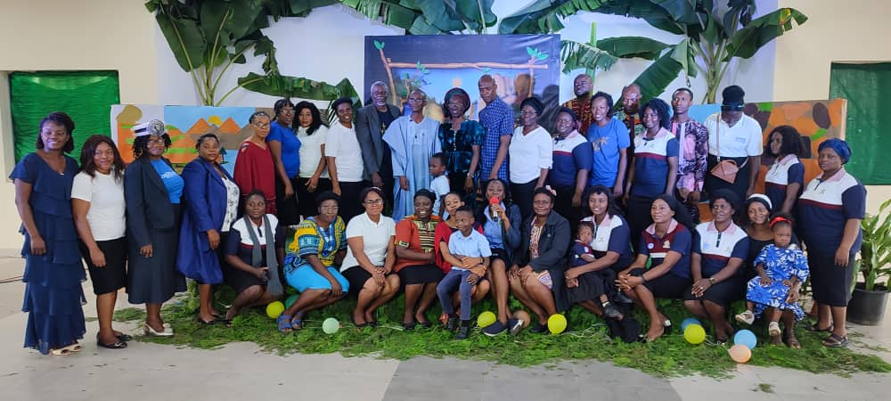
Vacation Bible School

Slide 13
Vacation Bible School

Slide 14
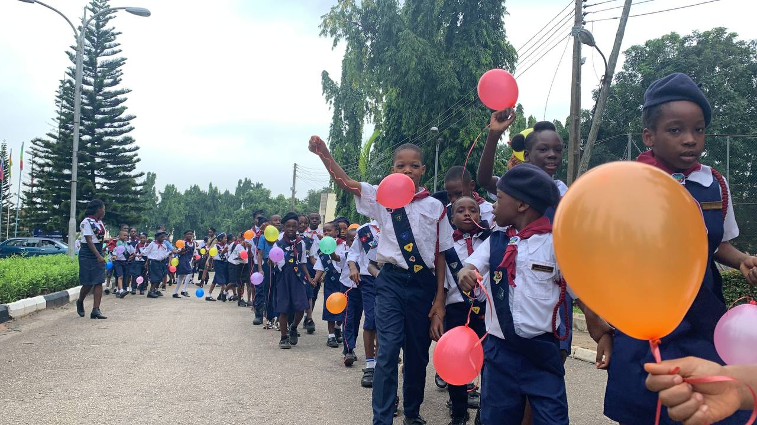
Vacation Bible School

Slide 15
KPI 5.3: Significant increase in acceptance and practice of the church’s distinctive beliefs, especially: Creation (FB 6); Salvation by faith (FB 10); State of the dead and power of prayer over witchcraft and spiritualism (FB 26, FB 11); Remnant Church (FB 12, FB 14); Principles of healthful living (FB 22); The Sanctuary/Investigative Judgment (FB 24); Second Coming (FB 25); and the nature of the Fundamental Beliefs as a whole as Bible-centered doctrines that reflect a loving, gracious God | ACTIVITIES OF BU IN ITS IMPLEMENTATION Increased number of morning Devotional Centres on Campus manned by trained Chaplains Variety of Programmes introduced in the 30 Halls of Residence on Campus Bible study centres increased on Campus

Slide 16
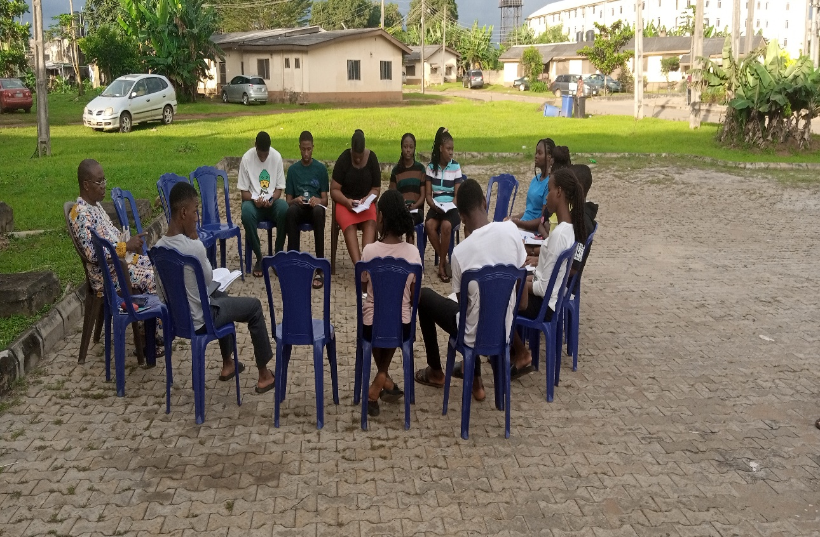
Mission to Inisa District, Osun State: August 14-27, 2022
Pastor Tanko Jonathan Dauda, 400 level students conducting Bible Study at Bethel Chapel

Slide 17
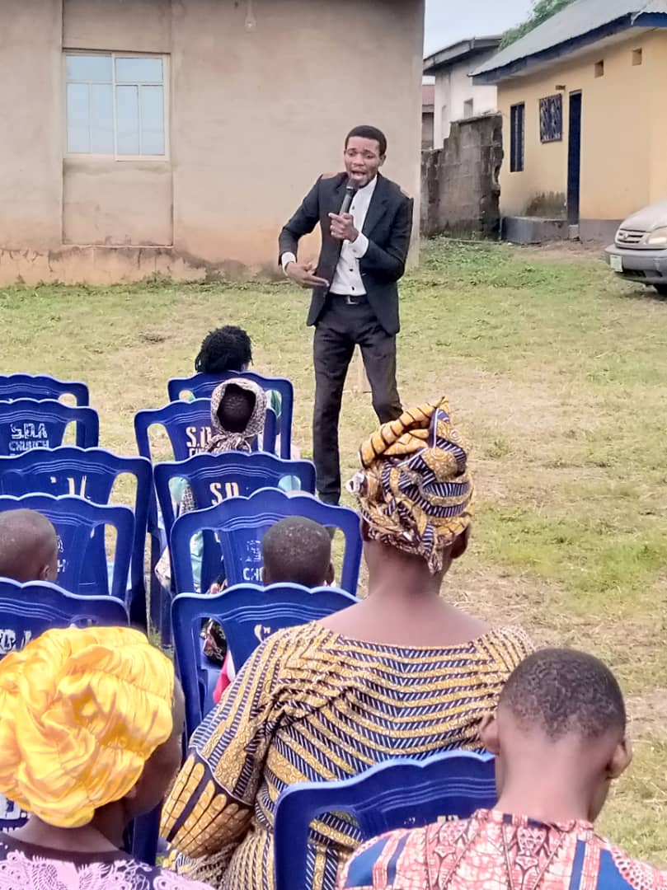
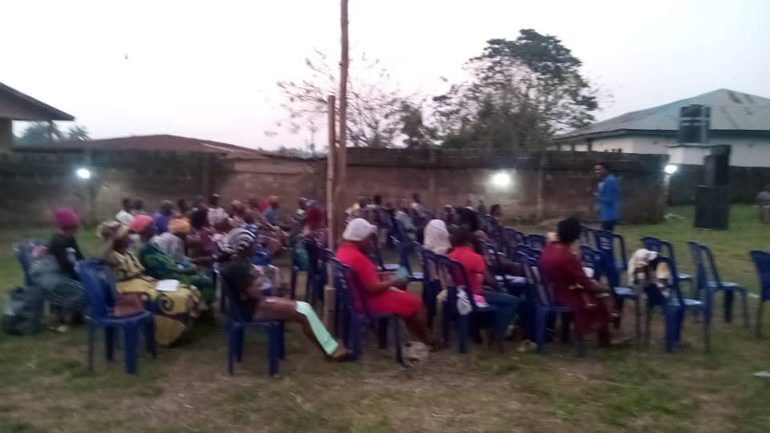
MINISTRY TO NEIGHBORING CHURCHES Mission to Inisa District, Osun State: August 14-27, 2022 Daniel Babatunde, a 400 level indigent student and his Mission of Hope Evangelistic Network in a 2-Week Bible and Medical Outreach.

Slide 18
KPI 6.2: Evidence of greater unity and community among church members, of reduced conflict in local churches, and of an active commitment to zero tolerance of physical, emotional, and sexual abuse | ACTIVITIES OF BU IN ITS IMPLEMENTATION Inculcation of Cultural Sabbath in the 30 Worship Centres on Campus Inclusiveness and Participation of the specially challenged and outreach to the people of other beliefs. Inauguration of Adventist African-traditionalist Relation Centre at Babcock University

Slide 19
Church Unity and Community

Slide 20
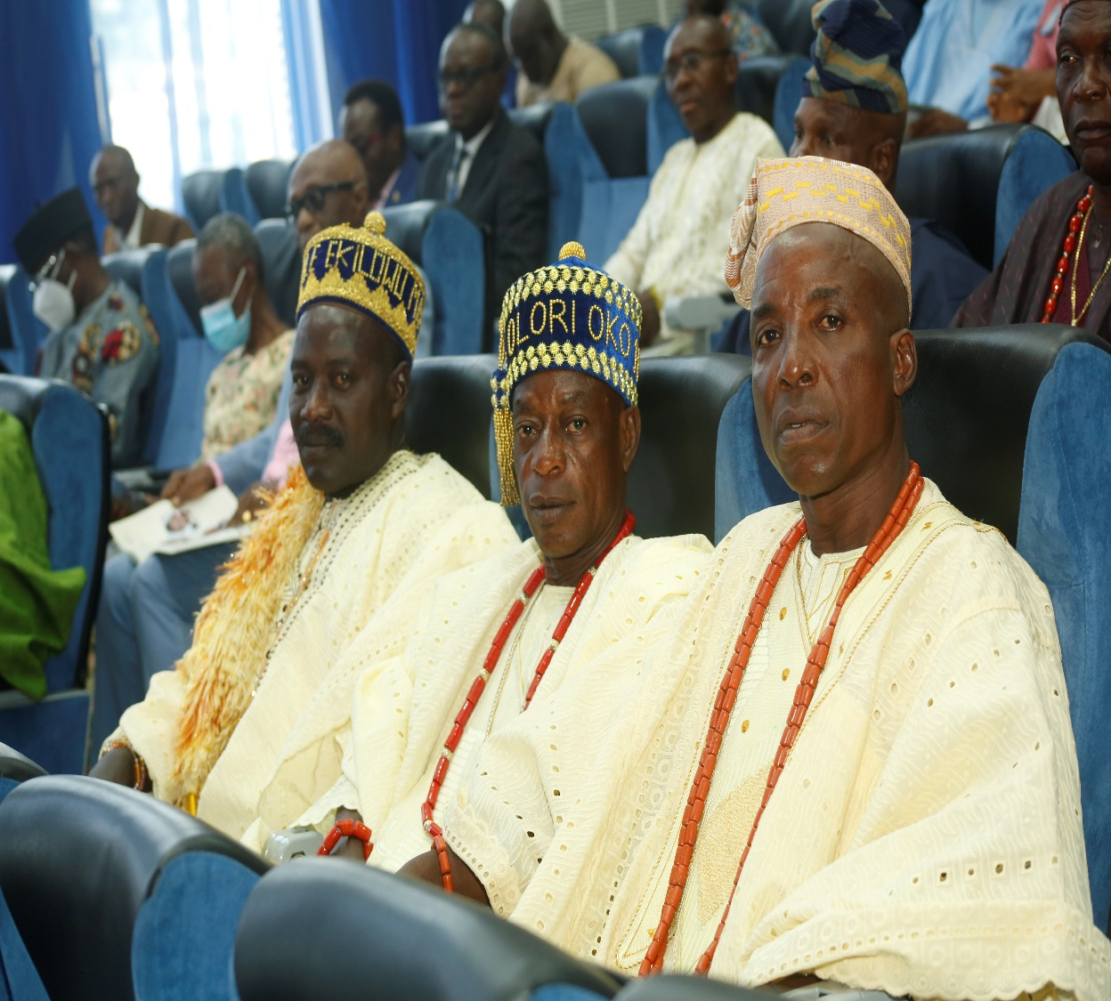
Celebration of Diversity

Slide 21
Inauguration of Adventist African-traditionalist Relation Centre

Slide 22
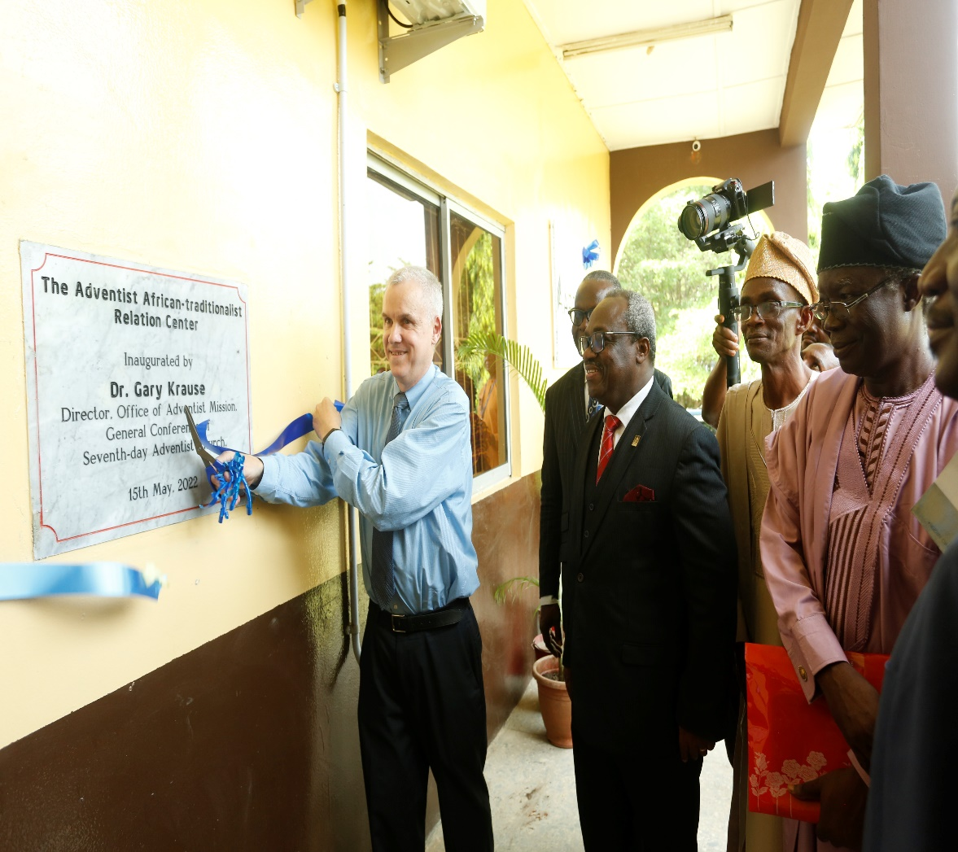
Inauguration of Adventist African-traditionalist Relation Centre

Slide 23
Inauguration of Adventist African-traditionalist Relation Centre

Slide 24
KPI 8.1:Evidence that most pastors and teachers feel supported by church members and by conference administrators, continue to feel called to ministry, and are engaging in continuing education and development | ACTIVITIES OF BU IN ITS IMPLEMENTATION Babcock University granted 75 percent tuition rebate to Theology students in order to encourage more in the Ministry (Beginning 2022/2023 session) Pastoral Family Retreat parading tailor made topics and training e.g Pastoral Burn out, Pastoral Family and Ministry Subscription in Pastoral Journals in order to keep Pastors updated.

Slide 25
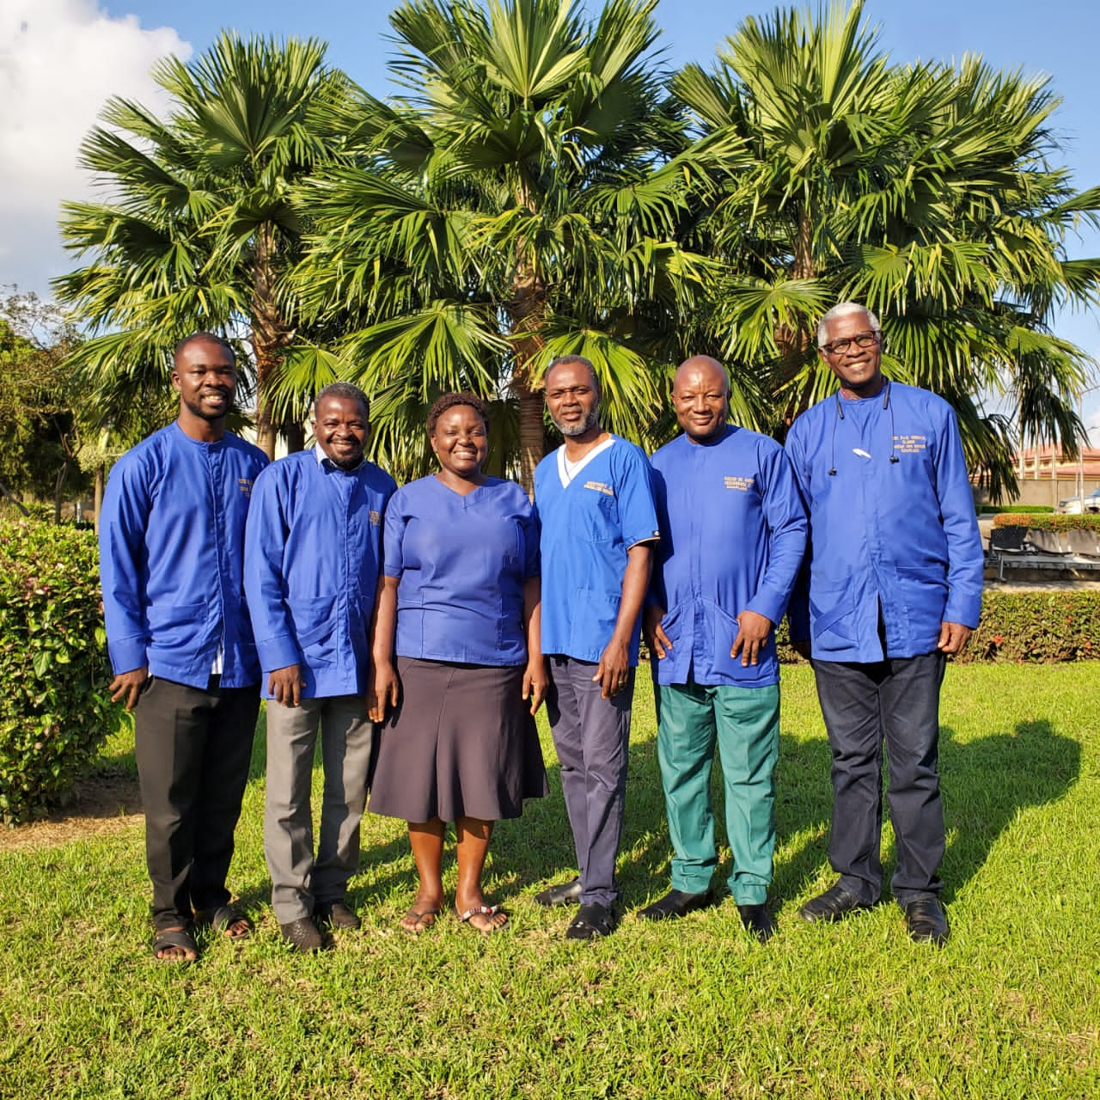
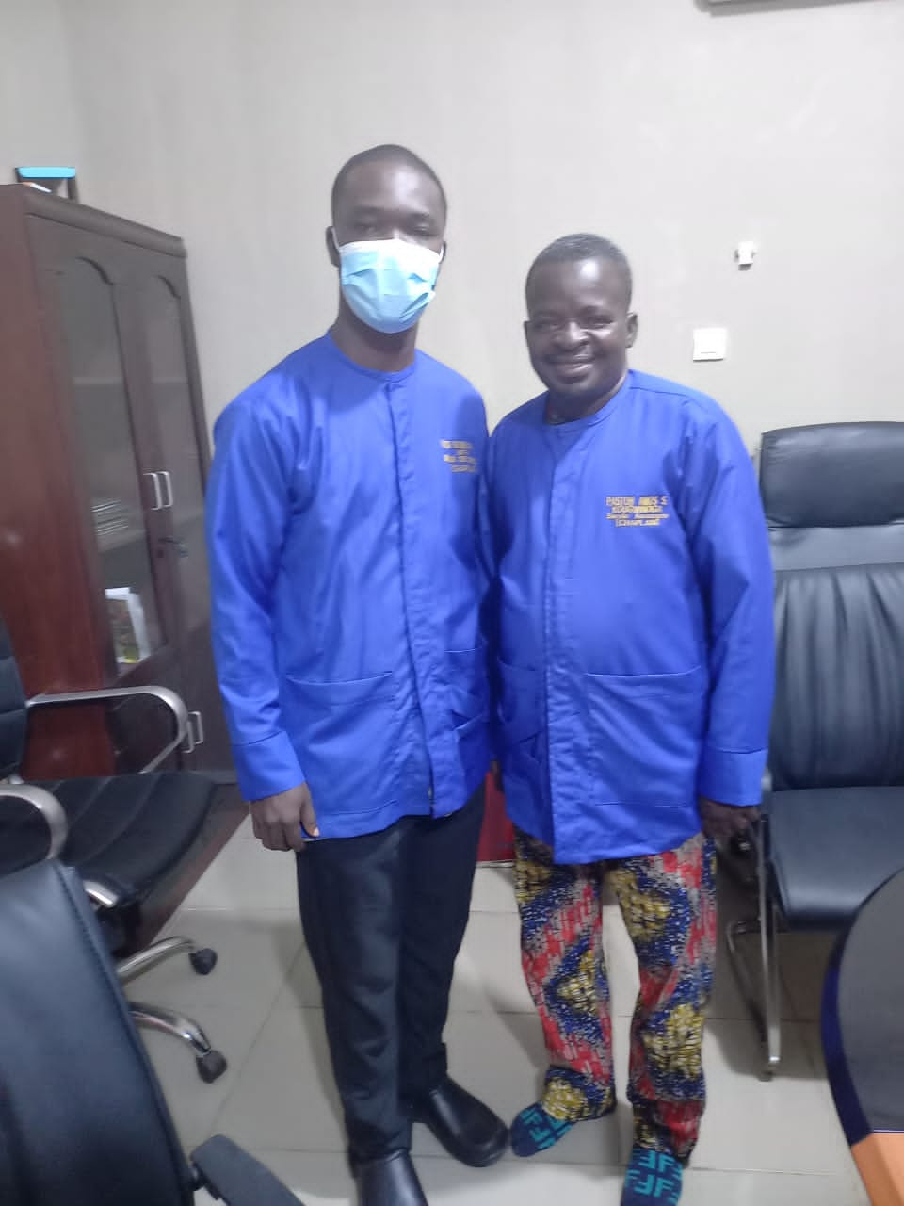
Pastoral engagement in continuing education and development

Slide 26
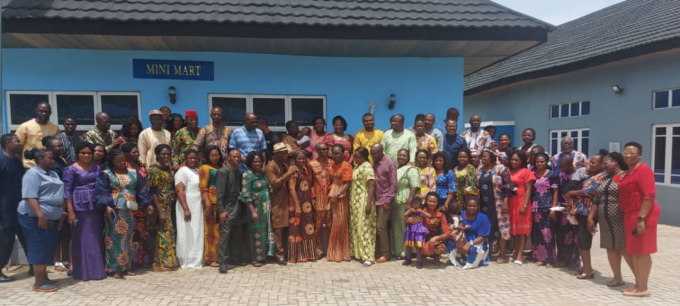
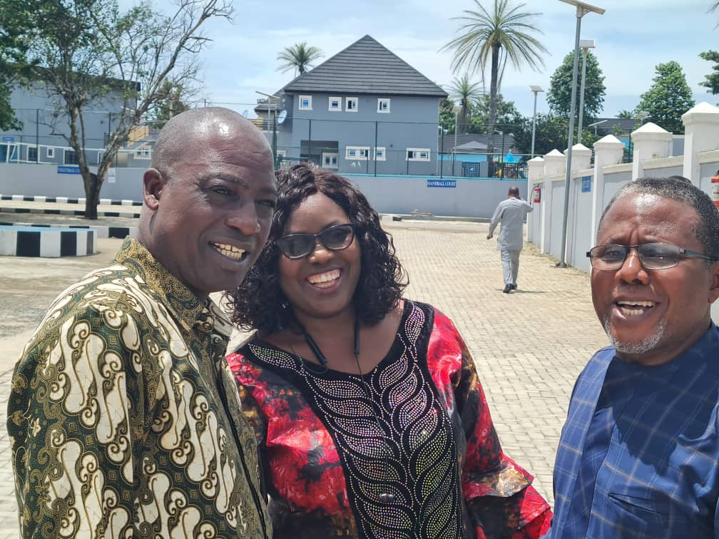
Pastoral Retreat

