Slide 2
Worship
Issue – Matt 4:8-10
Basis – Exodus 20
Exodus 31
Neh. 9: 5,6
Psalm 33:6-9
Psalm 95, 100
Acts 4:23,24
Acts 14:11-15
Acts 17: 24-27
Rev 4:10-11

Slide 3
Salvation and Redemption
Issue: Romans 5:18, 19
Redemption: To recover ownership of by paying a specified sum. (Isa. 52:3)
Isaiah 43:1, 44:22-24, 54:5
Isa 43:11-14,
John 1:1-12
Col. 1: 13-16
Salvation: Ps 95: 1-7, 96:2-6 Isa 43:1-3
ISA 45:8-12, 17-19;
Sanctification: Exodus 31:12,13

Slide 4
Integrity and Authority
Exodus 31:12-18
God’s integrity
Moses’ integrity
Integrity of Revelation
Isaiah 29:15,16, 45:9-19,
Romans 9: 20,21
Jeremiah 27: 4-6
Col 1:15-18

Slide 5
Three Key Questions
Why is the doctrine of Creation foundational to the Adventist Church?
Why does my belief about Creation matter to my faith?
How can we respond to the hard issues of origins?

Slide 6
Revelation 10

Slide 7
The Mandate of Revelation
The Story of Revelation 10:
Rev. 10:2
And he had in his hand a little book open…

Slide 8
Revelation 10
Is the “Little Book” of Revelation 10 the book of Daniel?

Slide 9
The Mandate of Revelation
The Story of Revelation 10:
Daniel 12:4
But thou, O Daniel, shut up the words, and seal the book, even to the time of the end: many shall run to and fro, and knowledge shall be increased.
Rev. 10:2
And he had in his hand a little book open…

Slide 10
The Mandate of Revelation
The Story of Revelation 10:
Daniel 12:4
But thou, O Daniel, shut up the words, and seal the book, even to the time of the end: many shall run to and fro, and knowledge shall be increased.
Rev. 10:2
And he had in his hand a little book open…
Setting is the last days

Slide 11
Rev. 10:5, 6:
And the angel which I saw stand upon the sea and upon the earth
lifted up his hand to heaven,
And sware by him that liveth for ever and ever, …
…that there should be time no longer:
Daniel 12:7:
And I heard the man clothed in linen, which was upon the waters of the river,
when he held up his right hand and his left hand unto heaven,
and sware by him that liveth for ever
that it shall be for a time, times, and an half;

Slide 12
…Time no longer
The longest bible prophecy is the 2300 day
(= year) prophecy of Daniel 8:13,14.
This prophecy was seen to end in October of 1844 by William Miller and was the basis for the Great Advent Movement that opened up the Book of Daniel and ultimately gave rise to the Seventh-day Adventist Church
When no events were apparent on earth on October 22, 1844, believers were greatly discouraged.

Slide 13
Great Disappointment Rev 10:8-10
Then the voice which I heard from heaven spoke to me again and said, “Go, take the little book which is open in the hand of the angel who stands on the sea and on the earth.” ⁹ So I went to the angel and said to him, “Give me the little book.” And he said to me, “Take and eat it; and it will make your stomach bitter, but it will be as sweet as honey in your mouth.” ¹⁰ Then I took the little book out of the angel’s hand and ate it, and it was as sweet as honey in my mouth. But when I had eaten it, my stomach became bitter.
God knew what would happen in 1844 and planned for it. The Angel responded to John’s puzzlement:

Slide 14
Great Disappointment Rev 10:8-10
Rev. 10:11
And he said unto me, You must prophesy again before many peoples, and nations, and tongues, and kings.
Evidently God was not yet finished with His work on the earth. But what was the message remaining to be preached?

Slide 15
Great Disappointment Rev 10:8-10
Rev. 10:11
And he said unto me, You must prophesy again before many peoples, and nations, and tongues, and kings.
Rev. 14:1
And I saw another angel fly in the midst of heaven, having the everlasting gospel to preach unto them that dwell on the earth, and to every nation, and kindred, and tongue, and people,

Slide 16
Great Disappointment Rev 10:8-10
Rev. 14:6
And I saw another angel fly in the midst of heaven, having the everlasting gospel to preach unto them that dwell on the earth, and to every nation, and kindred, and tongue, and people,
So here we find the message yet to be preached, the message that occasioned the Great Disappointment and that had to be preached before Jesus could return.

Slide 17
So What is the Message?
Rev. 14:7
saying with a loud voice, “Fear God and give glory to Him, for the hour of His judgment has come;
The first part is focused on something that happened in Heaven – the beginning of the Investigative Judgment in 1844 that would lead to Christ’s return. The Adventist part of our name come from this.

Slide 18
Revelation 10

Slide 19
The Story of Revelation 10:
Setting is the last days
Daniel 12:4
But thou, O Daniel, shut up the words, and seal the book, even to the time of the end: many shall run to and fro, and knowledge shall be increased.
Rev. 10:2
And he had in his hand a little book open

Slide 20
Daniel 12:7:
And I heard the man clothed in linen, which was upon the waters of the river,
when he held up his right hand and his left hand unto heaven,
and sware by him that liveth for ever
that it shall be for a time, times, and an half;
Rev. 10:5, 6
And the angel which I saw stand upon the sea and upon the earth
lifted up his hand to heaven,
And sware by him that liveth for ever and ever, who created heaven, and the things that are in it, and the earth, and the things that are in it, and the sea, and the things which are in it,
that there should be time no longer:

Slide 21
But was there some significant event that took place on earth in 1844, in mid October 1844, that would justify including this most significant reference to God’s Creatorship in the same verse?
Yes!
But first let’s look at another prophecy covering the same time period.

Slide 22
2 Peter 3:3-6
Knowing this first, that there shall come in the last days scoffers, walking after their own lusts,
And saying, Where is the promise of his coming? for since the fathers fell asleep, all things continue as they were from the beginning of the creation.
For this they willingly are ignorant of,
that by the word of God the heavens were of old, and the earth standing out of the water and in the water: (Creation)
Whereby the world that then was, being overflowed with water, perished: (Catastrophism)

Slide 23
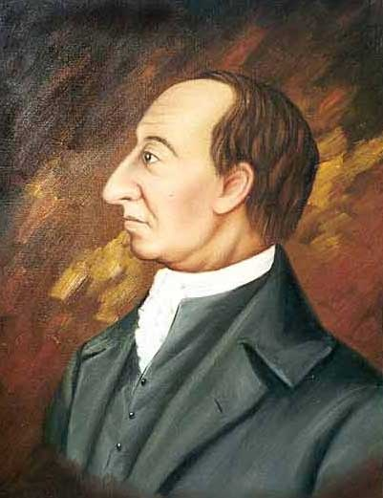
History of the Rise of Evolutionary Thought: Development of the Apostasy
James Hutton 1795 and onward –”Theory of the Earth”:
” But if the succession of worlds is established in the system of nature, it is in vain to look for anything higher in the origin of the earth. The result, therefore, of our present enquiry is, that we find no vestige of a beginning,—no prospect of an end.
Quote used extensively to establish authority of Standard Model (16,000 Google hits)

Slide 24
2Pet. 3:4 says:
Where is the promise of his coming? (the end of the world)
for since the fathers fell asleep, all things continue as they were from the beginning of the creation. (no evidence of a fiat creation)
Hutton says:
no prospect of an end.
no vestige of a beginning,

Slide 25
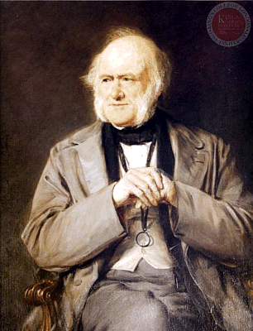
The Stage is Set for Development of the Apostasy
Charles Lyell – Followed Hutton’s ideas in his Principles of Geology 1830-33 three volumes. First volume published 1830.
Darwin carried that volume with him when he left for South America on the HMS Beagle.
Other two volumes reached him while he was on his journey.
Lyell greatly influenced Darwin.

Slide 26
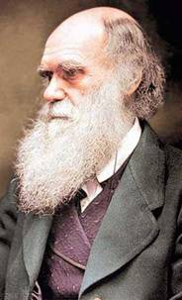
History of the Rise of Evolutionary Thought: Development of the Apostasy
Darwin and 1844 - July
"I have just finished my sketch of my species theory," he wrote in July 1844 (this sketch runs to 230 pages and 50,000 words!). "... in case of my sudden death ... I wish that my sketch be given to some competent person [suggested Lyell], with [£400] to induce him to take trouble in its improvement and enlargement.”
Finally published in 1859

Slide 27
But, What on Earth Happened in Mid - October, 1844?

Slide 28
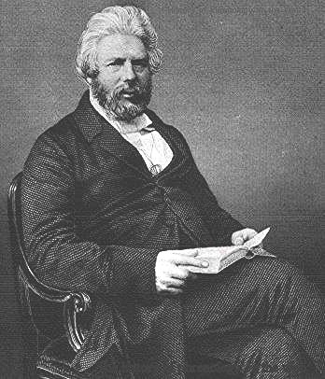
History of the Rise of Evolutionary Thought: Development of the Apostasy
Robert Chambers mid October, 1844 published anonymously Vestiges of the Natural History of Creation. First deliberate promotion of evolution. Paved the way for acceptance.
In this 400 page work he gives a comprehensive account of the origin of the universe, life and even the origin of humans with a completely naturalistic framework (i.e. without God’s involvement).

Slide 29
The Impact and Consequences
The book was an instant success, selling over 20,000 copies in seven editions during its first ten years, making it perhaps the best-selling book of the 19th century. It was widely distributed on the continent as well as abroad and was read by major poets, statesmen, scientists and philosophers on both sides of the Atlantic. Lincoln and Queen Victoria both had read the book.

Slide 30
The Impact and Consequences
Physicist Sir David Brewster warned that Vestiges stood a "fair chance of poisoning the fountains of science, and sapping the foundations of religion."
Darwin, who himself in July of 1844 had included provisions in his will to have his then 250 page manuscript on origins published, was devastated by Vestiges, thinking he had lost his chance to get the credit he thought he deserved for ideas he presumed to be his own.

Slide 31
The Impact and Consequences
A modern historian, James Secord has recently written a treatise on Chambers’ book. In the following passage, he spells out his sense of the importance of this work in changing men’s minds about evolution:
“How did evolution gain this pivotal role in the public arena? The answer turns out to have little to do with Darwinian biology or Big Bang astronomy. Instead, the critical period is the first half of the nineteenth century, and the turning point is the response of readers to Vestiges.” Victorian Sensation. James A. Secord. 624 pp. Chicago 2000.

Slide 32
The Message of Rev 14:7
Saying with a loud voice,
Fear God, and give glory to him; for the hour of his judgment is come: (Focus on something that happened in Heaven - Adventist )
and
worship him that made heaven, and earth, and the sea, and the fountains of waters. (Focus on something that happened on earth – Seventh day)

Slide 33
So, Why is there a Seventh-day Adventist Church today?
Two vital messages God wanted the world to hear before He could return:
1. The Hour of Judgment is come
2. Worship Him who made the heaven and earth , the seas and fountains of waters.
Are we doing our job?

Slide 34
Creation in the Twentieth Century
Special seminar on creationism at annual meeting of the Geological Society of America in 2004 named and figured this person as individual responsible more than any other for the modern creationist movement

Slide 35
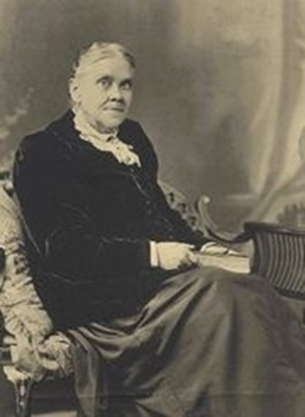
Creation in the Twentieth Century
Special seminar on creationism at annual meeting of the Geological Society of America in 2004 named and figured this person as individual responsible more than any other for the modern creationist movement

Slide 36
Three Key Questions
Why is the doctrine of Creation foundational to the Adventist Church?
Why does my belief about Creation matter to my faith?
How can we respond to the hard issues of origins?

Slide 37
The Present Conflict
Creation is not just another doctrine
Worship Rev 4:11, Acts 4:24, Acts 14:15
Salvation and Redemption Romans 5:12
Integrity of God Ex 31:12-18
Faith Heb 11:1-3
Attempts to understand Genesis as other than literal are doomed to failure
Sin problem still exists
Integrity problem still exists

Slide 38
Three Key Questions
Why does my belief about Creation matter to my faith?
Why is the doctrine of Creation foundational to the Adventist Church?
How can we respond to the hard issues of origins?

Slide 39
We Must Understand There Are Issues That Challenge Us
Radiometric dating
Other dating methods
Fossil record
Orderly fossil record
Hominid record

Slide 40
We Must Know There Are Issues That Encourage Us
Origin of life
Fossil record
Sudden appearances
General absence of intermediate forms
Sedimentology and Catastrophism
Molecular biology

Slide 41
We Must Exhibit Confidence While Living Without All of the Answers
Can never expect even in eternity to have all of the answers to all of the questions. Tell people.
For scientists having all of the answers is not even desirable; it is questions that are interesting to the scientist. Teach students this.
As a layperson or a scientist, learn to appreciate the importance of faith for the Christian. Practice faith.
Secular or spiritual, all must exercise faith. But increasingly it will be a rare commodity:
Luke 18:8 Nevertheless when the Son of man cometh, shall he find faith on the earth?

Slide 42
The Future of Creation
Heb. 11: 3,6 - By faith we understand that the worlds were framed by the word of God, so that the things which are seen were not made of things which are visible…. 6 But without faith it is impossible to please Him, for he who comes to God must believe that He is, and that He is a rewarder of those who diligently seek Him.

Slide 44
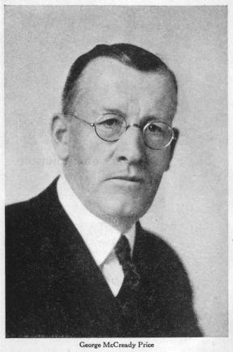
Creation in the Twentieth Century
Voice in the wilderness G.M. Price
Adventist pastor who was challenged by pamphlets supporting evolution supplied by an acquaintance
Began to study the subject in detail. His work featured prominently in Scopes Trial

Slide 45
History of the Rise of Evolutionary Thought: Development of the Apostasy
Ready acceptance by those preconditioned to be looking for an escape from the authority of God
Gradual acceptance by the scientific community at large
Some opponents just had to die off
Winning of the young minds to new ideas
Becomes normative in science by 1900

Slide 46
The Biblical Account of Origins
The Bible presents the prehistory of the world from Creation to Abraham in the first 11 chapters of Genesis.
None can doubt that the Genesis 1-11 account is being assaulted from every quarter today.
Yet all significant authorities, including those who deny its message, admit that the author of Genesis intended the account of creation and a worldwide flood in Chapter 1-11 to be taken literally.

Slide 47
Professor James Barr, Regius Professor of Hebrew at the University of Oxford, has written:
“Probably, so far as I know, there is no professor of Hebrew or Old Testament at any world-class university who does not believe that the writer(s) of Genesis 1–11 intended to convey to their readers the ideas that:
(a) creation took place in a series of six days which were the same as the days of 24 hours we now experience
(b) the figures contained in the Genesis genealogies provided by simple addition a chronology from the beginning of the world up to later stages in the biblical story
(c) Noah’s flood was understood to be world-wide and extinguish all human and animal life except for those in the ark.”

Slide 48
He continues: “Or, to put it negatively, the apologetic arguments which suppose the “days” of creation to be long eras of time, the figures of years not to be chronological, and the flood to be a merely local Mesopotamian flood, are not taken seriously by any such professors, as far as I know.”
[He is not saying they believe the account is historical, just that to argue for a nonliteral interpretation is contratextual.]
Conclusion: the best scholarship supports a literal reading of the first 11 chapters of Genesis.

Slide 49
Creation in the Twentieth Century
H.W. Clark - the addition of data
Morris and Whitcomb – The Genesis Flood inspired largely by Price’s work
Geoscience Research Institute
Loma Linda Biology department
Post Loma Linda days –
ID;
the right wing with the wrong message: Baugh, Hovind and others;
Ross and RTB, Ham and AIG and Morris and Gish and ICR

Slide 50
The Present Conflict
Growth of the scientific enterprise
False sense of personal freedom – Dawkins and the “intellectually-fulfilled atheist”
The tendency of the “soft sciences” to follow the “hard sciences”
Capitulation of theologians
Today – even among some SDAs, doubts about Biblical account.

Slide 51
The Present Conflict
Creation is not just another doctrine
Worship Rev 4:11, Acts 4:24, Acts 14:15
Salvation and Redemption Romans 5:12
Integrity of God Ex 31:12-18
Faith Heb 11:1-3
Attempts to understand Genesis as other than literal are doomed to failure
Sin problem still exists
Integrity problem still exists
Motivation is questionable

Slide 52
Three Key Questions
Why does my belief about Creation matter to my faith?
Why is the doctrine of Creation foundational to the Adventist Church?
How can we respond to the hard issues of origins?

Slide 53
We Must Understand There Are Issues That Challenge Us
Radiometric dating
Other dating methods
Fossil record
Orderly fossil record
Hominid record

Slide 54
We Must Know There Are Issues That Encourage Us
Origin of life
Fossil record
Sudden appearances
General absence of intermediate forms
Sedimentology and Catastrophism
Molecular biology

Slide 55
We Must Exhibit Confidence While Living Without All of the Answers
Can never expect even in eternity to have all of the answers to all of the questions. Tell students.
For scientists having all of the answers is not even desirable; it is questions that are interesting to the scientist. Teach students this.
As a layperson or a scientist, learn to appreciate the importance of faith for the Christian. Practice faith.
Secular or spiritual, all must exercise faith. But increasingly it will be a rare commodity:
Luke 18:8 Nevertheless when the Son of man cometh, shall he find faith on the earth?

Slide 56
The Future of Creation
Heb. 11: 3,6 - By faith we understand that the worlds were framed by the word of God, so that the things which are seen were not made of things which are visible…. 6 But without faith it is impossible to please Him, for he who comes to God must believe that He is, and that He is a rewarder of those who diligently seek Him.

