Slide 1
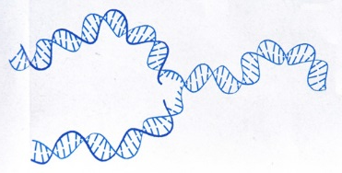
Can evolution survive the new biological insights?
Leonard Brand, PhD
Professor of Biology and Paleontology
Department of Earth and Biological Sciences
Loma Linda University

Slide 2
Goals of this talk:
Evaluate the current state of the evidence for the evolution of life forms by random mutation and natural selection
Understand why the newest evidence is causing big trouble for Darwin’s theory

Slide 3
History of scientific advance
Darwin (mid-1800’s)
Molecular biology unknown
Genetics still decades in the future
Neo-Darwinian Synthesis (the Modern Synthesis)
1930’s and 1940’s
Synthesis of current genetic ideas
Molecular biology still in the future
Molecular biology
Especially since the 1950’s, with rapid advance recently

Slide 4
What do we know now that we didn’t know a few decades ago?
Recent developments – last 5 to 10 years
Rapid and spectacular advance in genetics and molecular biology

Slide 5
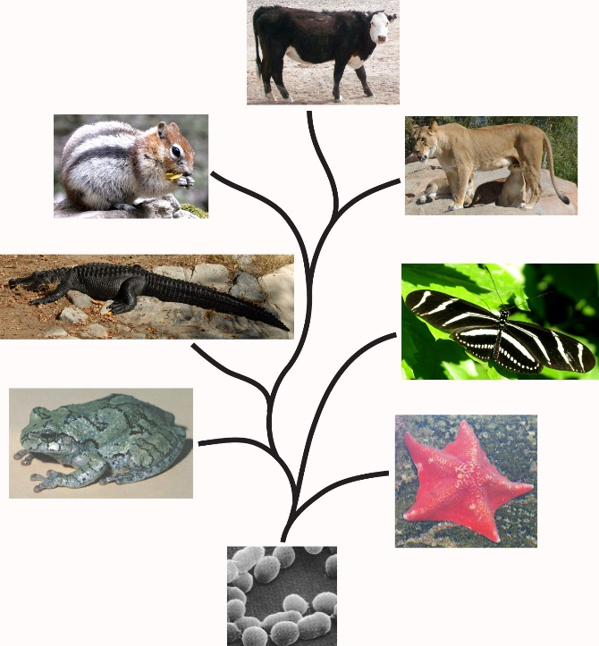
Macroevolution
Evolution of new major groups of organisms – Orders,
Classes, Phyla.
New organs and systems
Must invent:
Bones
Feathers
Hearts
Locomotion systems
Genes for all this
Macroevolution is contrary to biblical creation

Slide 6
How does macroevolution work? What is the process?
Accepted evolution theory:
1. Random mutations
2. Natural selection
These two concepts are the core of Neo-Darwinism

Slide 7
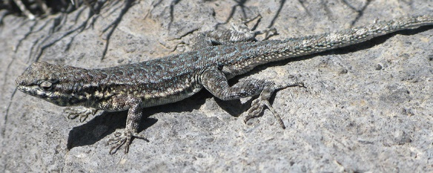
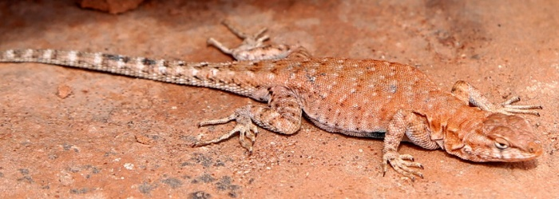
In Darwinian theory, the process must be random.
Nowhere in the process can there be foresight
of what would be beneficial to the organism
Only natural selection (a naturalistic process)
determines which random change will succeed

Slide 8
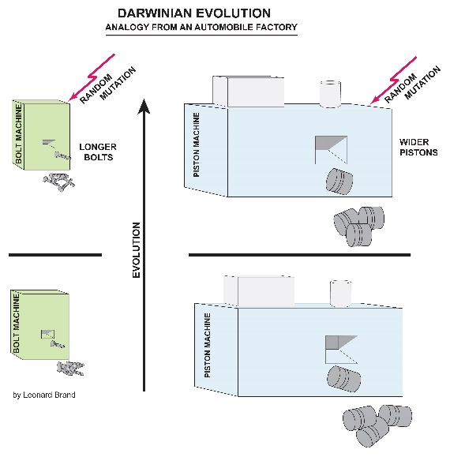
Foresight would imply creation or
intelligent design
An analogy of evolution
FEATHER

Slide 9
New evidence causing serious trouble for the Darwinian theory of random mutation and natural selection
Problems are rapidly increasing, especially from advances in molecular biology

Slide 10
Problem # 1 – what is junk DNA?
About 98% of human DNA is called “silent DNA” because it does not produce protein
This has been interpreted as junk DNA – functionless remnants of evolution
This DNA is needed by evolution as a resource for making new genes

Slide 11
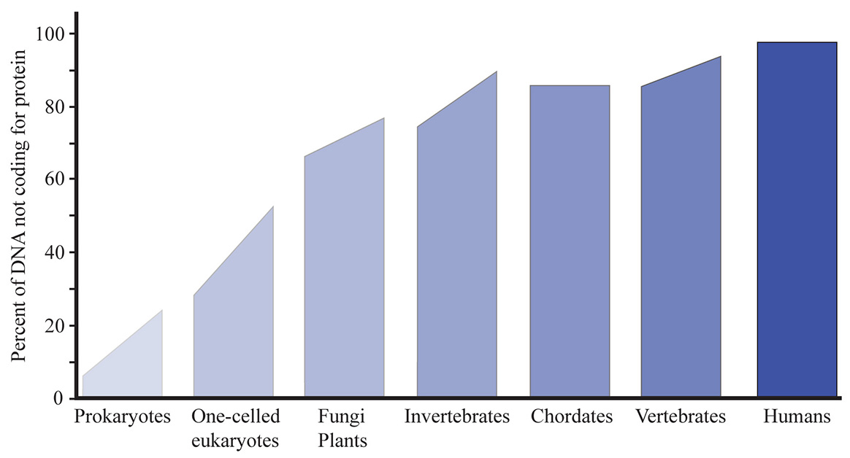
Evidence: the percent of “junk DNA” is proportional to organism complexity

Slide 12
The percent of “junk DNA” is proportional to organism complexity
Thus the “junk DNA” seems to be involved in producing that complexity

Slide 13
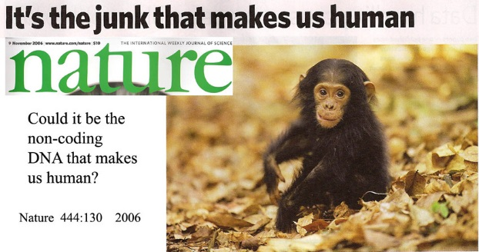
A serious challenge to junk DNA

Slide 14
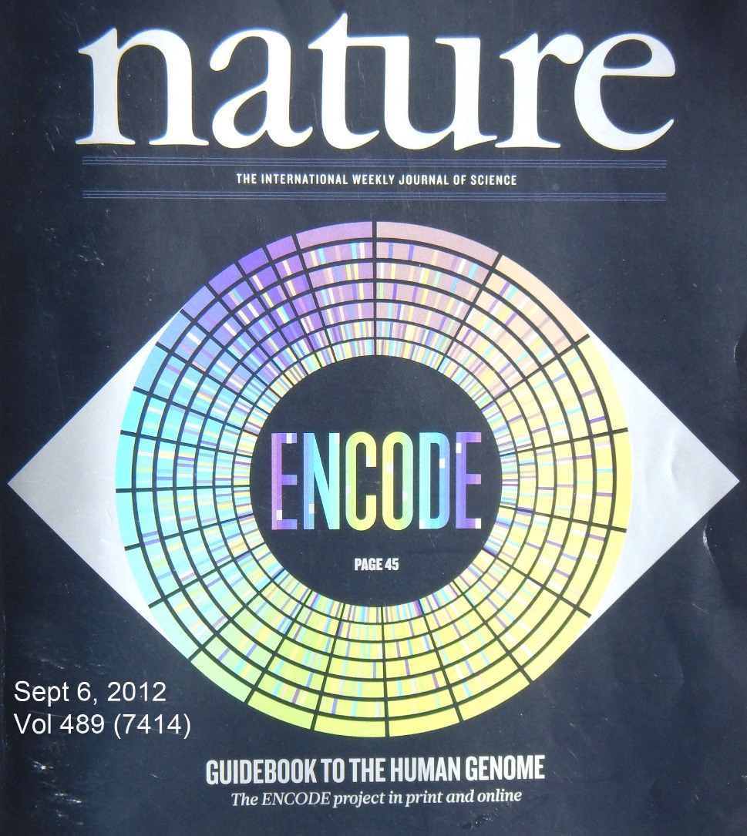
September, 2012
Results of the massive Encode Project published
All or most “junk DNA” is regulatory
DNA, controlling the protein-
coding DNA
Nature 489 (7414): 45-113, September 6, 2012.

Slide 15
“Junk DNA” is no longer even a useful concept
The supposed junk DNA controls whether our protein-coding DNA will make a human, a chimpanzee, or a mouse

Slide 16
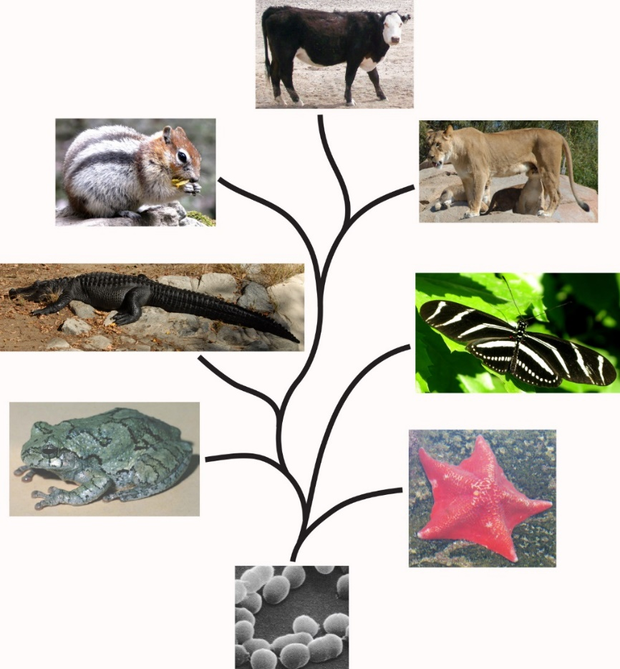
Problem # 2
Evidence for the tree of life (common ancestry of all genes and organisms) – is facing serious setbacks

Slide 17
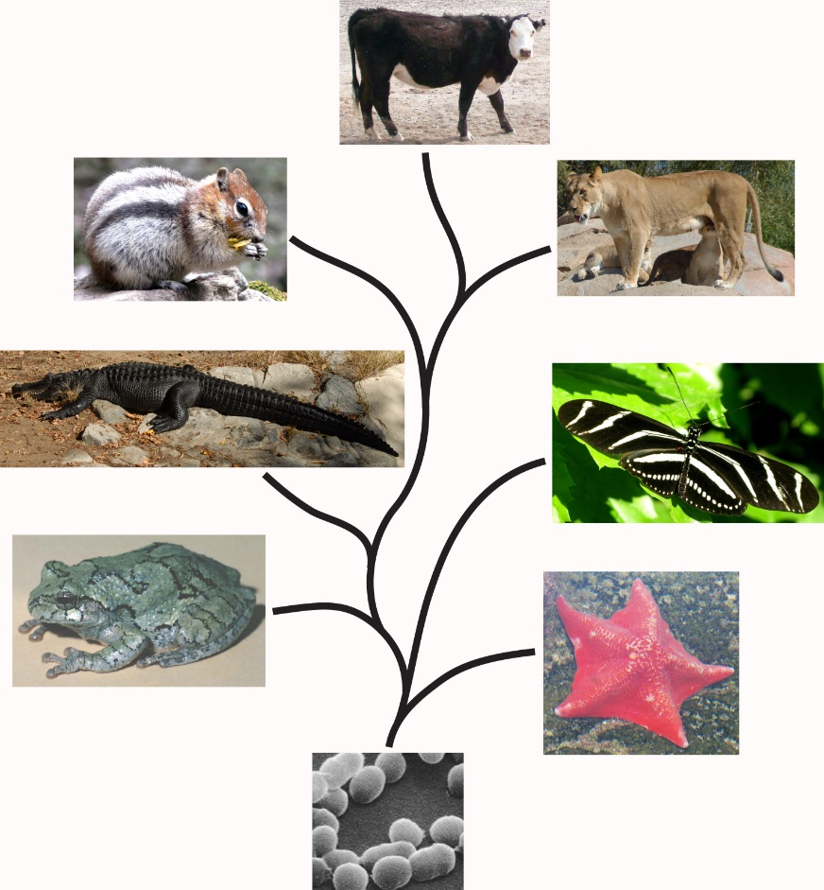
Darwinian understanding of macroevolution requires that all new features arise by a long, gradual series of small changes
The tree of life is claimed to be a record of this series of changes

Slide 18
Problem: ORFan genes (orphan genes) – genes that seem to just appear with no evolutionary ancestry
At least 10 – 20% of genes are orphan genes.
Hundreds of these in humans alone.
Some are very important; including
responsibility for the large human brain

Slide 19
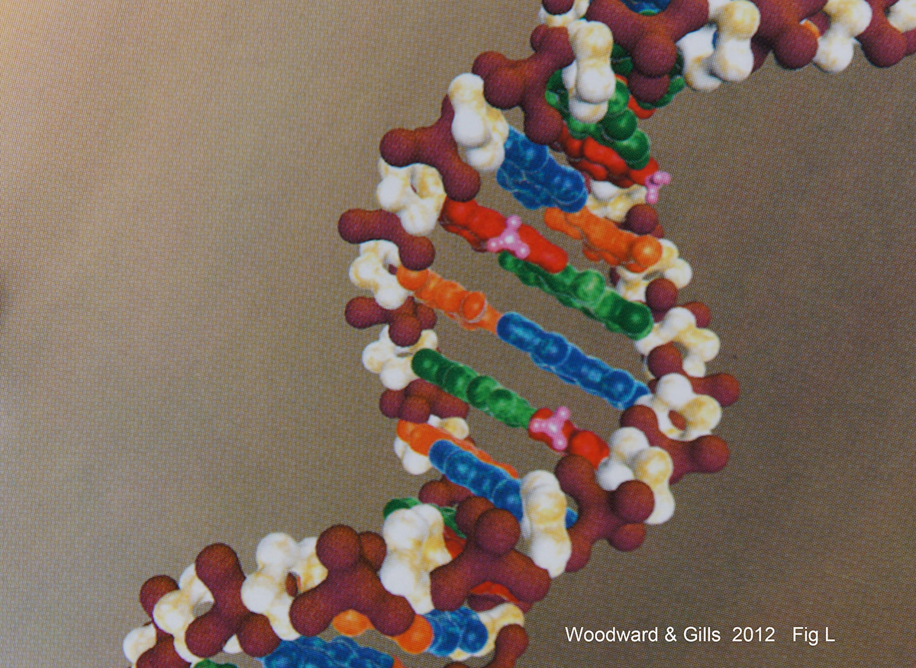
Problem # 3: Epigenetics
Epigenetics is a management system that determines how to use the DNA
Sensors in the cell detect environmental factors
Places chemical tags on the DNA
(the little pink tags)
They turn genes on and off, without
changing the information in DNA

Slide 20
Exodus 20:5
“Punishing the children for the sins of the fathers to the third and fourth generation”

Slide 21
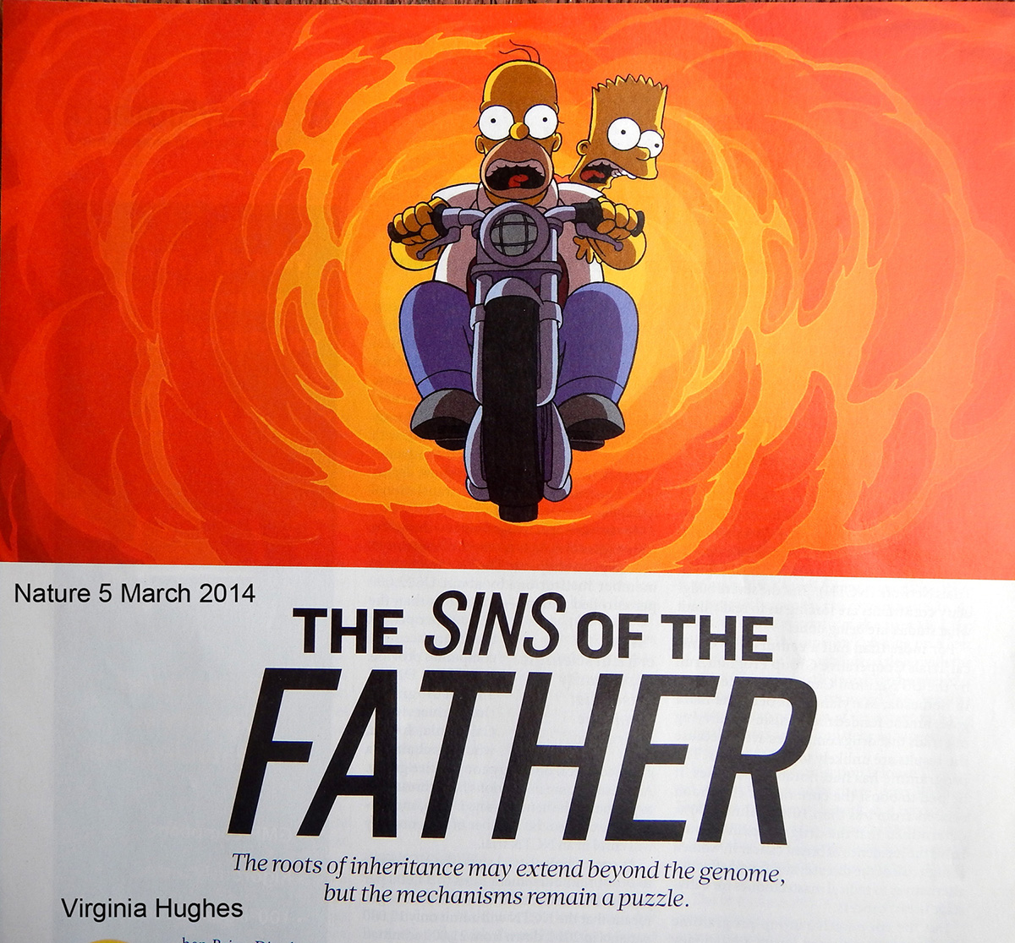
Epigenetics

Slide 22
Epigenetics
Epigenetic effects can last for several generations
Example 1:
Response of mice to the odor of peach blossoms

Slide 23
Example 2:
Blind cave fish – how did they become blind?
Old explanation – random mutations destroyed sight

Slide 24
Example:
Blind cave fish – how did they become blind?
Old explanation – random mutations destroyed sight
New explanation – epigenetics
Their eye genes are intact, but have been turned off.
No changes in the DNA

Slide 25
Epigenetics is a problem for Darwinism, because:
Epigenetics initiates changes that are:
A response to environmental influence
Beneficial
Inheritable
Non-random

Slide 26
Epigenetics is a problem for Darwinism, because:
Epigenetics initiates changes that are:
A response to environmental influence
Beneficial
Inheritable
Non-random
How can this happen unless there is, somehow, intelligent
awareness behind the design or operation of this system?

Slide 27
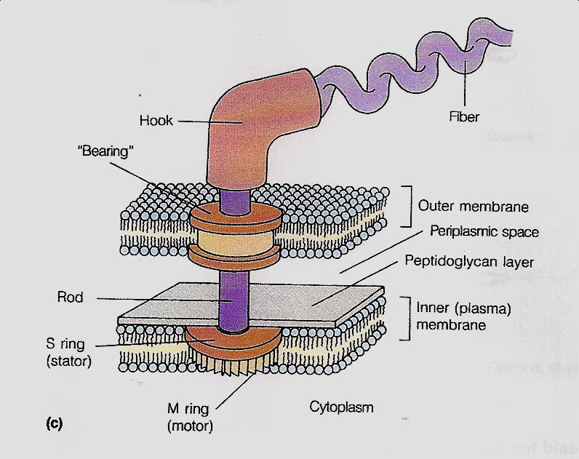
Problem # 4: Irreducible complexity

Slide 28
Problem # 5: Other new insights from molecular biology
A group of “new evolutionists” recognize that:
Darwinian random mutations and natural selection don’t work
New genetic information must arise some other way

Slide 29
“the Modern Evolutionary Synthesis included an ad hoc assumption about the random nature of hereditary variation.” Shapiro p. 142
“It requires great faith to believe that a process of random, accidental genome change could serve this function” (adaptation). Shapiro p. 134
Natural genetic engineering – “cells are now reasonably seen to operate teleologically (with purpose): their goals are survival, growth, and reproduction.” Shapiro p. 137
The complex biochemistry in the cell “decides” how to interpret the DNA.
Shapiro. Evolution: A View from the 21st Century.

Slide 30
Random mutations are not the source of genetic change

Slide 31
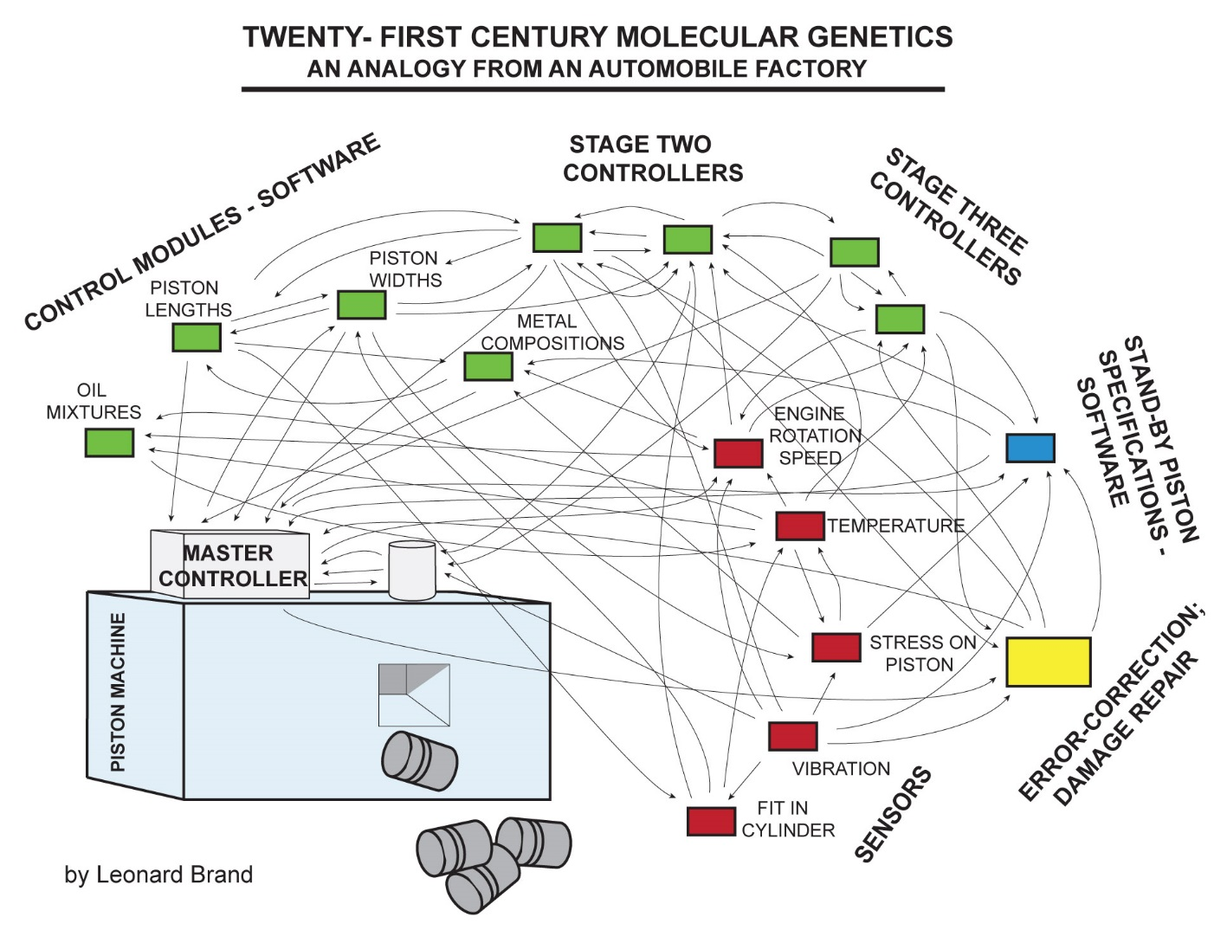
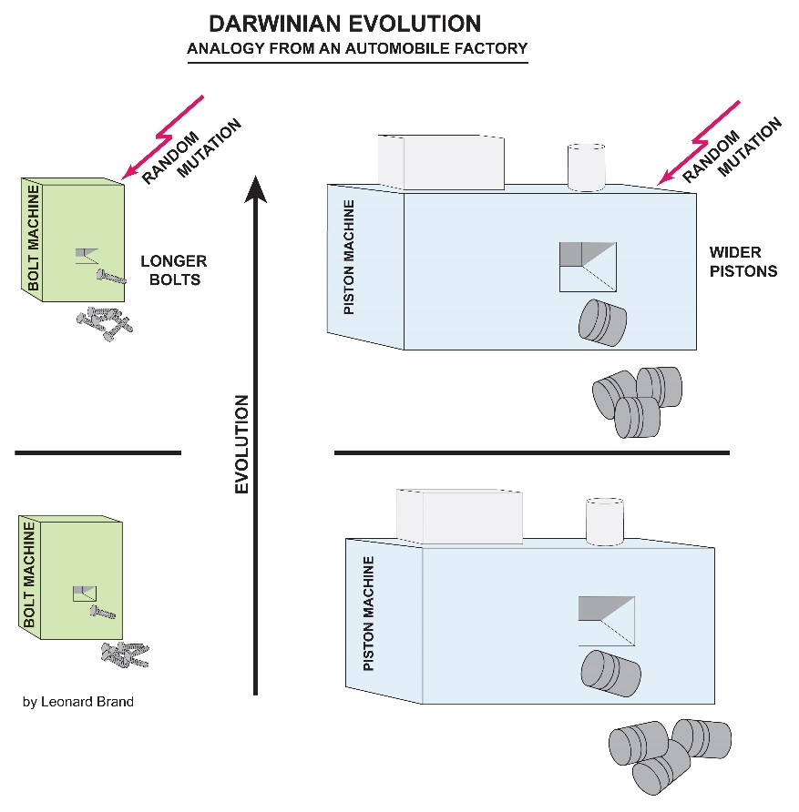
The analogy must be revised

Slide 32
Organisms have “stand-by” genetic information:
Potential for change

Slide 33
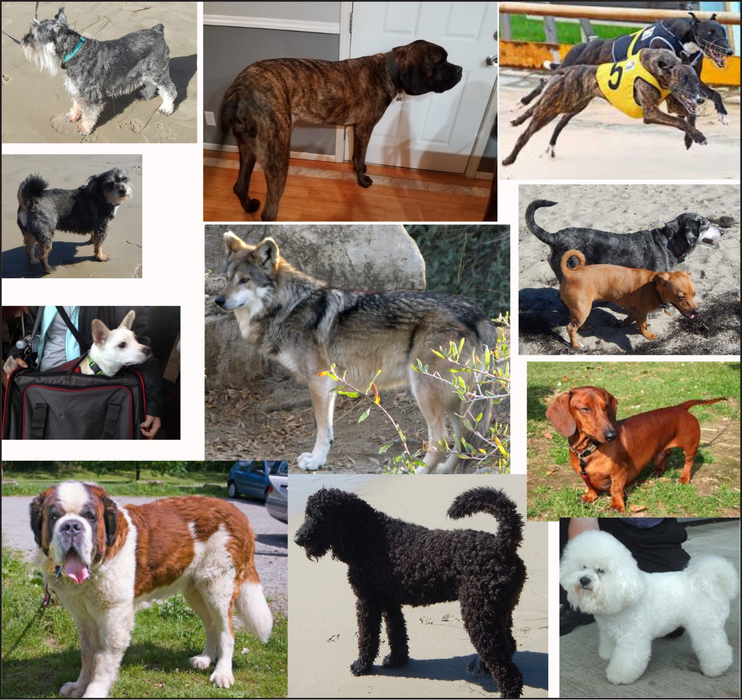
Stand-by genetic information – example: genetic variability in dogs

Slide 34
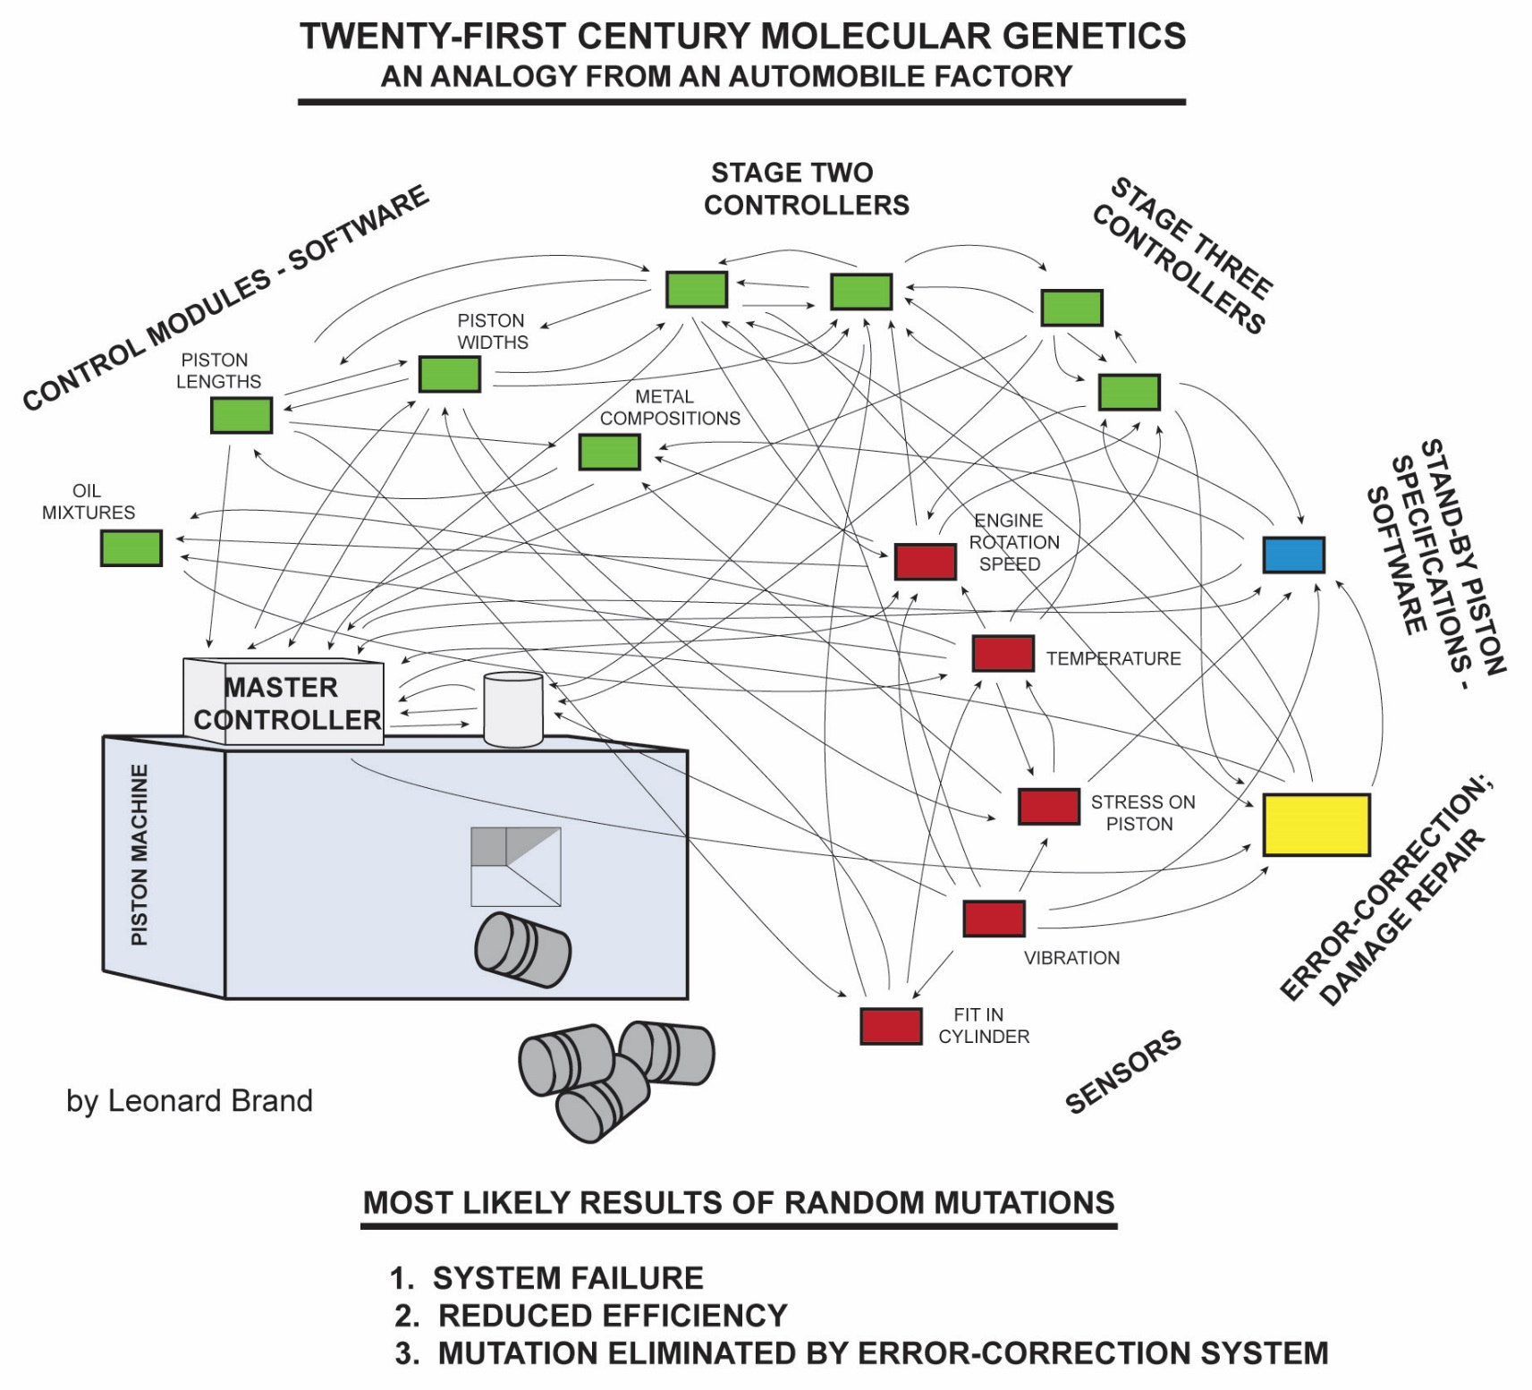
Random mutations (random damage) do occur; so what is the most likely result?

Slide 35
Summary of challenges to the theory of evolution
And challenges to naturalistic explanations

Slide 36
Summary of challenges to the theory of evolution
And challenges to naturalistic explanations
Macroevolution: is it just an accumulation of microevolution
over time?

Slide 37
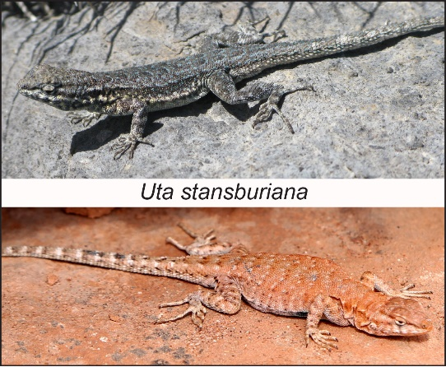
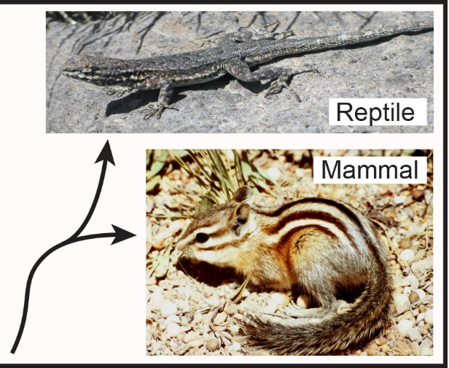
Answer - NO
Macroevolution is a different process:
It is not just accumulated microevolution over time
Macroevolution requires evolution of new structures and organs
Bones
Feathers
Hearts
Brains

Slide 38
Microevolution is becoming even more compatible with creation
Rapid adaptation – Darwin’s finches
Epigenetics – salamanders adapt to new environments
Microevolution within created genetic potential - dogs

Slide 39
Microevolution is becoming even more compatible with creation
Rapid adaptation – Darwin’s finches
Epigenetics – salamanders adapt to new enviroments
Microevolution within created genetic potential - dogs
Microevolution is not a naturalistic process

Slide 40
And, . . . . macroevolution theory is collapsing
No junk DNA
Orphan genes
Epigenetics
Molecular complexity
Intelligent design
Irreducible complexity
Abiogenesis does not work

Slide 41
And, . . . . macroevolution theory is collapsing
No junk DNA
Orphan genes
Epigenetics
Molecular complexity
Intelligent design
Irreducible complexity
Abiogenesis does not work
The evidence favors creation

Slide 42
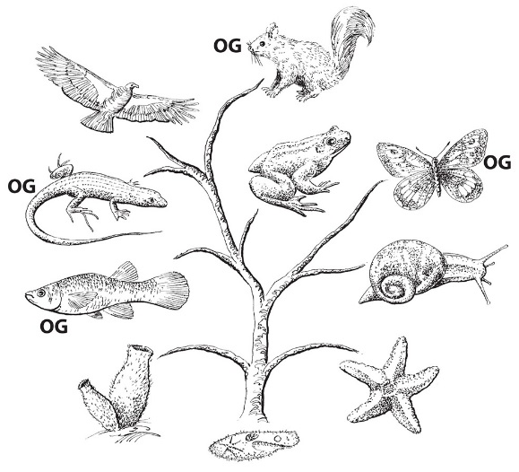
How are evolutionary biologists responding to these challenges?
Orphan genes
Failure of Darwinism
No junk DNA
Epigenetics

Slide 43
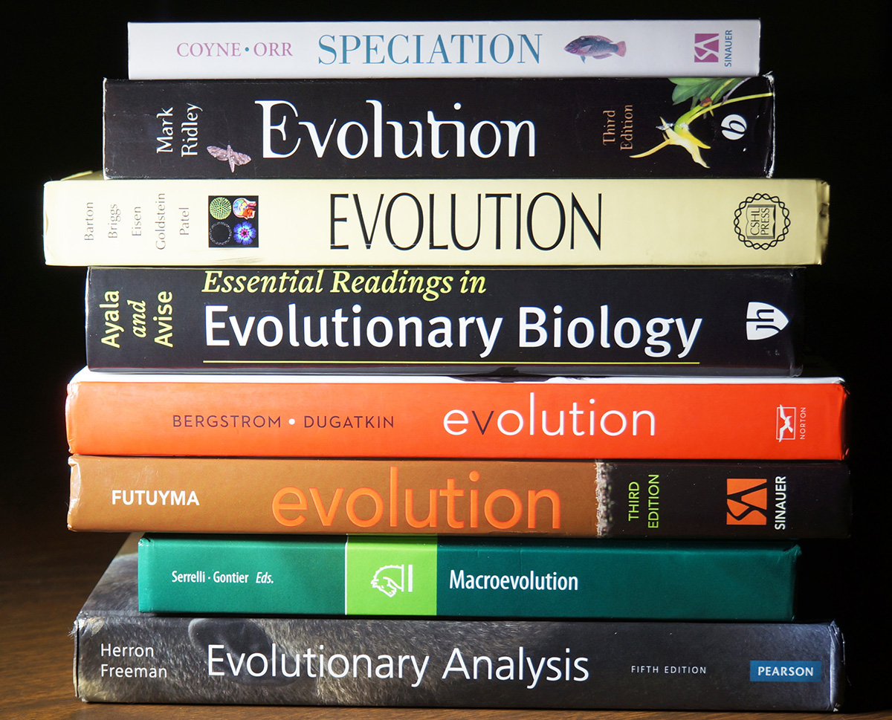
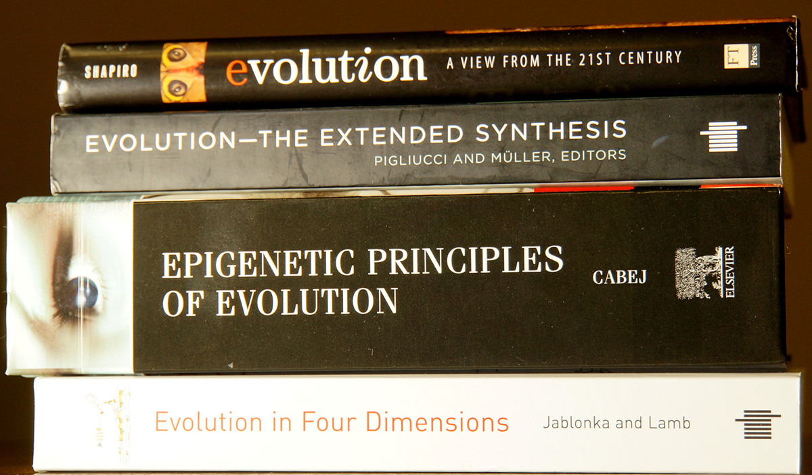
Two groups of current evolution textbooks
Epigenetics minimized or ignored
Orphan genes not mentioned
Epigenetics – proposed basis for a new evolution theory
New features: how do they arise?

Slide 44
Macroevolution is facing increasingly serious challenges
Eminent evolutionists, primarily molecular biologists, are raising those challenges and rejecting Darwinian theory – random mutations do not work
So –
Why do evolutionary biologists seem to be more committed to their theory than ever?

Slide 45
Macroevolution is facing increasingly serious challenges
Eminent evolutionists, primarily molecular biologists, are raising those challenges and rejecting Darwinian theory
So –
Why do evolutionary biologists seem to be more committed to their theory than ever?
It is because of philosophy, not evidence

Slide 46
Darwinian theory is collapsing, largely from the molecular challenges.
Hard-line Darwinists are relying on commitment to their naturalistic philosophy (worldview)
A division within conventional scientists
Hard-line Darwinists Darwinism does not work
Dawkins J Shapiro
Coyne Denton
Miller Muller
Pennock Pigliucci
Prothero Noble
Tour

Slide 47
Conclusions
Darwinian theory of evolution through random mutations and natural selection is facing deadly challenges
There is a growing conflict within science, between hard-line Darwinists and the “new evolutionists” who recognize the collapse of Darwinism
Creationists have increasing reasons to be confident of the literal creation of life forms – This is a new day for us

Slide 48
Conclusions
How can we grasp the full truth about origins?
Gain a broad and deep understanding of life and all the complexities of life processes.
The deeper our broad-scale knowledge of the processes of life becomes, the more likely it is that ideas like abiogenesis (chemical evolution) and large-scale macroevolution will sink into an abyss of impossibility, right next to a plan to build a railroad to Mars.

Slide 49
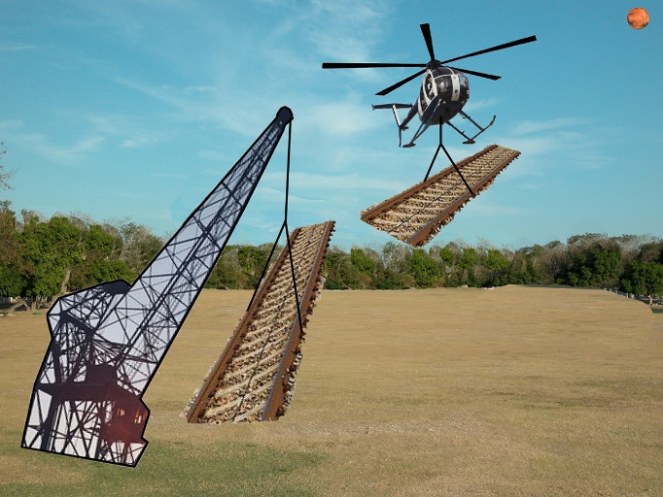

Slide 50
Conclusions
God loves all persons.
Be respectful of those we disagree with, even though we reject their
beliefs about origins

Slide 51
Conclusions
God loves all persons.
Be respectful of those we disagree with, even though we reject their
beliefs about origins
Our standard; our confidence - is still faith in the Bible
But God is using science to encourage us

