Slide 1
2025-2026
NEW PRODUCTS

Slide 2
WAD 2025
Year-end Meeting, Accra

Slide 3


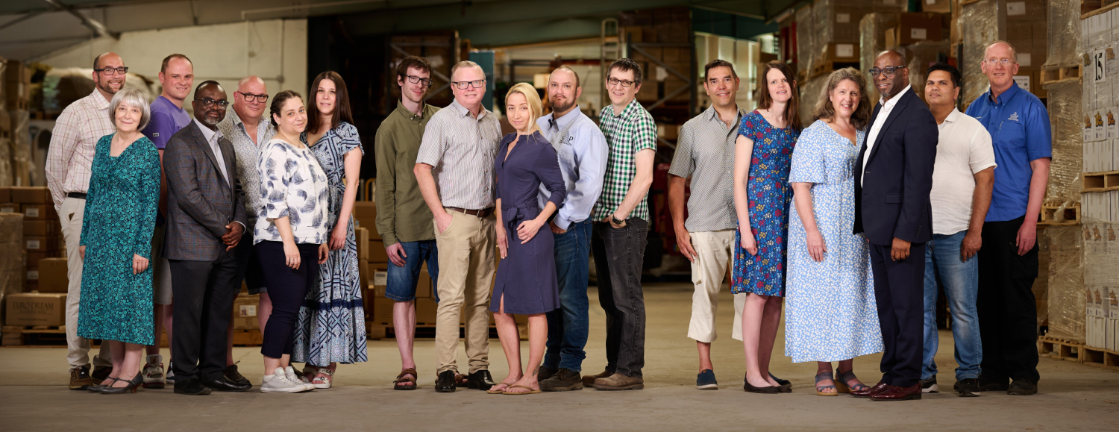



The STANBOROUGH PRESS LTD
www.stanboroughpress.org.uk

Slide 4
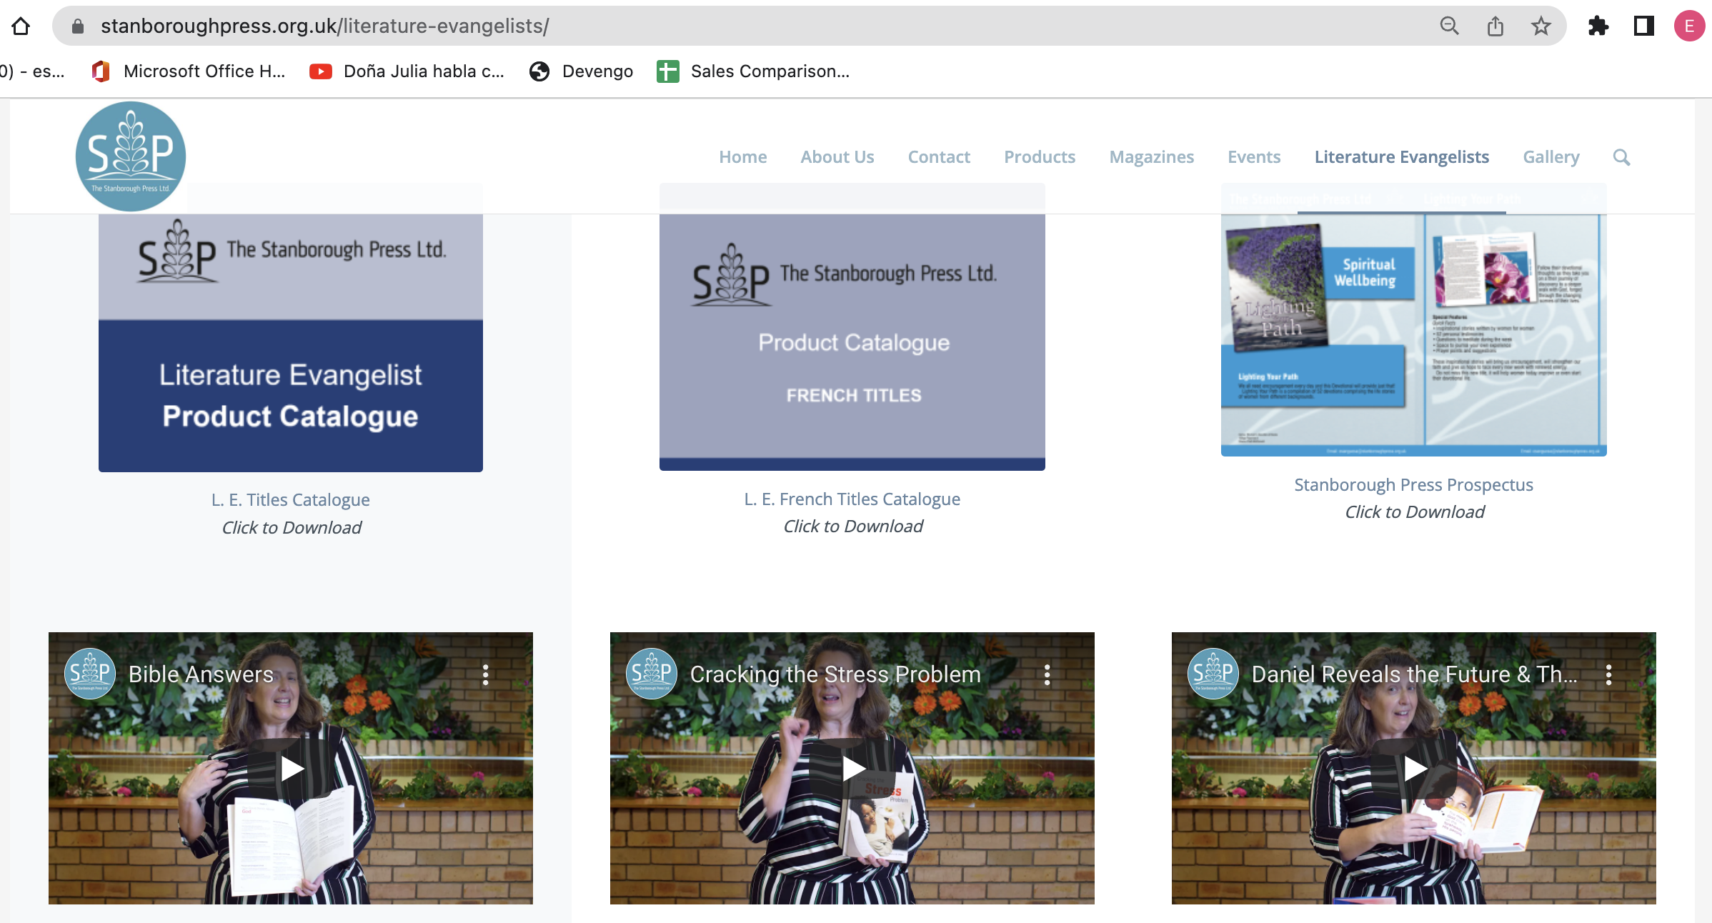

www.stanboroughpress.org.uk

Slide 5
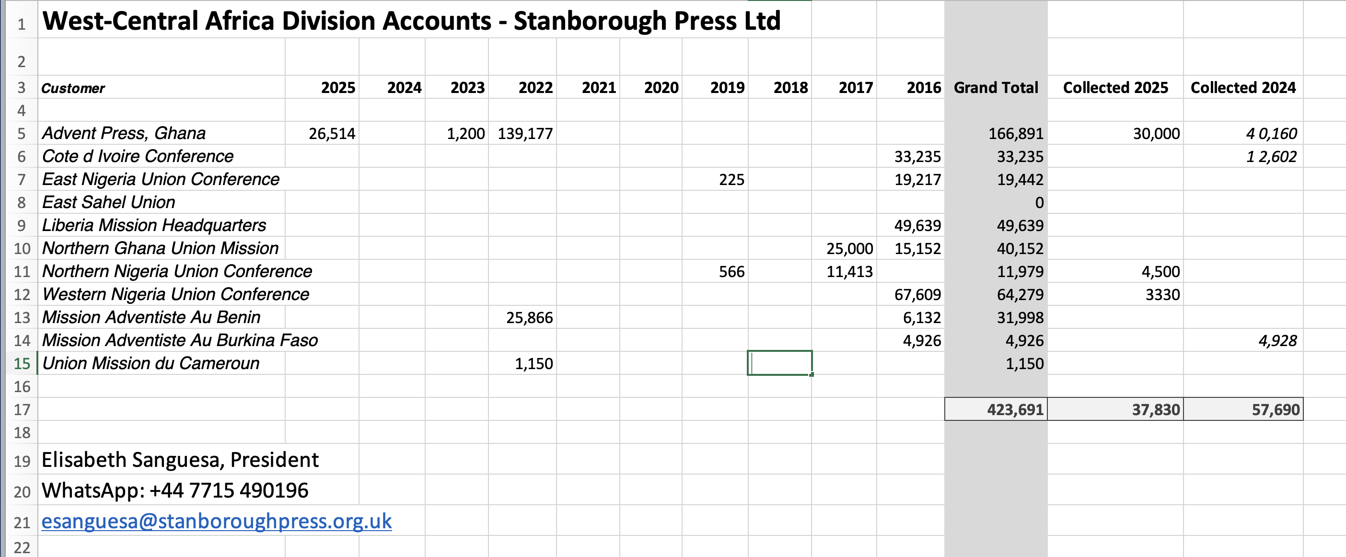

Slide 6

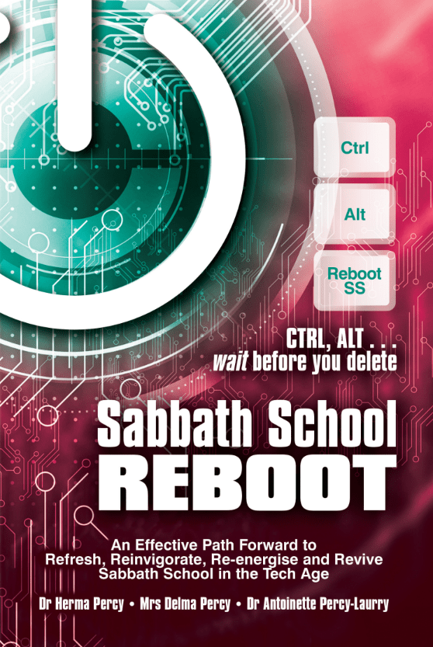
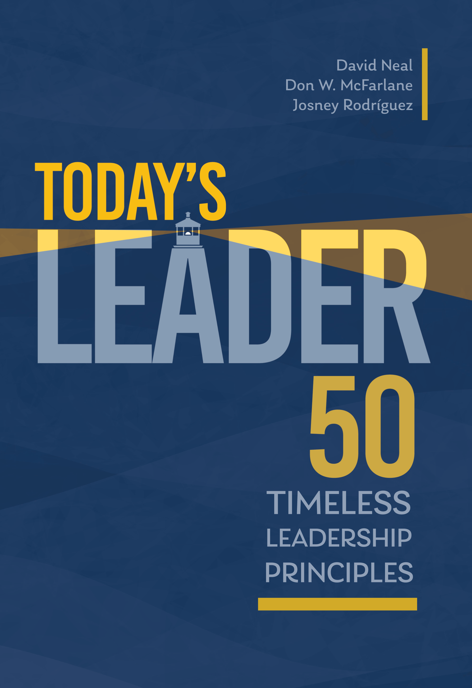


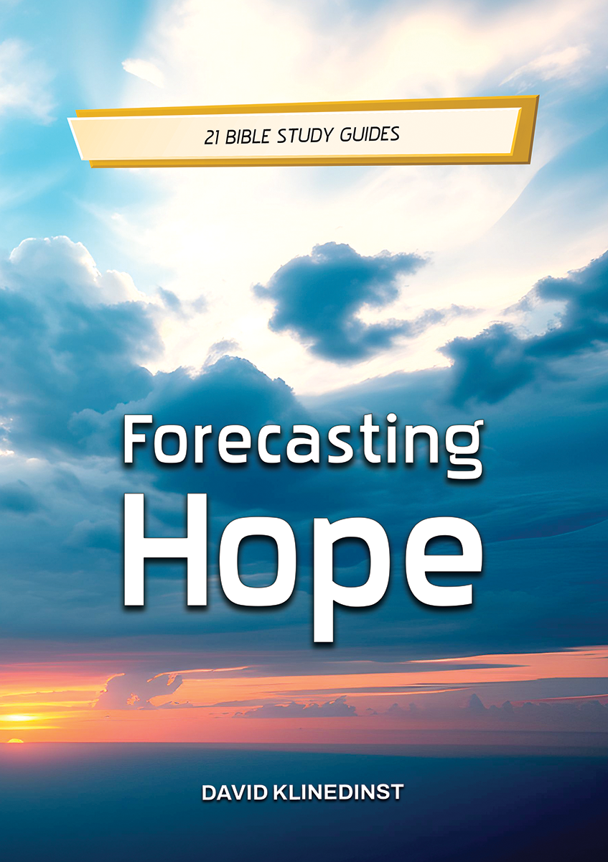



Slide 7
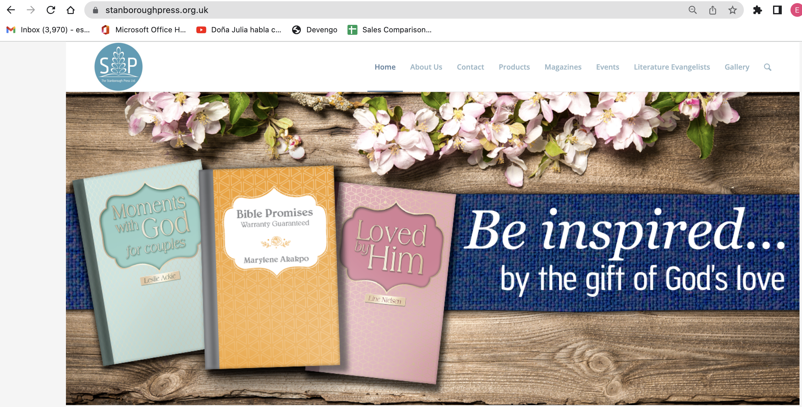
The stanborough press ltd
How TO ORDER:
WEBSITE: WWW.STANBOROUGHPRESS.ORG.UK
Email: esanguesa@Stanboroughpress.org.uk
Call on 01476 591700

Slide 8
SPIRITUAL GROWTH

Slide 9

NEW
Leadership can be daunting – whom should we turn to for advice? Thankfully, God in His wisdom has made abundant provision for all our concerns in the pages of Holy Scripture.
Alongside the accurate and accessible text of the New King James Version, you will find in this Bible plenty of insightful devotions and spiritual leadership tips to help you make a
difference.
Created with all Christians in mind, they will be blessed by
thoughtful and prayerful study of the Holy Scriptures and the Bible study resources, and both aspiring and current
leaders will be richly blessed by the supplementary materials, including the 64 page inserts and the Learning to Lead section which contains: Leadership Qualities Index; Ten Commandments of Teamwork; Biblical Conflict Resolution Process; Leadership reflections for each book of the Bible; Great Teachings of the Bible; 200 Well-Loved Passages of
Scripture; Bible Answers to Crucial Life Questions;
Themed Bible Index; Bible Kingdoms and Empires; and
8 full-colour maps

Slide 10
NEW
Today there is still a need for inspiring leaders.
But, today more than ever, being a leader is a challenge, because we are going through an unprecedented crisis of confidence. To regain the trust that society has lost in leadership, a leader must live authentically, modelling timeless principles in their conduct.
Principles such as transparency, generosity, humility, loyalty, reflection, active listening, spirituality, moral value and vocation. Principles that, unfortunately, have been lost on the way to a technological and individualistic society. This book is about these kinds of principles.
Every company, every home, every church, every classroom and every country needs men and women who motivate, unite and push energetically towards a vision, managing, with their influence, to improve their environment. You can be that person who makes a difference.
To help you, these pages invite you to discover 50 timeless leadership principles. They are principles that we find in the Book of books; principles that ultimately point to the ultimate source of power for all successful leadership: God.
Do not miss this new title, it will help leaders today improve
their devotional life and leadership experience.

Slide 11
NEW
Blending wisdom from the ancient pages of Scripture, contemporary thought, and reflections from pastoral practice, Seventh-day Adventist theologians, pastors, and practitioners unite to provide fresh perspectives on the character of God: who he is and why it matters today.
This book reveals God as a compassionate and relational Creator who comforts the hurting, offers hope to the broken, and invites us to partner with him in creative, meaningful, and life-affirming ways.
The Character of God challenges us to consider anew the beauty and depth of God’s person and embark on a spiritual journey of transformation and discovery. This isn’t just another book about theology—it’s an invitation to an encounter with the living God.

Slide 12

NEW
The Holy Spirit is often spoken of, but often misunderstood. What is His nature? What is His role? And what can we tell of Him from the book He inspired – the Holy Bible?
Join Dr Richard Müller on a fascinating journey through Christian history and the pages of Scripture to discover more about the redemptive and transformative work of the Spirit for us, in us and through us as He points us to Jesus Christ to the glory of God the Father.

Slide 13
NEW
‘Daniel Pel guides us on an exciting journey through the prophecies of Revelation, presenting them in a clear, logical and captivating manner. Enlightening, engaging and deeply inspiring, this book directs our focus to the beauty of Jesus, His power and His victory, especially in these uncertain times.
Open these pages and be refreshed by the profound story of redemption revealed in the book of Revelation!’
—Taj Pacleb, Speaker/Director, Revelation of Hope

Slide 14
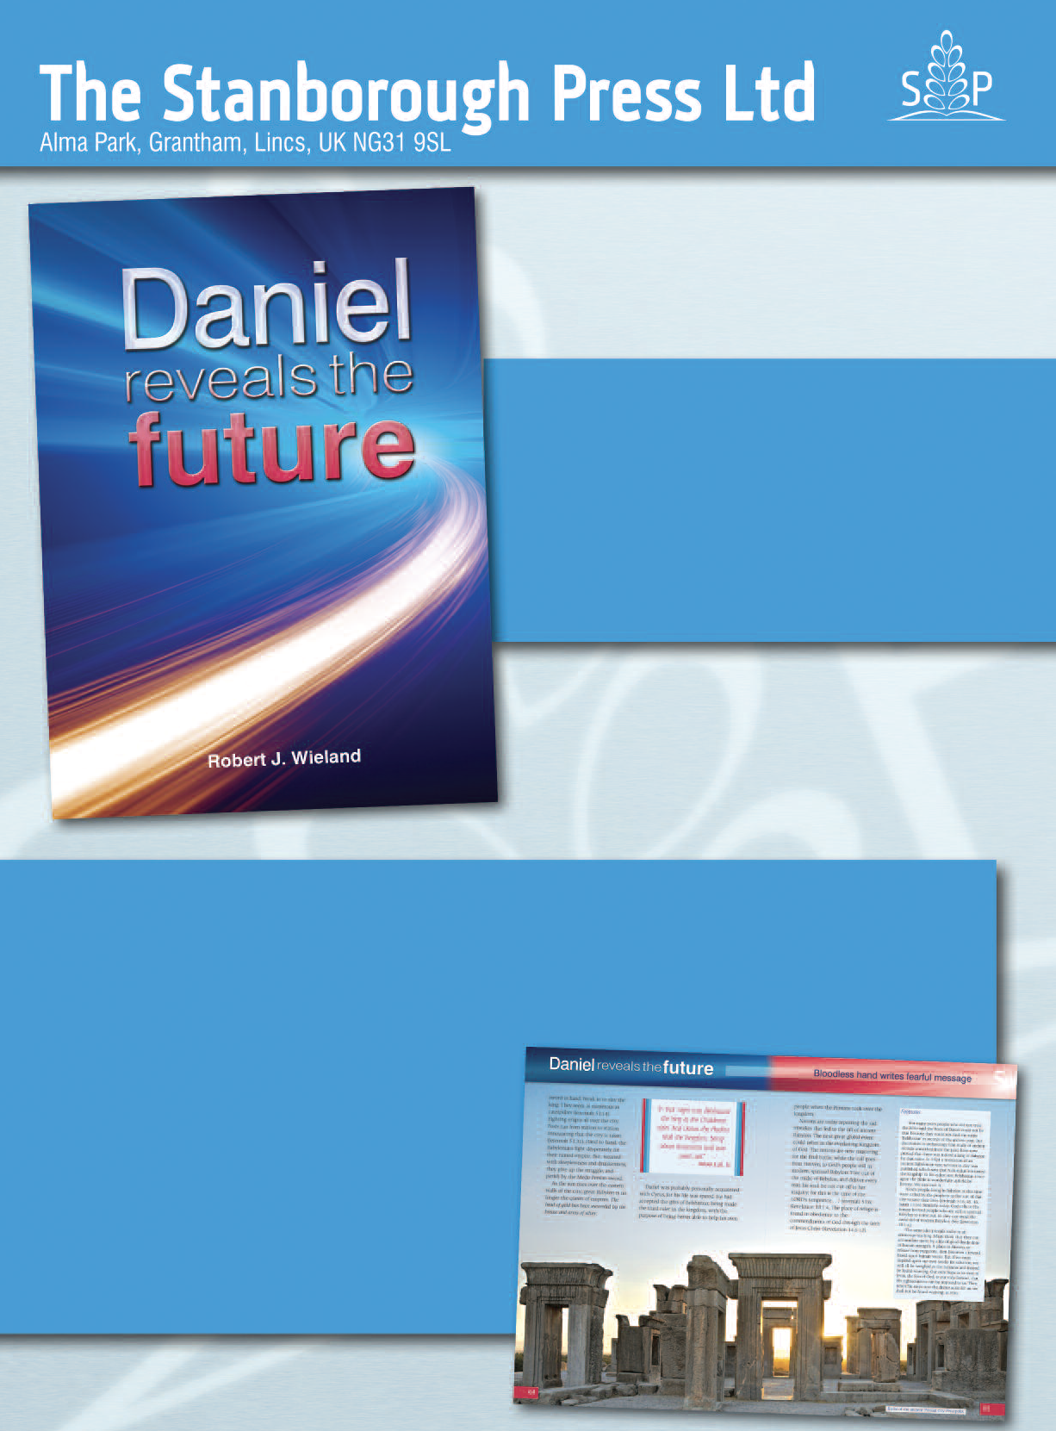
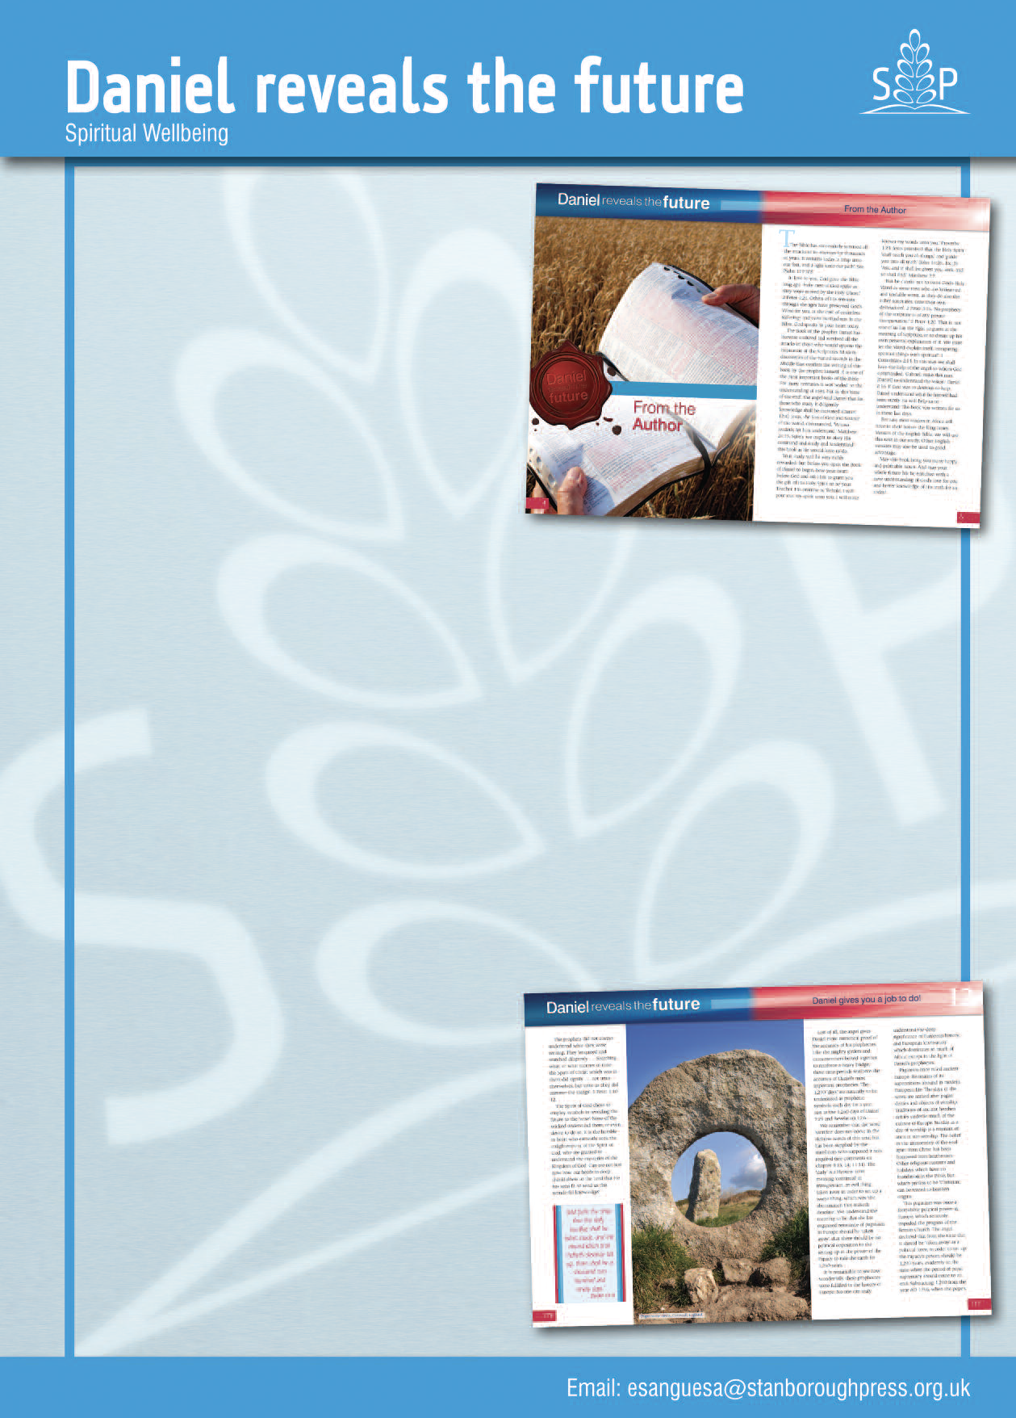
The book of Daniel has likewise
endured and survived all the
attacks, and modern discoveries
of the buried records in the
Middle East confirm the writing
of this book by the man himself.
Daniel reveals the future is a
unique, special, attractive and
modern book that presents an easy explanation, chapter by chapter, verse by verse, that will help you to better understand this book which seemed to be ‘sealed’ for centuries.
No prophecy of the Scripture is of any private interpretation. If God was desirous to help Daniel understand what he himself had seen, surely He will help us to understand it as well. This
book was written for today’s society. Daniel reveals the future will answer some of the questions that are present in our minds today:
•How can a dream explain the mystery of what is happening in Europe, Africa and the rest of the world?
•There are wars and political struggles all around us, but can we know who will rule the world?
•Who was that ‘Jesus’? Was
He really sent by God?
•Why does prayer often seem
unanswered?
•Is this world really coming
to an end or is it just Hollywood
fantasy?
•Is there anything we can do
to change the situation?
Spiritual Wellbeing
Spiritual
Wellbeing
Daniel reveals the future will make you aware of many of these interesting and fascinating facts that will enrich your whole life and your future with new understanding of God’s love for you and give you better knowledge of His truth for you and your family today.
One of the things people would really
like to know is what the future holds
for them – don’t you think so?
Have you ever wondered why the
Bible has successfully survived all the
attacks of its enemies for thousands
of years?
Series: Spiritual Wellbeing
199pp Hardback
Robert J. Wieland

Slide 15

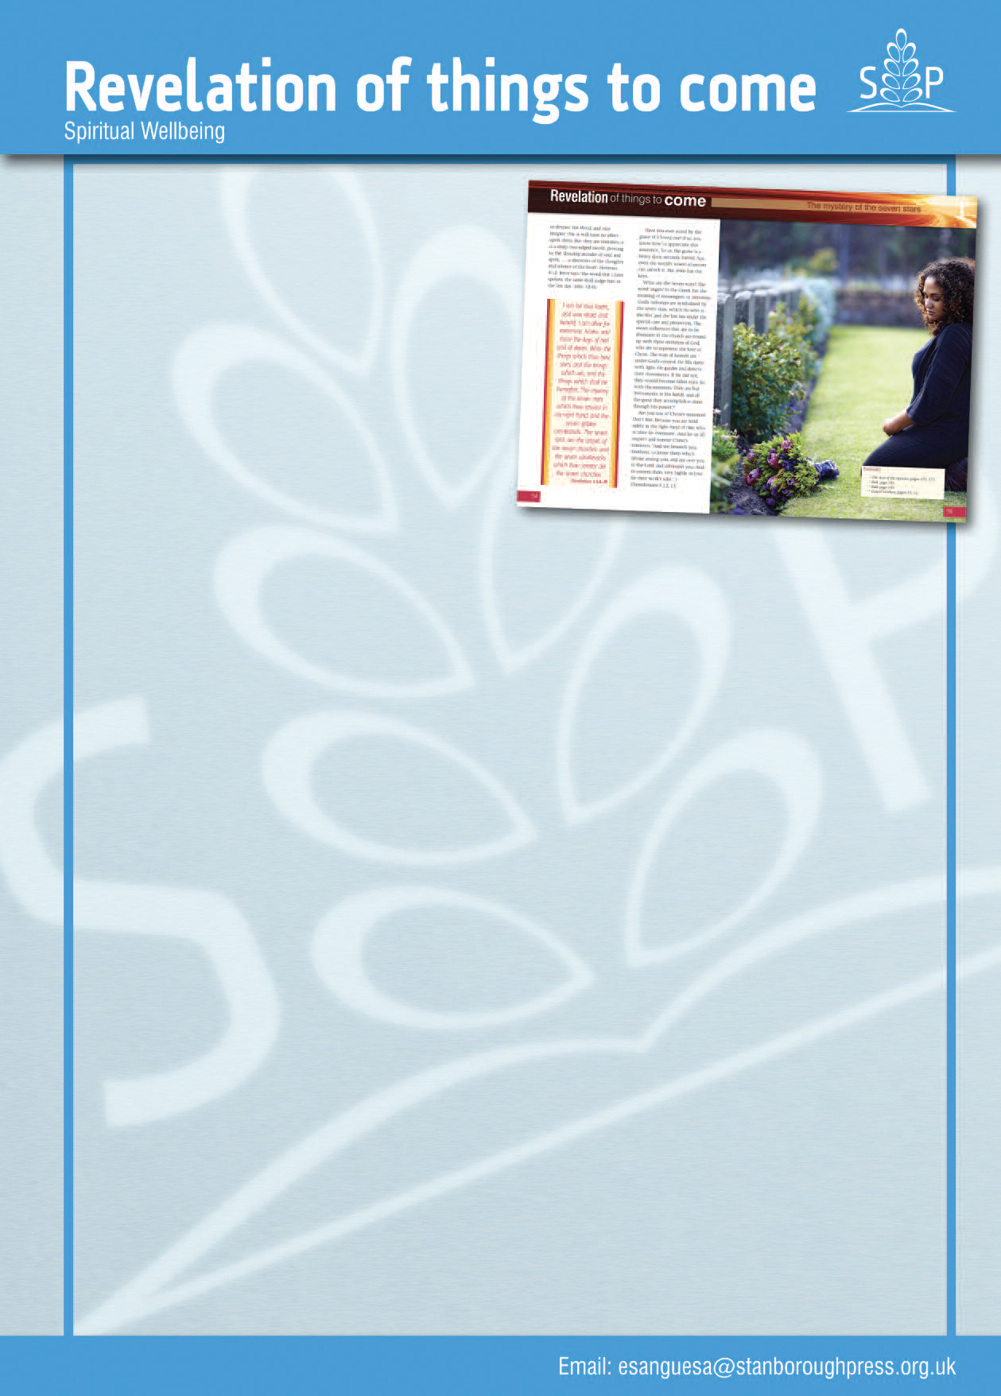
that will help you to better understand
this book that seemed to be ‘sealed’ for
centuries.
Revelation of things to come by
Robert J. Wieland provides
answers to issues like:
•What do the events around us tell
about the future?
•What is the mark God places on the
foreheads of His people?
•Is there any hope for the human race?
•The door that was open in Heaven . . . are we all invited?
•The strange book no man could open . . . angels, trumpets, plagues, beasts . . . what is all that about?
•What does the Bible say about the rise of Islam?
•What about your home in the New Jerusalem?
A fourth edition, revised and updated in 2014, provides information that can be found easily with the new Scriptural, Timeline and General Indexes, such that is worth more than any material security.Reading this volume will be the richest and happiest experience of your life, as it reveals Jesus: the only hope of a world in chaos.
No prophecy of the Scripture is of any private interpretation. If God was desirous to help John understand what He told him, surely He will help us to understand it as well. This vital book describes itself as the ‘Revelation of Jesus Christ’, and He is certainly its central figure. Written for today’s society this interesting volume not only pictures Jesus as revealing what is to come, but also shows that He will come personally.
Revelation of things to come will make you aware of many of those
interesting and fascinating facts that will enrich your whole life and your future with new understanding of God’s love for you, and give you better knowledge of His truth for you and your family today.
Here is the wisdom you have been waiting for!
Spiritual
Wellbeing
Revelation of things to come
One of the things people would really like to know is what the future holds for them – don’t you think so? Have you ever wondered whether this world will come to an end?
Home Health Education Service presents to you a publication entitle
Revelation of things to come.
Millions of people are crying out for some word from God, and this volume reveals the events to come and some signals that are to take place in the last days, and what we can do to prepare for the future.
This volume, containing 240 pages that are divided in 22 chapters with full-coloured illustrative pictures on each page, explains in detail a set of prophecies spanning human history from beginning to end.
Revelation of things to come is a unique, special, attractive and modern
Series: Spiritual Wellbeing
199pp Hardback
Robert J. Wieland

Slide 16

NEW
Coming from a dysfunctional family, filled with jealousy and bitterness, Judah sold his brother into slavery, lied to his father, ran away from his responsibilities, and fell into sexual sin. But then Judah starts to accept responsibility, and even becomes willing to sacrifice his own freedom for that of his favoured brother . . . and in this we can see similarities with Jesus. What about you? What is your story? Can you see the part you play in God’s wonderful, surprising, grace-filled plan? Can you see His work in your life?
Take some time to think about how Judah’s story – Jesus’ story – might be reflected in your own.
This book is for any Christian who is looking for encouragement to see how God’s plan can be worked out in the lives of His broken and sinful followers – even in us.
Line Nielsen is passionate about sharing her daily experiences with Jesus. She loves sharing stories with people about God, and prays that you will enjoy her personal stories of liberation in Jesus. She has also written Loved by Him and The Truth Sets You Free, which are available from the same publisher.

Slide 17
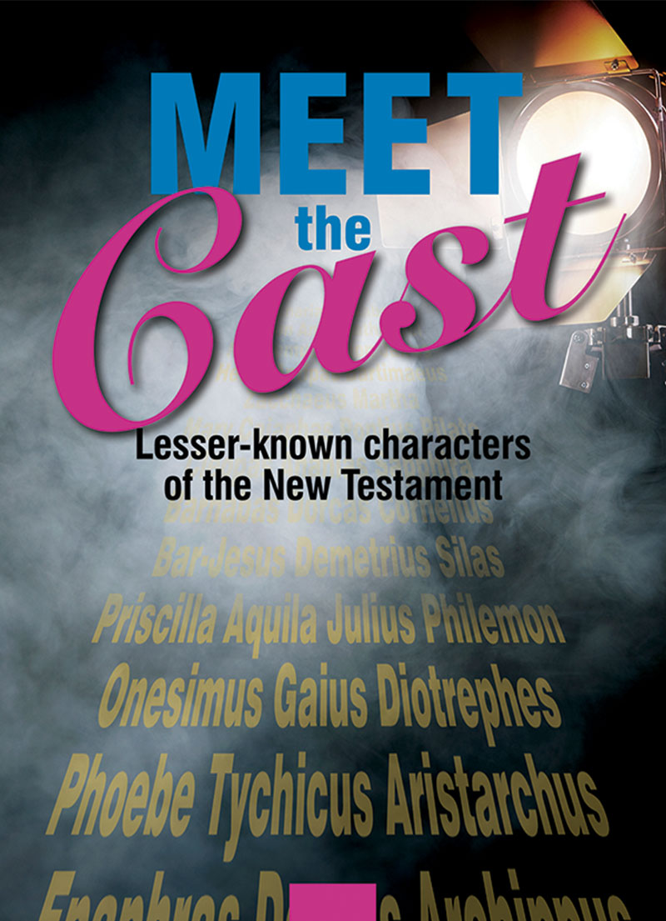
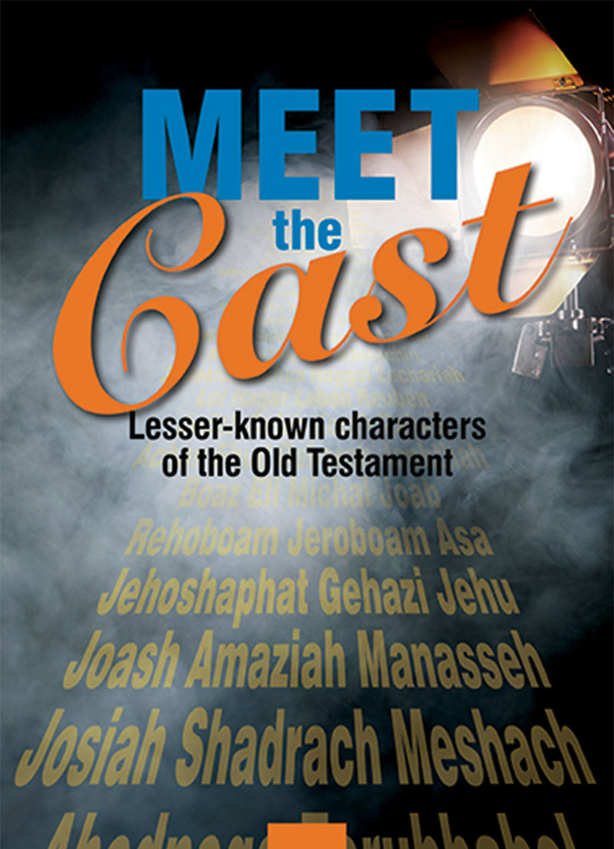

Boaz… Jehoshaphat… Josiah… are they just names in another genealogy, or are there gripping, exciting stories to tell here? Swivel the spotlight a little, and you’ll find that behind each of these names is a man or woman with their own hopes, desires, dilemmas… and sometimes darker motives. Join Ray Markham as he focuses in on these lesser-known characters in the greatest drama ever told.
Meet the Cast OT & NT

Slide 18
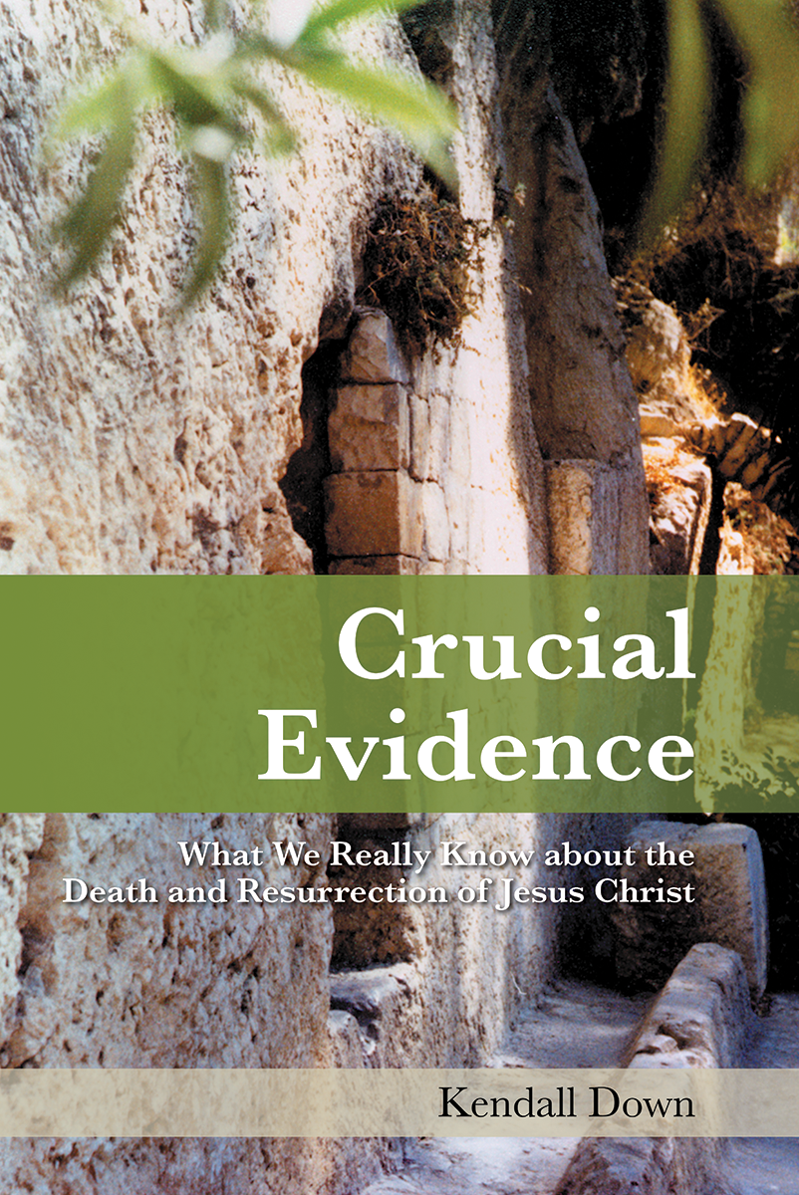
NEW
It’s the foundation of our faith. It’s the reason for all of our hopes and beliefs as Christians. But what do we actually know about the crucifixion and resurrection of Jesus Christ, our Lord and Saviour?
What insights can we glean from the ankle bone of the unfortunate Yohanan ben-Hagkol, the writings of the Jewish historian Josephus, and the ancient Roman graffiti of Alexamenos and Alkmila?
Prepare to have your long-held assumptions challenged and your faith affirmed and strengthened as Kendall Down uses scholarly research and archaeological evidence to powerfully confirm the historical reality of the death and resurrection of Jesus Christ.

Slide 19
RESOURCES

Slide 20
NEW
A book that is indispensable for all who want to draw closer and closer to God. It will lead the reader to kneel before the altar of self-sacrifice.
This is a book that finds evidence in the Scriptures that shows how our Creator sees us and then reflects on what this means for the church and for each individual.
It clearly demonstrates that, as valuable as earthly possessions may be to us, they pale in comparison to the value that God attributes to each and every one of us.
Do not miss this new title, it will help leaders today improve their devotional life and leadership experience.
Excellent for the Stewardship department.

Slide 21
NEW
Real insights into why youth leave the church and how to win them back – or, better yet, deter them from leaving in the first place – and how to re-energise adult Sabbath School and increase membership and participation.
All who have a desire to get back to the foundational principles and reasons for Sabbath School, all who enjoy and receive a blessing from Sabbath School, and all who would like to see every aspect of Sabbath School improve and continue into the future until Christ’s return will be blessed by this book.
The Percy family have served in the Sabbath School
ministry as Sabbath School superintendents in the
Inter-American Division, NAD, and TED for about 100 years. As fourth-generation Adventists, the sisters have given decades-long service to Sabbath School, including as children’s and youth Sabbath School superintendent, youth Sabbath School teacher, general Sabbath School superintendent, and adult Sabbath School teacher. Their mother also served for more than 30 years, and their grandmother for 40 years, as superintendent.

Slide 22
NEW
Amid the uncertainties of the modern world, discover what you need to know from the pages of the Holy Scriptures.
Ancient prophecies predicted events that are being fulfilled before our eyes. What does this mean for us today?
These 21 Bible studies have been compiled by Pastor David Klinedinst, Evangelism Director of the Cheesepeak Conference and edited by Pastor Jeffrey Brown, Associate Editor of Ministry Magazine, and they go through the different prophecies, their explanation and practical application for today.
The are presented as individual booklets within a folder for easy access.
Ideal for pastors, elders, Bible workers and anyone involved in Evangelism.

Slide 23
DEVOTIONALS AND SHARING

Slide 24
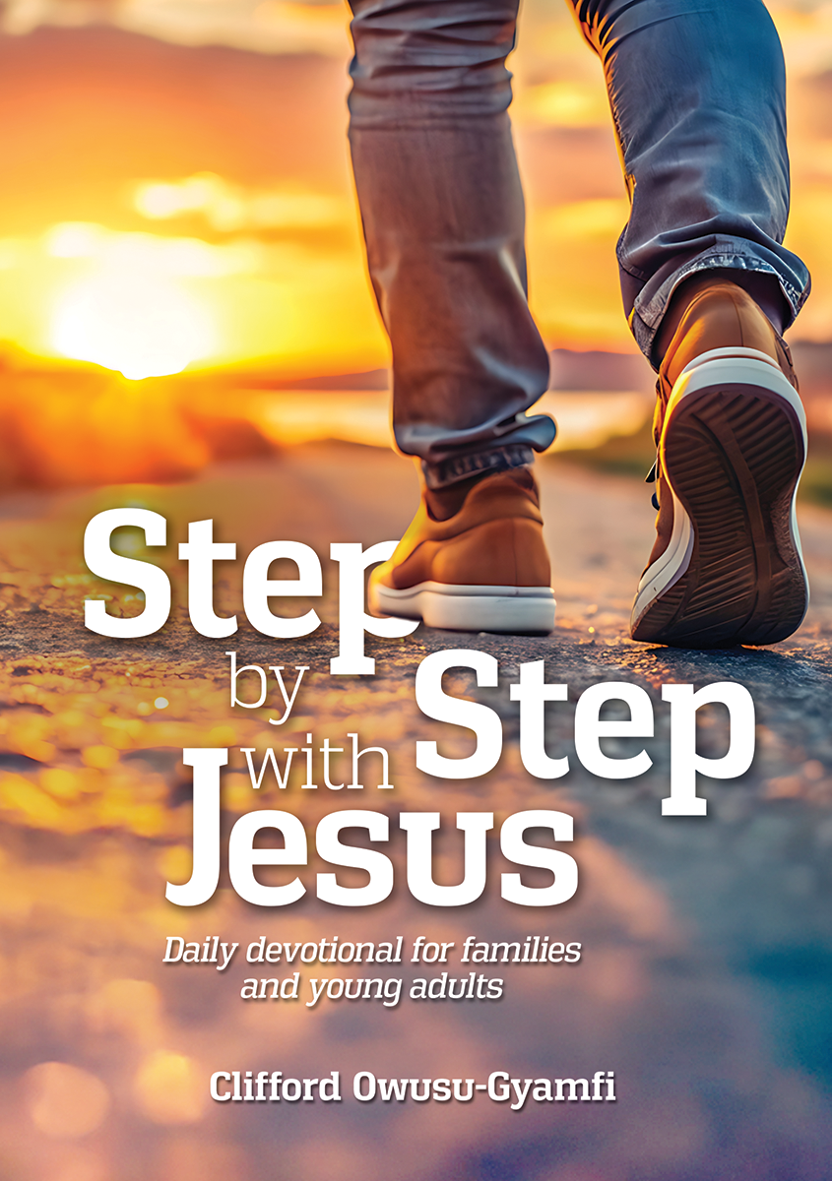
NEW
Has your yearly devotional reading often trailed off by mid-year? Do you find yourself among those who struggle to maintain the commitment?
Step by Step with Jesus is not merely a 365 daily devotional: it’s a journey with the Saviour that engages and captivates you throughout the entire year.
Embedded within each devotion are timeless truths woven into stories and illustrations that reflect the challenges, trials and questions we all face. The pages of this book are designed to inspire commitment, offering a fresh perspective each day, and infusing your daily routine with spiritual vitality. The engaging topics, scriptural insights, and practical applications will draw you into a deeper relationship with Jesus.
Step by Step with Jesus is a personal invitation to walk hand in hand with the Saviour, step by step, day by day, growing and maturing in your faith.

Slide 25
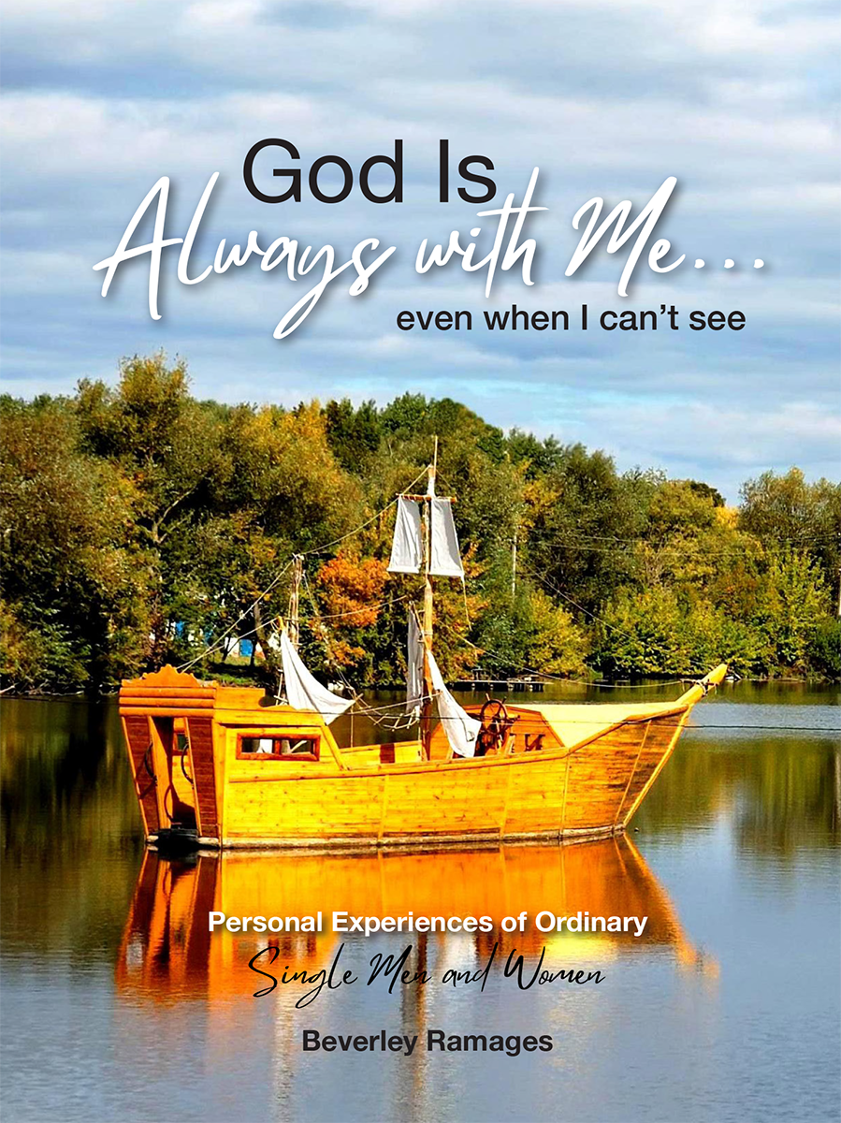
NEW
These devotional writings record some of the real struggles and blessings of ordinary single men and women who love the Lord. They tell of experiences with God that have strengthened and enriched their walk with Him.
Written by a variety of authors of different ages and backgrounds, the reading have been compiled into 5 different sections directly our reflections to focus on our relationship with God, our relationships with others, personal finances, our health and our social well-being.
May their stories bless you and give you the assurance that God is always with you . . . even when you cannot see Him!

Slide 26
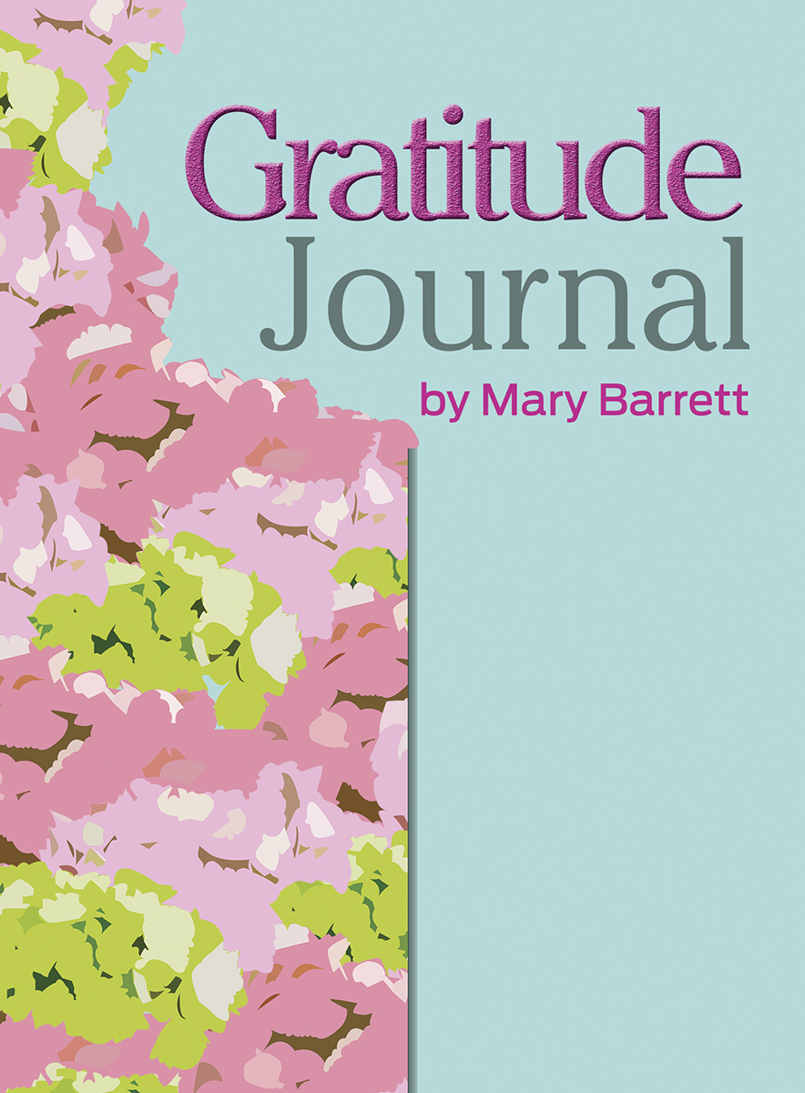
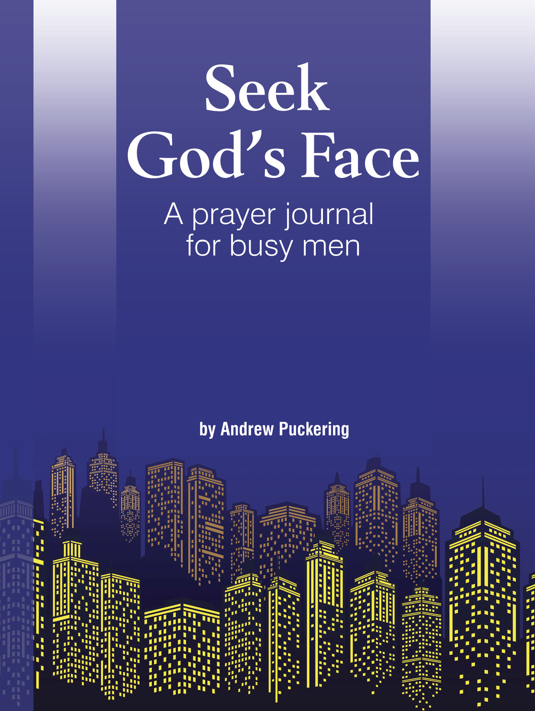
Mary Barrett had a burning issue to take to the Lord – but, instead of asking Him for help, she chose to praise Him.
What happened next was truly amazing!
This prayer journal provides encouraging scripture texts, inspiring thoughts, and space for you to write out your own requests and prayers of praise.
We ask God for so many things in our prayers . . . but how often do we thank Him?
Start your ‘attitude of gratitude’ today!
Among all your busyness, find time to rest. Among the stresses of life, experience God’s peace. It can be stressful in a man’s world, with so many competing pressures and demands on our time. God understands the challenges we face, and He encourages us to take time out and come before Him in devotional time and prayer.
To be the men that God calls us to be, we need to come before Him and seek His face. Let us join together in seeking our loving God today.

Slide 27
NEW
Scripture speaks for itself.
In this sharing book, Hope for the World, Beulah Galloway presents Bible texts on God and His law, sin and salvation, Jesus, the Holy Spirit, and man’s place and purpose in the world, arranged topically for your convenience such as:
Who are God’s children?,
How reliable are the Scriptures?,
What comfort is there for the broken-hearted?,
What can the Bible tell me about how to live?,
What good being humble do?,
Will God always provide for my needs?,
What will happen when Jesus returns?,
What are the Ten Commandments?,
Where did Jesus come from?
And What should I do now that I know all these things?
It is our belief and prayer that you will find this to be a rich blessing in your walk with God.

Slide 28

Gratitude is the forgotten theology
“…In all things give thanks, for this is the will of God in Christ Jesus…”
1 Thessa 5:18
Pray for each other
“Therefore comfort each other and edify one another, just as you also are doing… ”
1 Thessa 5:11

Slide 29
PERSONAL GROWTH

Slide 30
NEW
We all have an inherent need for acceptance, validation and belonging. We all need to feel loved. But what happens when we face rejection – either from others or from ourselves?
Closely examining the work of psychological researchers on this topic, along with the trustworthy counsel of Holy Scripture, the testimonies of others, and her own lived experience, Alison Awuku takes us through why people reject others, the psychology of self-rejection, the need for resilience, and the gift of being able to see rejection as a needed opportunity to refocus and even as a blessing.
May you be significantly blessed and enriched to fulfil your purpose as you consider whether to be Dejected or Redirected.
Alison Awuku, MA, MSc is an accredited psychotherapist and counsellor based in the UK but originally from Ghana. She is passionate about helping varied individuals, groups and organisations at all levels to achieve positive and effective relationships and positive mental and emotional health through education, empowerment, therapy, coaching, mentoring, workshops, events, and writing.

Slide 31

NEW
Learn how to live life without hurting others or yourself;
- to life more peacefully in a world that is in permanent conflict; - to store the past and live in the present without endangering the future;
- to make life beautiful, even though ugly things will always exist; to not be a failure when you fail, and to do good even though you may not be good; to change the ordinary into the extraordinary;
- to be content without falling into conformity;
- to discover the true purpose of your life;
- to accept providence without being fatalistic; and
- not to leave for tomorrow what you can do today, because the only moment you own is the present.
What Happy People Do teaches us to find happiness without having to search for it.
This book is for everyone wishing to develop their attitude to be more positive and improve their well-being.
Fernando Zabala has extensive credentials as a professor, university president, speaker, editor and witty and profound writer. . . . However, his best references are the lives
his books have changed.

Slide 32

This book focuses on practical steps to make any marriage thrive. What does love look like in practice? Mashudu Ravhengani offers
encouraging and practical counsel on pride and patience, finances, in-laws, conflict resolution, the marital covenant, and how to be the best husband or wife you can be. Allow God to work in your marriage and help your love to soar like an eagle!
Younger or older husbands and wives, those looking to get married in the near future, and those whose marriages seem to be on the verge of falling apart – all will benefit from reading this book.
Mashudu J. M. Ravhengani is the author of a number of books, including Thriving Through Trials, The Pursuit of Purpose and the Search for Meaning, Tempted, Tested, and Tried, But Still Standing, and How to Live, Love, Marry and Stay Married.
He is an internationally renowned evangelist, preacher, marriage counsellor, and highly sought-after speaker for seminars and conferences on relationships, motivation, marriage, courtship, self-empowerment, and parenting. He is the speaker and director of the supporting ministry, Living Power Ministry. He
resides in Pretoria, South Africa.

Slide 33

The remarkable testimony of Mavis Massey, whose unconventional journey through married life has involved three husbands, the first two of which were highly unsuitable. During her marriages, the Lord has helped her to grow spiritually, to the point where she is ready to share the lessons she has learned from His Word and from her life experiences in this book.
Young women who are either recently married or are looking to get married will be blessed by this book, as well as anyone else who enjoys reading testimonies, autobiographies, and sound spiritual relationship advice.
Mavis Massey, the youngest of ten siblings, was born in Port Elizabeth, South Africa, and grew up in a Methodist home. She pursued nursing training in Cape Town, South Africa from 1986 to 1990, after which she returned to work in Port Elizabeth, and she
became a Seventh-day Adventist at the age of 19. She has been married three times, with no children, and eventually moved to Wales with her third and current husband in 2010.

Slide 34

If you’re struggling to distinguish the true from the false when it comes to parenting advice, you’re not alone – but praise God for the timeless and reliable truths of Holy Scripture.
Alongside the accurate and accessible text of the New King James Version, you will find in this Bible many inspiring devotions and much practical guidance to raise your child God’s way.
Created with all Christians in mind, they will be blessed by
thoughtful and prayerful study of the Holy Scriptures and the Bible study resources, and both and both expectant and
current parents will be richly blessed by the supplementary materials, including the 64 full-page inserts on biblical parenting and the Focus on the Family section which contains:
Kindling that Spiritual Fire in Your Child; Grandparents in the Bible; Ways to Help Your Child Engage with Scripture; Parenting pointers for each book of the Bible; Great Teachings of the Bible; 200 Well-Loved Passages of Scripture; Bible Answers to Crucial Life Questions; Themed Bible Index; Bible Kingdoms and Empires; and 8 full-colour maps.

Slide 35

NEW
Unless the Lord returns first or we suffer some calamity, each one of us will grow old. How should we prepare for this inevitability? How can we thrive and even enjoy being elderly? And, most critically, how should we prepare for what will come after?
In As Time Moves On, a seasoned pastor, missionary, administrator and theologian provides scriptural counsel on what happens to our minds and bodies as we become older; how to slow down the ageing process; the challenges of dementia; how to make the most of our senior years; financial matters in retirement; looking out for each other; end-of-life issues; and hope beyond the grave. This is an immensely practical book written from years of experience with a pastor’s heart.

Slide 36
Use these ten keys contained in this booklet to unlock the door between you and a better life . . .
Educate yourself, be empowered, and reflect on how the powerful spiritual insights and actionable strategies listed in this book can tap into your full potential and allow you to lead a purposeful life.
From Embracing Your Greatest Ally; to Communicating with Management; Cherishing Yourself; Choosing Health; Counting Your Blessings; realizing that Patience and Consistency are Your Friends;
Making Informed Decisions; Being A Good Stewart; Seeing the Beauty of Change; and Realizing that You can Also Be a Blessing. These 10 keys will richly bless you, both now and for eternity.
The author is an enthusiastic Christian driven by a profound dedication to guide others towards transformative change, with God leading their path at every step. She is an avid traveller who draws inspiration from diverse and enriching cultures and landscapes.
Hannah Montoute is an enthusiastic debut Christian author driven by a profound
dedication to guide others towards transformative change, with God leading their path at every step. She is an avid traveller who draws inspiration from diverse and enriching cultures and landscapes, and she prays that her readers will be inspired to unlock better living today.
NEW

Slide 37
INSPIRATIONAL STORIES

Slide 38

NEW
Her husband was dead; her faith was widely mocked; and now they were going to take away her child.
In Communist Ukraine, Maria Vasilevna’s life was being broken and covered with darkness. This was the price the state was determined to make her pay for clinging to her beliefs. Was it worth it, and would she be able to bear it?
Learn of how she endured one of the most terrible things that can happen to a parent; and of how she found peace with God amid the pain – and of her eventual joyful reunion.
This story, based on true events, is probably one of the most moving stories you will ever read.
Pastor Maksym Krupskyi was born and lives in Ukraine. Today he heads the largest Christian TV channel in the country (Hope TV Ukraine), and also works professionally on religious freedom issues for the Adventist community and others. He is married to Olga, and they have a daughter, Vladyslava. He has a law degree (Ukraine) and a doctorate in leadership (USA).
Paperback 110 pages

Slide 39

NEW
An intense spiritual journey and a remarkable testimony of healing.
Karin’s world was turned upside down when she discovered cancer in her leg. She had many questions for God, and fear threatened to engulf her – especially when the cancer returned and the doctors told her there was no more they could do.
Throughout it all, though, her family, friends and medical team supported her, and her faith remained strong. In fact, it grew even stronger as she wrestled with God and sought answers and comfort in Scripture. And her faith was rewarded in an amazing way . . .

Slide 40


If you have recently welcomed your precious little bundle of love into the world, Meditations for Mothers is for you!
Cuddles, funny faces, loneliness and sleepless nights – Lorraine Mwita and Renée Richards have been through the journey you are now on, and can definitely relate.
God has given us so many reasons to be thankful, and we can learn so much about our relationship with Him when we look at our sweet little children.
Praise God for the new life He has given you, and may these meditations bless your heart as you grapple with the challenges and joys of being a new mother.
Relatable and a perfect present to welcome and navigate motherhood, despite the circumstances.

Slide 41
CHILDREN

Slide 42



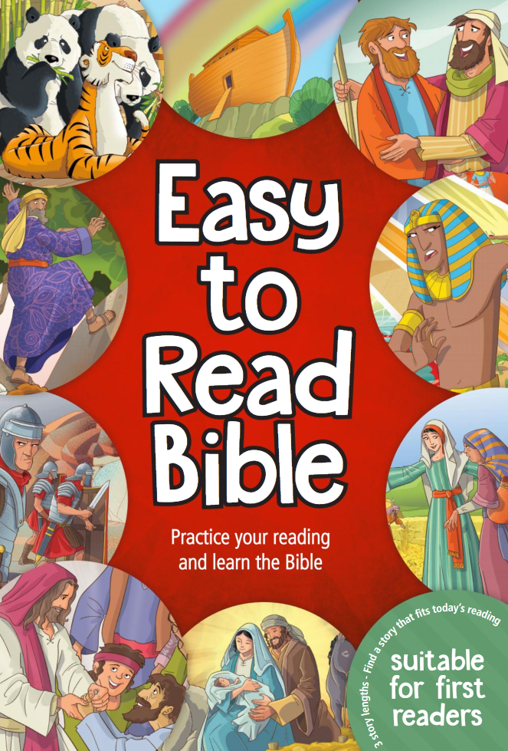

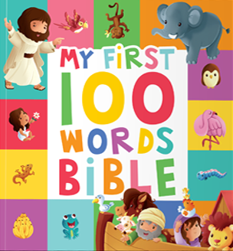





NEW

Slide 43
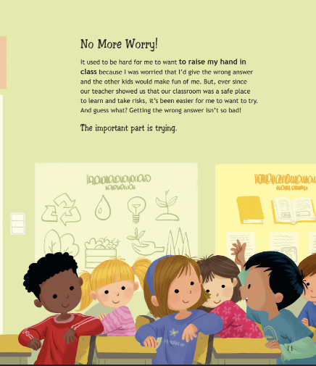
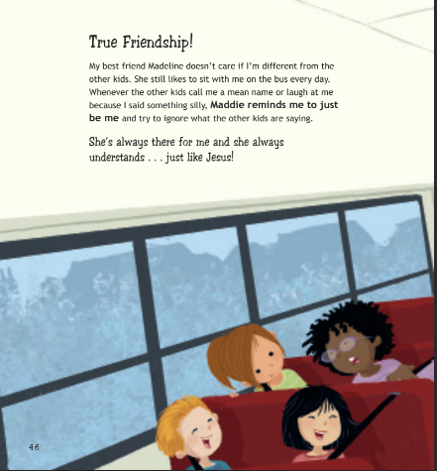
NEW
This book introduces kids to different emotions, helping them understand and manage their feelings in a healthy way. It’s perfect for building emotional intelligence.
- Identify and manage feelings and set healthy boundaries
- Encourage problem-solving and emotional awareness
- Empower children to understand their emotions

Slide 44
NEW
Welcome to The Alphabet of Values, a unique collection of teaching strategies, diverse cultural narratives, and interdisciplinary activities to instill essential Christian values in young minds.
Each value is illuminated by captivating stories, woven by authors from a kaleidoscope of cultural backgrounds, which serve as powerful conduits for instilling virtues that transcend borders and resonate universally.
Whether you are a teacher, a parent, or a curious young mind, this guide beckons you to embark on an adventure of discovery, growth, and understanding!
Age: 7-11 • Pages: 144 • Size A4 • Hardcover, Illustrated

Slide 45
NEW
Your children will love these heart-warming sermons from all over the world who discover how to put their Bible-based values into practice!
The value in each sermon is supported with multiple Scripture texts, and each sermon is concluded with a prayer.
These short but fascinating sermons are designed to enhance children’s faith in God and improve their relations with their families and church families, as well as giving them useful social skills.
May your home be blessed and your children inspired to grow in God’s love as you share these sermons with them.

Slide 46



Juniors:
This growth mindset booklet builds juniors’ self-esteem and encourages positive thinking by providing a special place for them to explore, create, and learn about the power of their minds. Using activities and analogies, it allows them to plant seeds of possibility, water them with effort, and face the storms of worry and fear, helping them to cultivate resilience and a positive approach to challenges.
Teens:
Life is a tapestry woven with threads of certainty and uncertainty. Guided by stories of faith, both ancient and contemporary, this devotional invites you to embrace uncertainty, develop your faith, find strength in the midst of doubt, and navigate life’s unknowns with trust in God’s plan.
Youth:
In life, we all encounter giants – obstacles that loom large, threatening to crush our dreams and steal our joy. We need a roadmap to navigate the land of life’s giants. Drawing inspiration from biblical stories and personal reflection, may this practical devotional guide you to uncover the warrior within, discover the unwavering love of God, and prepare you to face your giants with courage, knowing that you are not alone, and that victory is within your reach.

Slide 47
Lily's Lily Pad & We Are All Special Colouring Book
Lily is a frog. You might suppose that to be a drawback, but Lily is so grateful for all the wonderful things God has made for her that she wants to tell all her friends!
Also, read about a community of children who never argue and who always include each other and show each other love. Maybe you could do the same?
We trust that you will be blessed as you colour in Lily and the children, each of whom have reasons to be thankful to God!
Wondering Wendy Colouring Book
Wendy wonders about all kinds of things.
She wonders about elephants, cranes and chickens.
But she wonders about much more than that. She wonders about who made us, and why.
We trust that you will be blessed as you colour in Wendy’s wonderful journey of discovery!
NEW
Maddie Is Mad for Reading Colouring Book
Do you enjoy reading? So does Maddie!
But do you know, there was one book that Maddie had never read?
But when she did read it, it changed her life!
We trust that you will be blessed as you colour in Maddie’s journey of discovery with the Holy Bible!

Slide 48
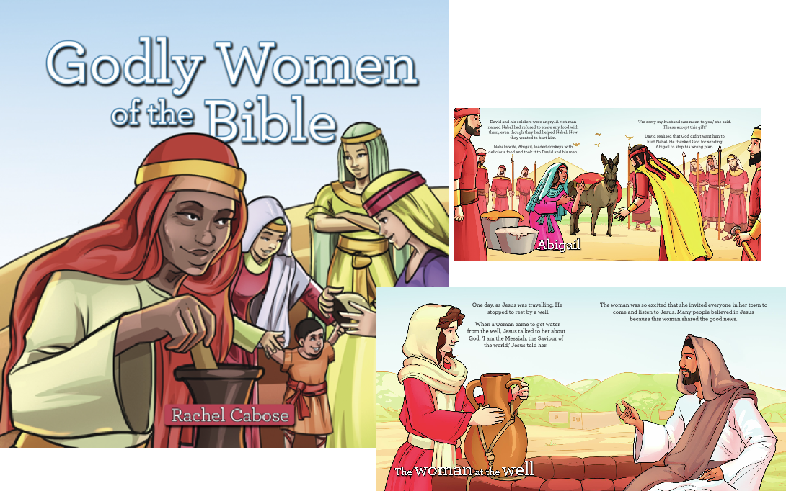
Come closer, little one!
Auntie Rachel has some stories to tell you – 17 stories about lovely, noble women of the Bible, women who loved God, women who were once little girls just like you!
Parents, if you would like your little daughters (and your sons as well) to be generous and hard-working, take the initiative, and seek God in prayer, why not inspire them with these 15 encouraging stories of the godly women in Scripture? We are sure your whole family will be blessed as you read.

Slide 49
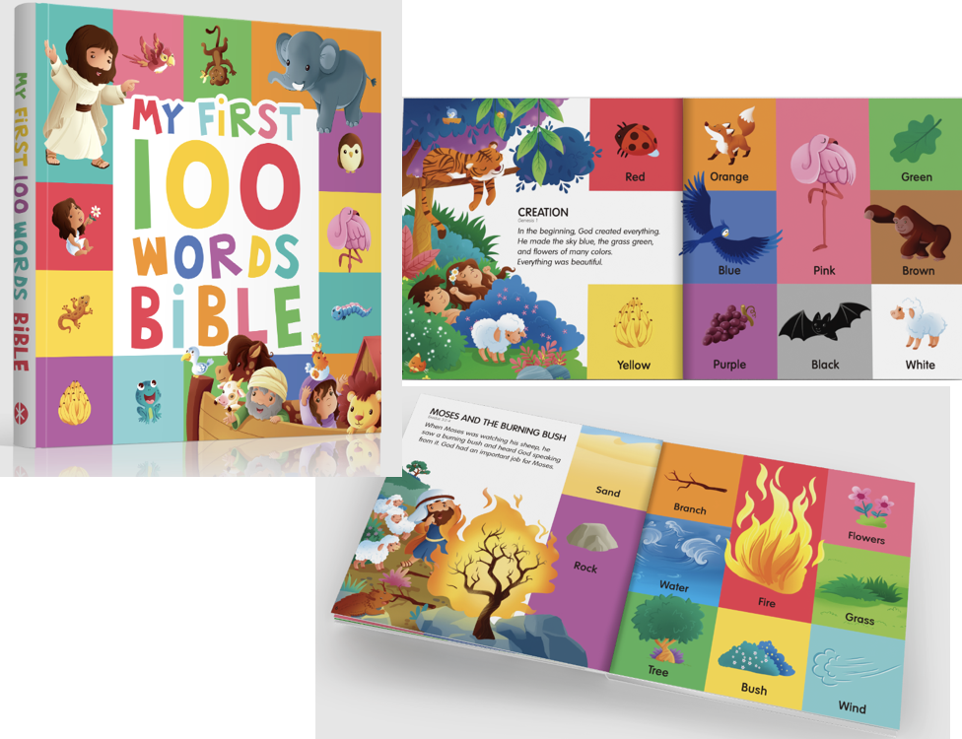
Bilingual
Introduce toddlers aged 1-3 to the world of words and faith with My First 100 Words Bible. This delightful board book combines early language learning with the foundational stories of the Bible, making it a great addition to any child’s book collection.
This beautifully illustrated board book is designed to introduce your child to their first 100 words, divided into ten engaging categories.
Each category features a spread with ten words and a short, related Bible story, helping to nurture their language skills.
The sturdy board book format is durable and perfect for young children, ensuring it can withstand enthusiastic handling.
The book is attractively designed to captivate young minds and keep them engaged while learning. Images are placed on high contrast background colours, to make it easier for the smallest kids to see and recognise the objects.

Slide 50
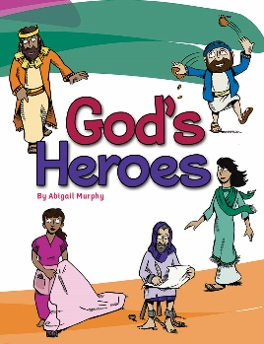
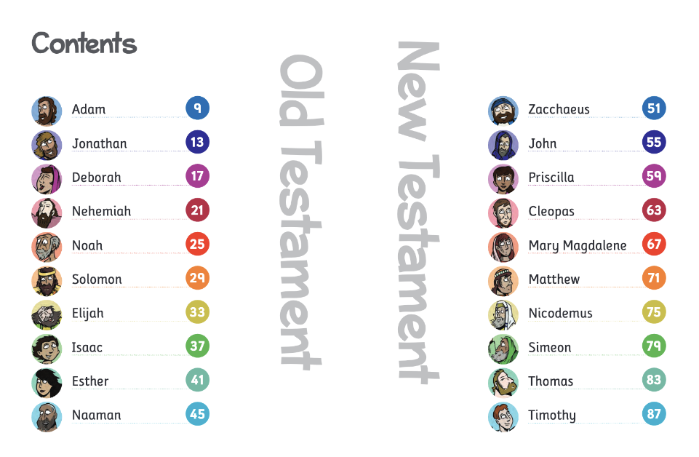
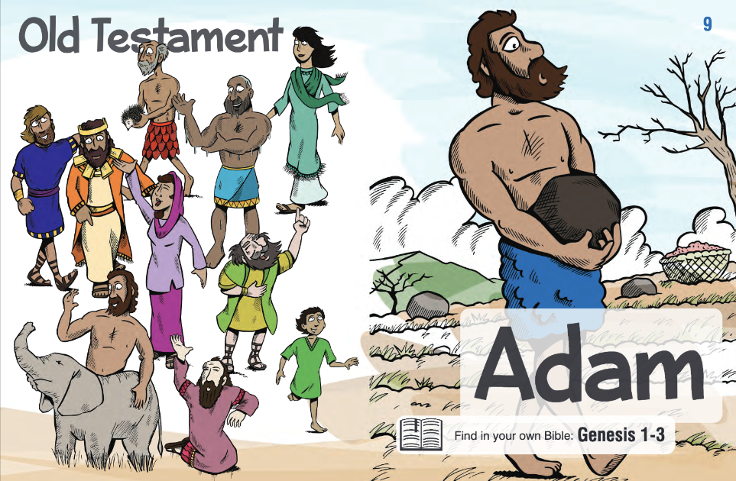
NEW
Explore the stories of twenty Bible characters as they help us to understand God, and to see that He always has good plans for His children.
This book is written so your children can read the stories all by themselves, and will provide hours of joy as well as encouraging them in their own personal relationship with God.

Slide 51

NEW
Young Joseph can’t wait to grow up and be a man. But what does being a man mean?
Happily, Dad is only too pleased to show him –
in the pages of Scripture, through daily life, and
in prayer.
This book is for young boys, ages 3-10, who are curious to know what biblical manliness involves what God expects of them, and how they can grow into their responsibilities as they mature and
develop. It is designed to be read either by the child alone or with one or both of his parents.
Andrew Puckering is a happily married father-of-two,
and an elder for his local church. He holds a Master of Arts degree in Philosophy from Cambridge University, and has been serving as proof-reader and assistant editor at the Stanborough Press Ltd. since 2010. In addition to this book, he has also written My First Book of Bedtime Prayers, The Little Book of Thankful Hearts, and Seek God’s Face.

Slide 52

NEW
Vikram and Leah are city slickers from Australia who have recently moved to the country, but they are in for the adventure of a lifetime when they adopt newly born twin lambs, Trust and Obey.
Join them on this exciting journey in the first seven years of the twins’ lives. Learn important spiritual truths about trust, obedience, salvation, and the gift of eternal life in stories you will treasure for years to come.

Slide 53
NEW
Do you like stories? So do we! And here are some of the most exciting stories you’ve ever heard.
Told by ‘the little giant’, the renowned children’s storyteller and church leader Saustin Sampson Mfune, these fully illustrated 28 stories and their scriptural lessons have already had a life-changing impact on hundreds of young people throughout the world.
From an exciting river rescue to a stolen phone, and from a close encounter with lions to the wisdom of a young blind boy, Mfune’s great stories are at times exciting, sobering, heart-warming, and soul-stirring.
It is our hope and prayer that your family too will be truly blessed as you read them and enter into a deeper relationship with Christ.

Slide 54


To be successful....
* Observe
* Plan what you want to achieve for the year or the quarter.
* Learn — IMPROVE ALWAYS!
* Put into practice
* Think BIG!
* SWOT Analysis: What are you Strengths, your Weaknesses, your Opportunities and your Threats.
* Look at you 4 PPPP: Product, Price, Position and Promotion.
KNOW YOUR MARKET, YOUR MEMBERS AND YOUR POTENTIAL.
Believe in change — BE CREATIVE!
Be proactive with your customers: You are there to SERVE them!

Slide 55
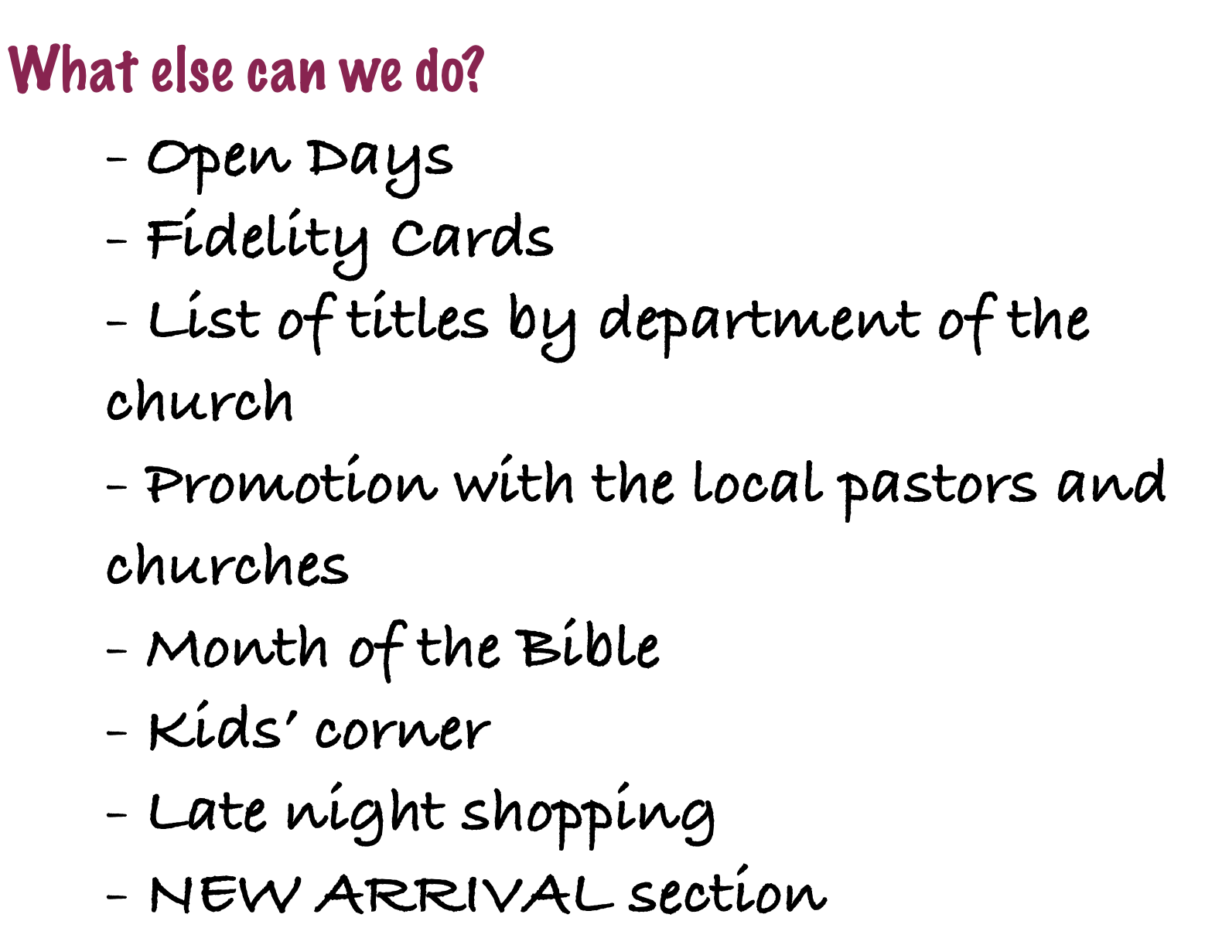


Slide 56
The stanborough press ltd
How TO ORDER:
WEBSITE: WWW.STANBOROUGHPRESS.ORG.UK
Email: esanguesa@Stanboroughpress.org.uk
Call on 01476 591700

