Slide 1











"I Will Go, I Will Serve, I Will Shine"
West-Central Africa Division
Strategic Plan (2025-2030)
A Journey of Faith, Vision, and Action
M
F
A
I
T
H
October 31, 2025

Slide 2













Strategic Planning Framework
Four core pillars guiding WAD's strategic planning (2025-2030)
Articulating the Dream
Addressing the Challenges
Clearly define vision and aspirations, ensuring alignment with mission and values, and setting inspiring goals.
Identify and mitigate potential obstacles by analyzing internal and external factors, and develop effective overcoming strategies.
Taking Advantage of the Moment
Stating the Approach
Capture emerging opportunities and trends, leveraging strengths to drive development and growth.
Outline specific methods and strategies to achieve goals, create clear roadmaps, allocate resources effectively, and establish metrics to track progress.
These pillars support the "I Will Go" theme and commitment to mission, evangelism, and service.

Slide 3
























Vision, Mission and Core Values
Guiding principles for WAD's strategic journey (2025-2030)
Vision
"To be a vibrant, inclusive, and mission-driven community, inspiring, empowering, and transforming lives through our collective efforts and unwavering commitment to excellence."
Mission
M-FAITH Core Values
To empower individuals, families, and communities to embrace and share Christ's love, promoting spiritual growth, social transformation, and community development through holistic ministry, innovative outreach, transformative education, and collaborative partnerships.
M-FAITH guides WAD's actions, decisions, and interactions:
Mission-Focus
Faithfulness
Accountability
Innovation
Transparency
Harmony
"I Will Go, I Will Serve, I Will Shine"

Slide 4









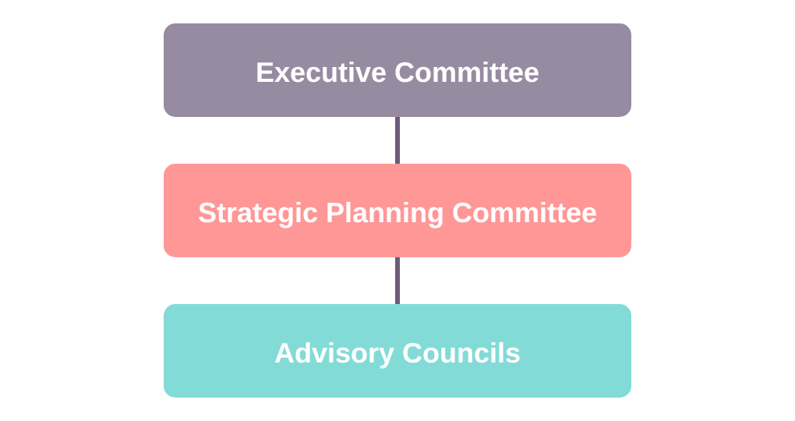








Operating Model (2025-2030)
Governance structure and leadership approach
Governance Structure
Leadership Approach
Benefits
Clear Direction
Collaboration
Strategic priorities understood
Teamwork among stakeholders
Effective Oversight
Accountability and progress monitoring
Accountability
Executive Committee: Strategic direction & decision-making
Transparency in governance
Strategic Planning Committee: Plan development & monitoring
Advisory Councils: Expert guidance on strategic areas
Operating model aligns with "I Will Go" theme and M-FAITH values

Slide 5














Strategic Priority 1: Communion with God
Developing spiritual maturity through daily connection with God
Bible Study
Prayer
Daily study and meditation on Scripture to grow in knowledge and understanding.
Regular, persistent prayer to maintain constant communication with God.
Mission Service
Communion with God
Stewardship
Active participation in God's mission through service and outreach.
Responsible management of resources, talents, and opportunities given by God.
"Through daily communion with God, believers grow into spiritual maturity." - Based on Ellen White

Slide 6





























Action Plans for Daily Prayer and Bible Study
Ten strategies to promote daily devotionals
1
Daily Prayer and Bible Study Guide
2
Digital Platform
Create guide for personal and family use.
Develop app for prayer and Bible study resources.
3
Prayer Meetings
4
Training
Organize weekly or monthly prayer gatherings.
Provide skills training for effective prayer and Bible study.
5
Sabbath School Time
6
Mentorship
Encourage Sabbath school classes to set aside time for prayer and study.
Develop program pairing experienced Christians with new believers.
7
Quarterly Calendar
8
Spiritual Retreats
Create prayer and fasting calendar for each quarter.
Hold retreats focused on prayer and Bible study.
9
Resource Library
10
Accountability Partners
Establish Bible study resource and book library.
Encourage partners to support each other in prayer and study.
Implementation timeline: 2025-2030

Slide 7
















Action Plans for Family Worship
Implementation strategies for increasing family worship participation
Family Worship Guides
Digital Resources Platform
Develop comprehensive guides with daily devotionals and activities for families.
Create website or social media platform for easy access to family worship resources.
Training for Parents
Dedicated Worship Time
Organize training sessions for parents and guardians on effective family worship techniques.
Encourage families to set aside regular time specifically for worship and spiritual connection.
Worship Resources
Family Worship Events
Provide music, materials, and tools to enhance family worship experiences.
Host periodic events that bring families together for worship and fellowship.
Mentoring Programs
Quarterly Calendars
Develop family mentorship systems for support and accountability.
Create calendars with focused worship themes and activities for each season.
Implementation timeline: 2025-2030 with quarterly reviews and annual adjustments

Slide 8















Action Plans for Sabbath School Engagement
Enhancing daily use of Sabbath School Bible study guides
Guide Accessibility
Promotion
Ensure Sabbath School Bible study guides are available in both print and digital formats for easy access.
Continuously promote the importance of using Sabbath School guides for daily Bible study.
Training
Class Engagement
Provide training on effective Bible study techniques using the guides, offered quarterly.
Encourage Sabbath School classes to discuss and apply the weekly lessons in their studies.
Tracking System
Recognition
Develop a system to track and report daily Bible study participation for accountability.
Recognize and reward individuals and classes for consistent use of the Sabbath School guides.
Digital Platform
Webinars
Create a Sabbath School app or online platform for easy access to guides and study resources.
Host webinars or online discussions about Sabbath School lessons to enhance understanding.
Implementation timeline: 2025-2027

Slide 9





















Prayer Meeting and Ellen White Literature Initiatives
Building spiritual growth through community and study
Weekly Prayer Meeting Participation
Ellen White Literature Initiatives
Establish new prayer meeting groups in different locations
Create reading plans for Ellen White writings
Promote prayer meetings through various channels
Develop online platforms for accessing resources
Provide training for effective prayer meeting leadership
Form discussion groups for reflection
Develop tracking systems for participation
Translate and distribute materials in local languages
Tracking Systems & Recognition
Quarterly reports
Regular recognition
"I Will Go, I Will Serve, I Will Shine"

Slide 10
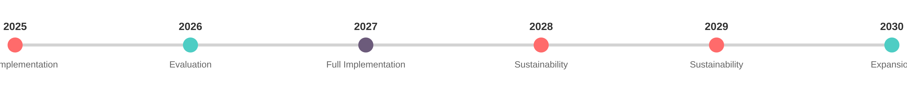




















Implementation Timeline and Expected Outcomes
2025-2030 Strategic Initiatives
2025
2026
2027
2028-2030
Initial implementation
Mid-term assessment
Full implementation
Sustain efforts
Quarterly reviews
Adjustments based on feedback
Annual evaluation
Expand successful initiatives
Expected Spiritual Growth Outcomes
Spiritual Growth
Community Impact
Mission Focus
Increased personal and corporate prayer life leading to spiritual maturity.
Enhanced community engagement and social transformation.
Greater commitment to the Great Commission and evangelism.
"I Will Go, I Will Serve, I Will Shine"

