Slide 1
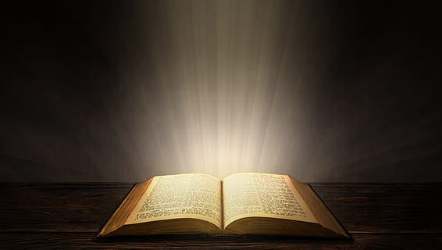

INTEGRATED FOR MISSION
Grounded in the Bible…
…Focused on the Mission

Slide 2
Integrated for Mission
West Central Africa Division of
The General Conference of
Seventh-day Adventists
ANNUAL COUNCIL
Accra, Ghana, November 2, 2025

Slide 3
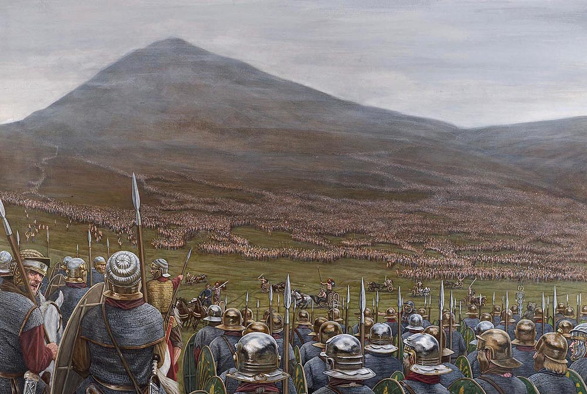
Integrated for Mission 3
Integrated for Battle--
--Integrated for Victory

Slide 4
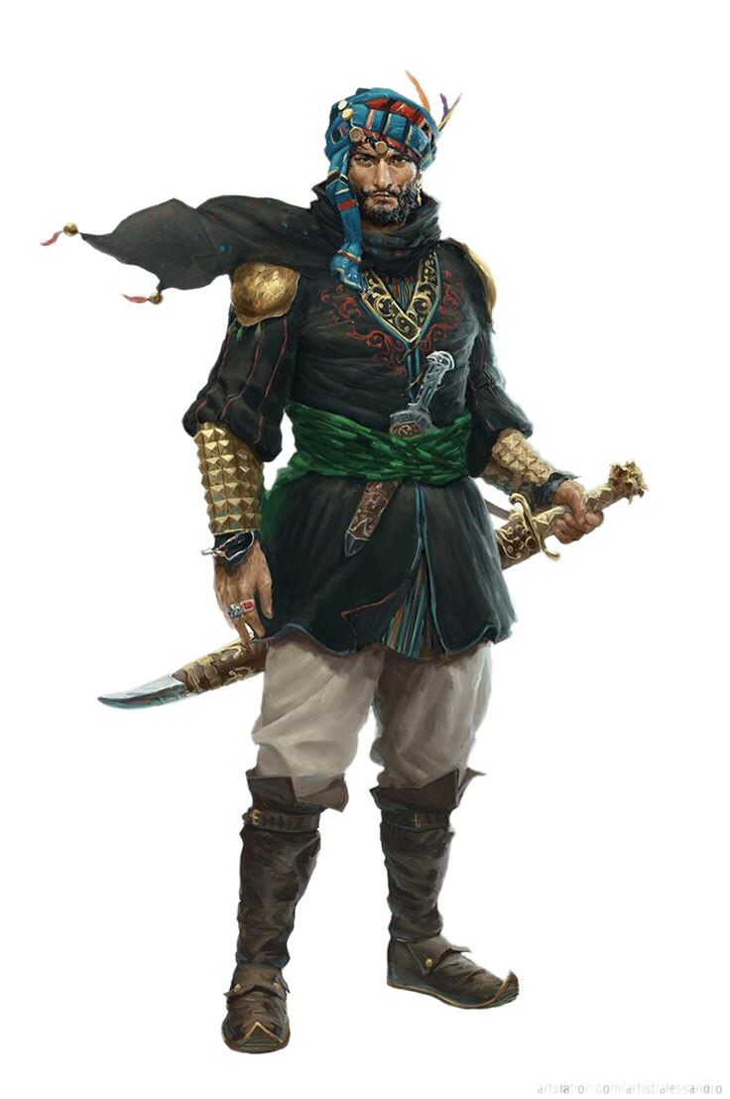
Integrated for Mission 4
“The LORD is with you, mighty warrior.” (Judges 6:12 b)

Slide 5
Integrated for Mission 5
INTEGRATION begins at the TOP
Gideon is not at the top-- He is from the smallest family in his tribe, and the youngest member of the family.
God is at the top and He invites Gideon into integration with HIM.
The LORD rarely invites leaders into integration with HIM who are already convinced of their ability-
Moses, Joshua, David, Isaiah, Jeremiah, Daniel, Joseph. And 11 of the disciples.

Slide 6
Integrated for Mission 6
Seven years of oppression from Midian, Amalekites and others.
Destroyed crops, stole food, stole cattle, sheep, donkeys
left nothing for the Israelites and forced them into caves for shelter
BECAUSE ISRAEL HAD FORSAKEN THE LORD

Slide 7
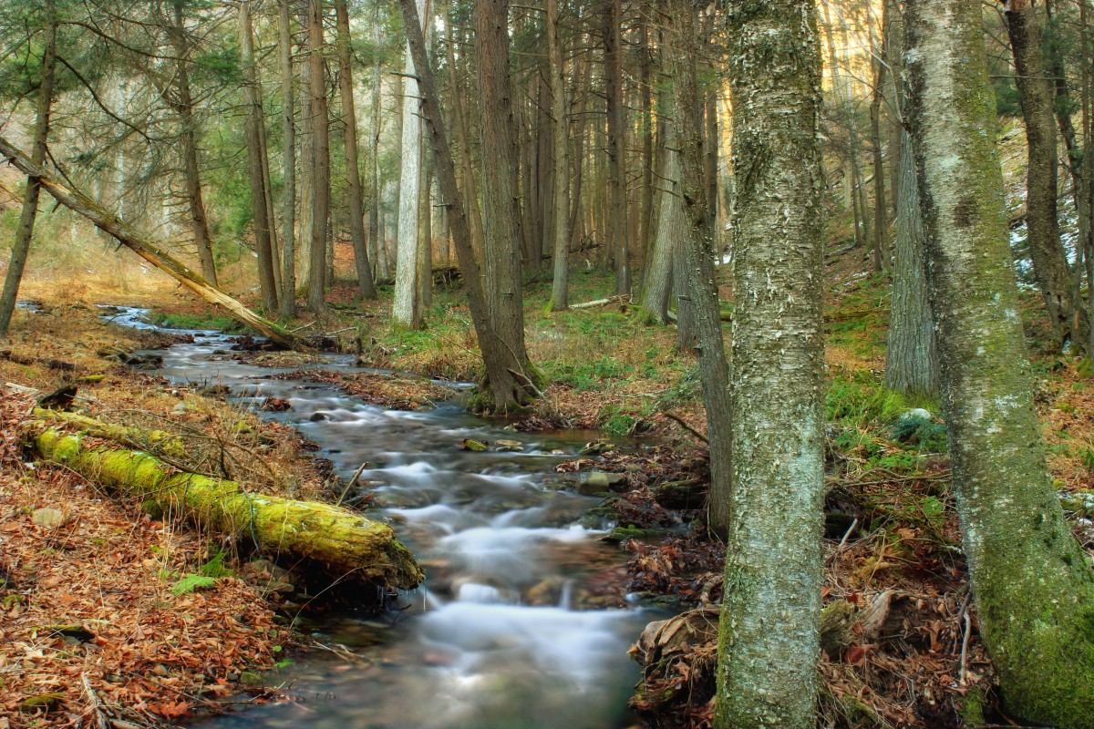
Integrated for Mission 7
TESTING THE INTEGRATION
Obedience in removing his father’s altar to Baal, and the Asherah pole. Replacing it with an altar to the LORD.
Testing with the wet fleece and dry ground---and the dry fleece and wet ground
Too many soldiers. Send the scared men home. BUT--
Still too many soldiers

Slide 8
Integrated for Mission 8
“The three hundred chosen men not only possessed courage and self-control, they were men of faith. They had not defiled themselves with idolatry. God could direct them and through them He could work deliverance for Israel. God is honored not so much by great numbers as by the character of those who serve him.” The Beginning of the End p 277b (Patriarchs and Prophets)

Slide 9
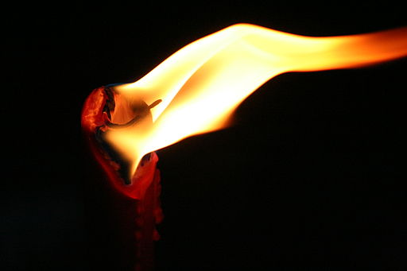
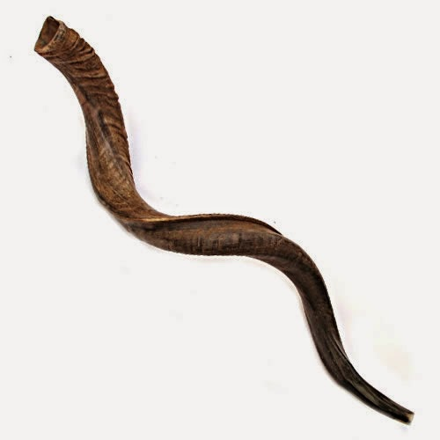
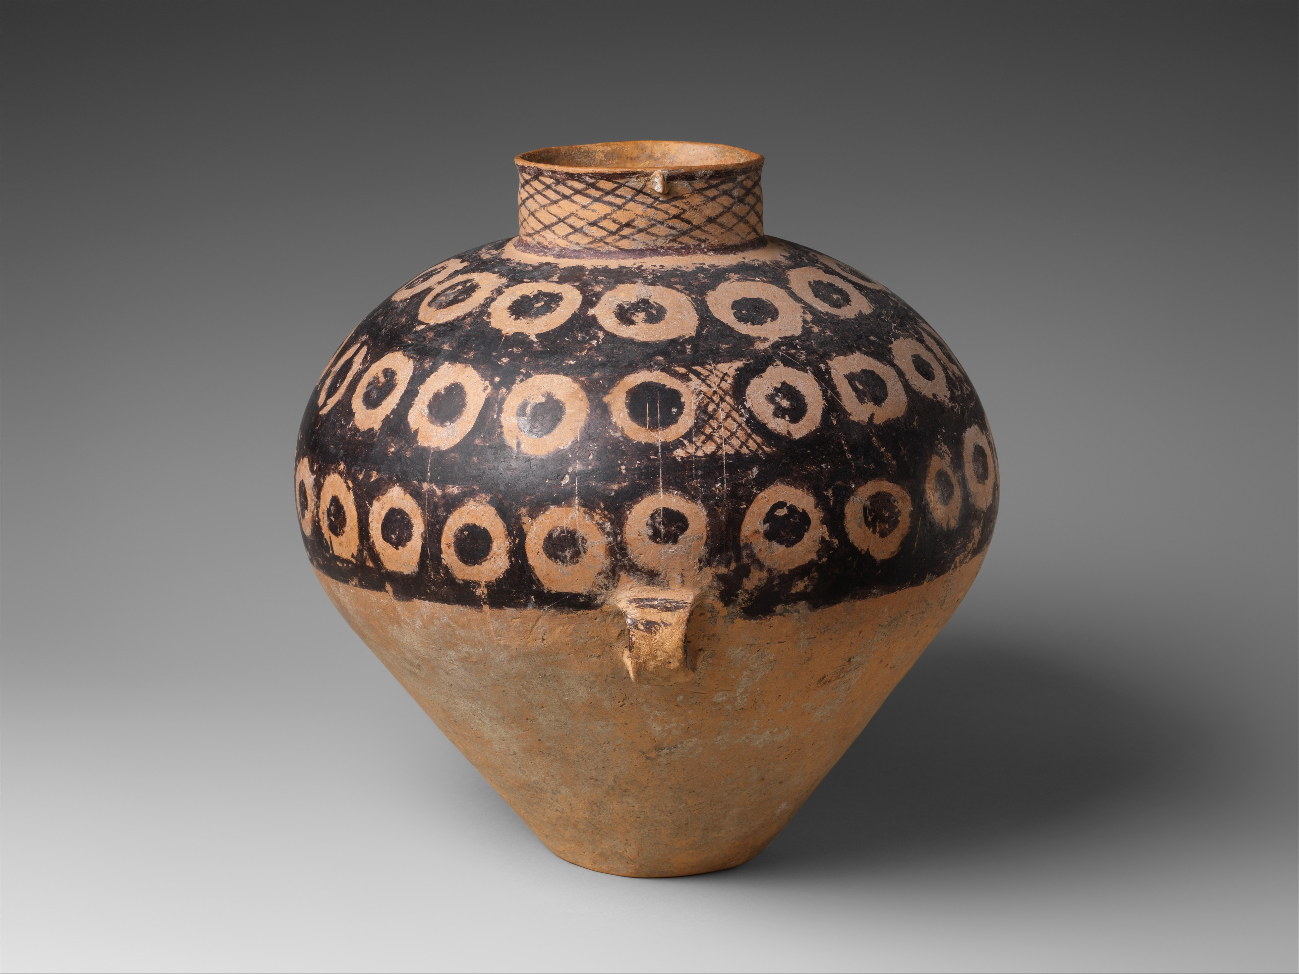
Integrated for Mission 9
THE POWER OF INTEGRATION
Few in number
Not trained in warfare
Strange weaponry– no swords, no spears, no cattle prods, nothing but torches, trumpets and pottery

Slide 10
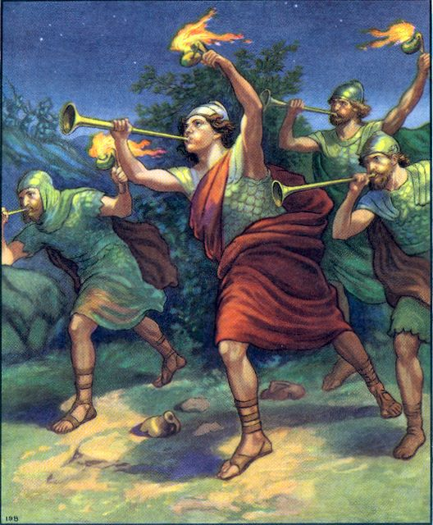
Integrated for Mission 10
They were integrated with Gideon who was integrated with the plans of God.
They were integrated at the riverside.
They were integrated in the darkness.
They were integrated with their trumpet blasts.
They were integrated with their shattering pottery.
They were integrated with their blazing torches.
They were integrated with their shouting.
They were integrated in the victory that only God could give them.

Slide 11
Integrated for Mission 11
THE SITUATION FACING THE CHURCH TODAY
“For our struggle is not against flesh and blood but against rulers, against the authorities, against the powers of this dark world and against the spiritual forces of evil in the heavenly realms” Eph 6:12
Rapidly rising secularism
Social unrest
Military action both formal and ”ad hoc”
Loss of faith
Economic prosperity AND uncertainty

Slide 12
Integrated for Mission 12
THE SITUATION TODAY continued.
The Sheer Size of the Task
“And this Gospel of the kingdom shall be preached in all the world for as a testimony to all nations and then the end will come.” Matthew 24:14
24 Million Adventists growing at about 1 million per year or a bit more
8.142 Billion world population growing at about 70-80 million or more.
THE TASK IS NOT DOABLE

Slide 13
Integrated for Mission 13
Gideon’s army of 300 was 0.24% of the 120,000 strong Midianites- But GOD gave him the victory–
Just like He defeated Jericho’s massive walls, and Egypt’s gods and army, and so much more
Our Adventist army of 24,000,000 is 0.29% of the 8.142000000 world’s population—
AND God will have His Victory again-
just like HE ALWAYS HAS BEFORE

Slide 14
Integrated for Mission 14
GROUNDED ON THE BIBLE and
FOCUSED ON THE MISSION
“… Then choose for yourselves this day whom you will serve. …But as for me and my household, we will serve the LORD.”

Slide 15
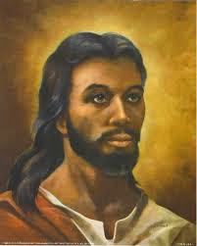
Integrated for Mission 13

