Slide 1
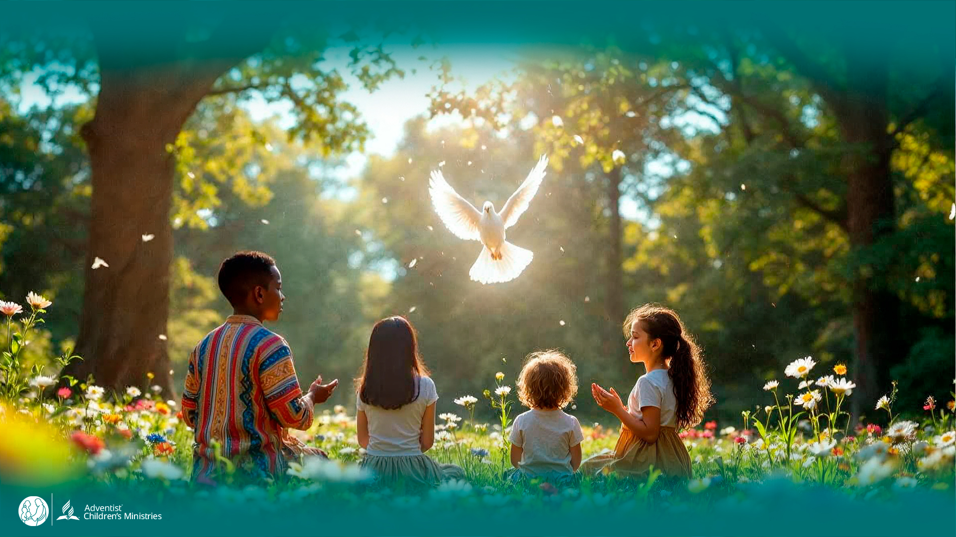
Day 9
The
UNLEASHED SPIRIT
Makes Us Children of God
DAYS OF
PRAYER
January 7-17, 2026
Notes:
Welcome to Day 9!
Today, Luca and Orel will meet someone who understood the Spirit’s power—Paul.
The Spirit makes us children of God. Let’s see how!

Slide 2
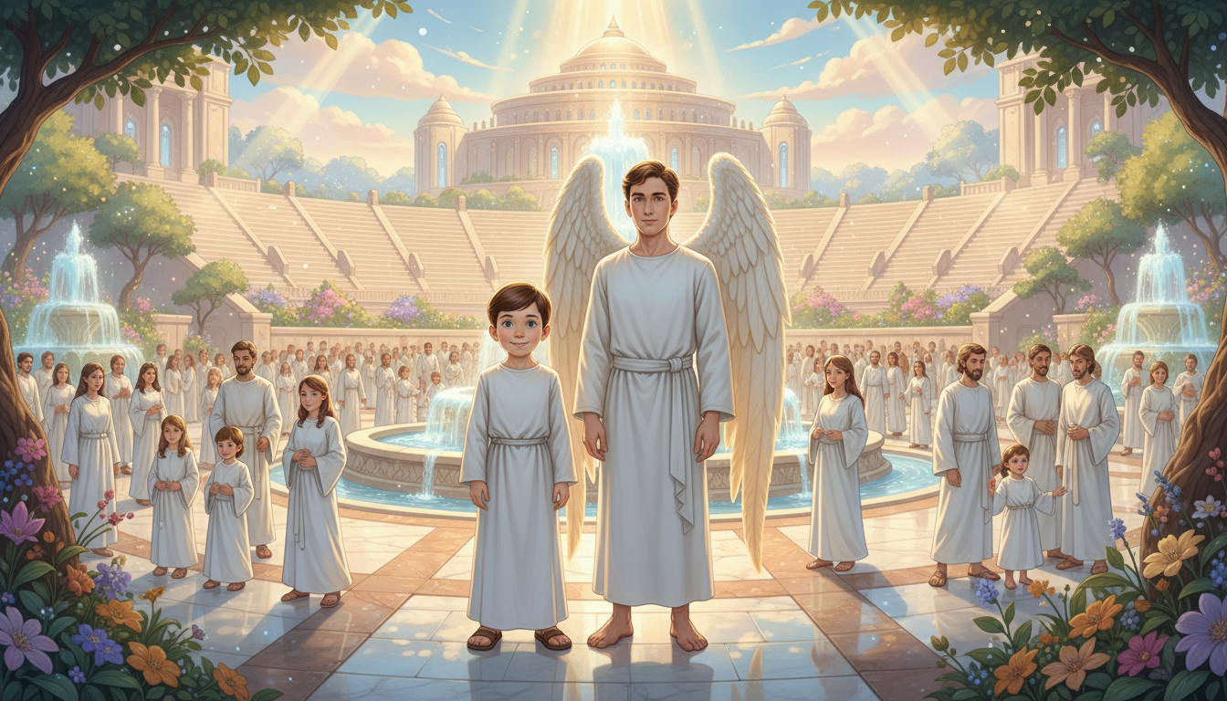
Notes:
“Welcome to the Central Plaza of the New Jerusalem,” says Orel.
“Wow!” Luca gasps. “Look at those fountains—it’s so beautiful!”
He runs toward one shaped like a flower, splashing with joy.
“There are so many people here,” says Luca. “And over there—an amphitheater!”
“We need to go there,” says Orel. “A great message is just ending.”

Slide 3
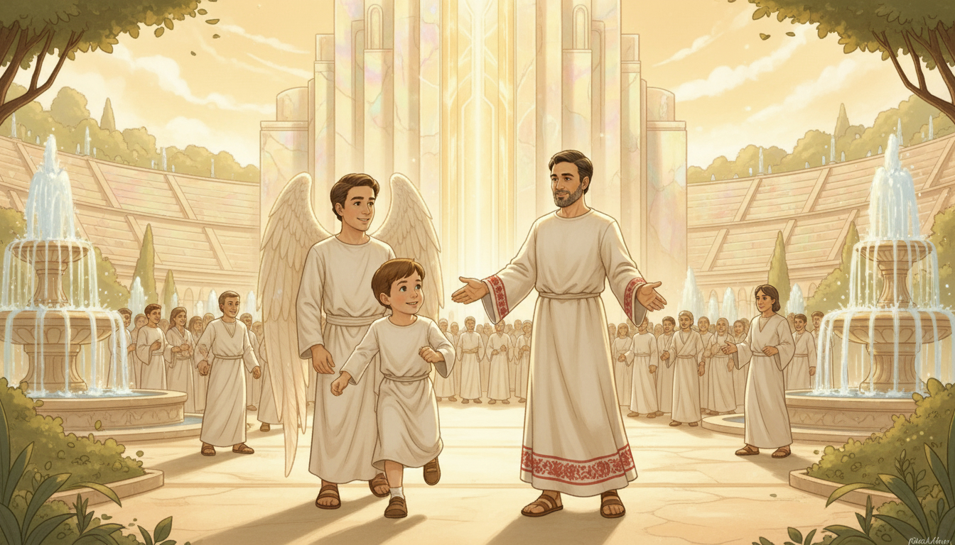
Notes:
Thousands of redeemed sing praises that echo across the plaza.
“There must be millions here!” says Luca in awe.
The speaker steps down from the stage—Orel waves. “Paul! Wait!”
Paul turns, smiling. “Orel and Luca—is it really you?”
“You know us?” Luca asks.
“Of course,” Paul laughs. “Stephen told me about your visits.”
“You’re amazing, Paul!” says Luca.
“All glory to Jesus,” Paul replies. “I was only His soldier.”

Slide 4
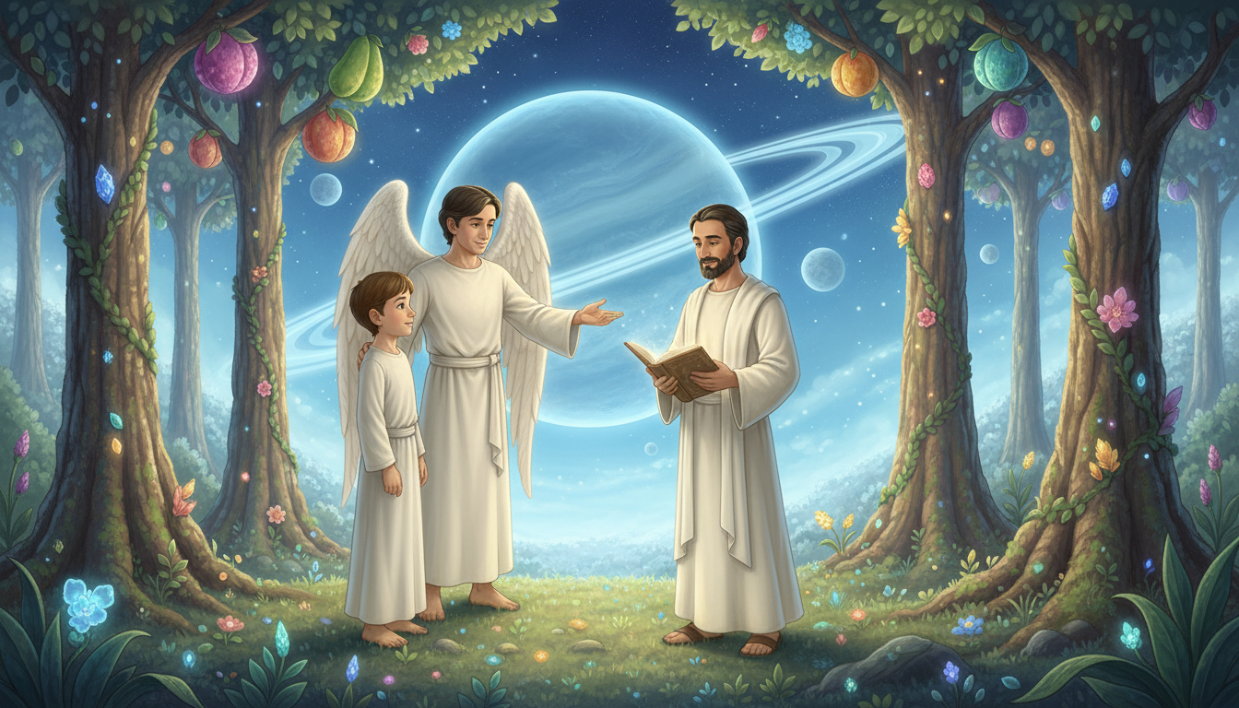
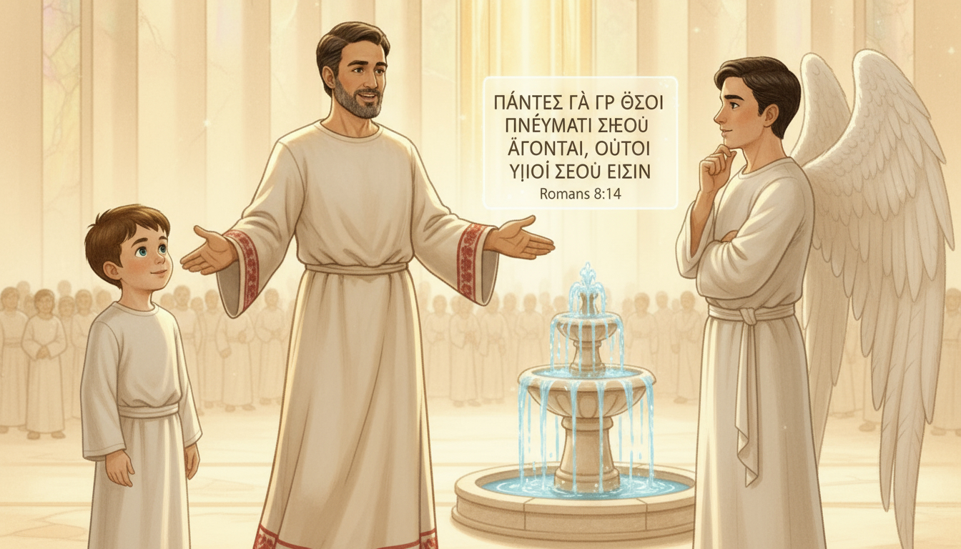
Notes:
Orel opens his glowing glass. “Let’s read something you wrote, Paul.”
He reads Romans 8:14 (NIV):
“For those who are led by the Spirit of God are the children of God.”
“Paul,” asks Luca, “how does the Spirit make us God’s children?”
Paul smiles. “When we accept Jesus, are baptized, and follow Him, the Spirit fills our hearts.
He changes us and makes us part of God’s family.”
“That’s why we’re all here!” says Orel joyfully.

Slide 5
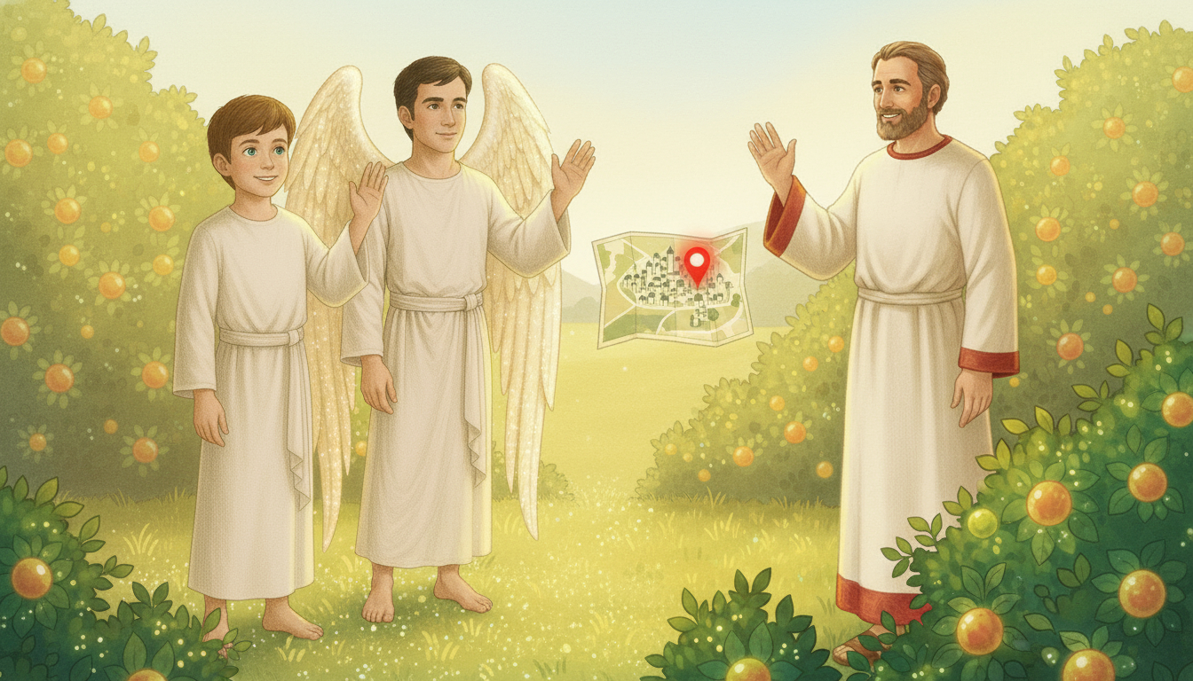
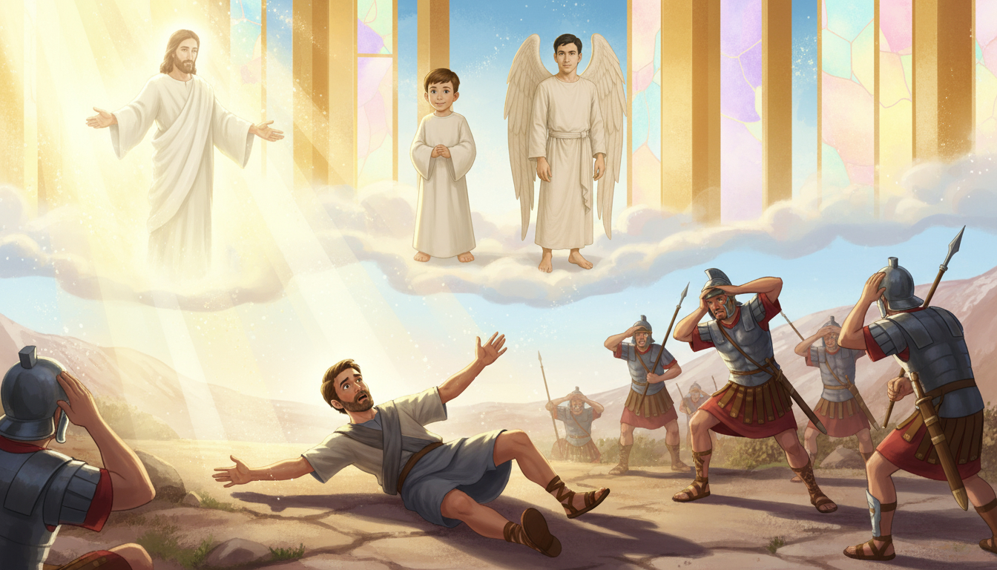
Notes:
“So,” says Luca, “I was adopted by God through His Spirit?”
“Exactly,” says Paul. “Even I was adopted.”
“If Jesus hadn’t stopped me on the road to Damascus, I’d still be lost.”
“But the Spirit changed everything—He gave me a new heart and a new mission.”
“What a miracle!” says Orel. “The Spirit truly makes us new.”

Slide 6
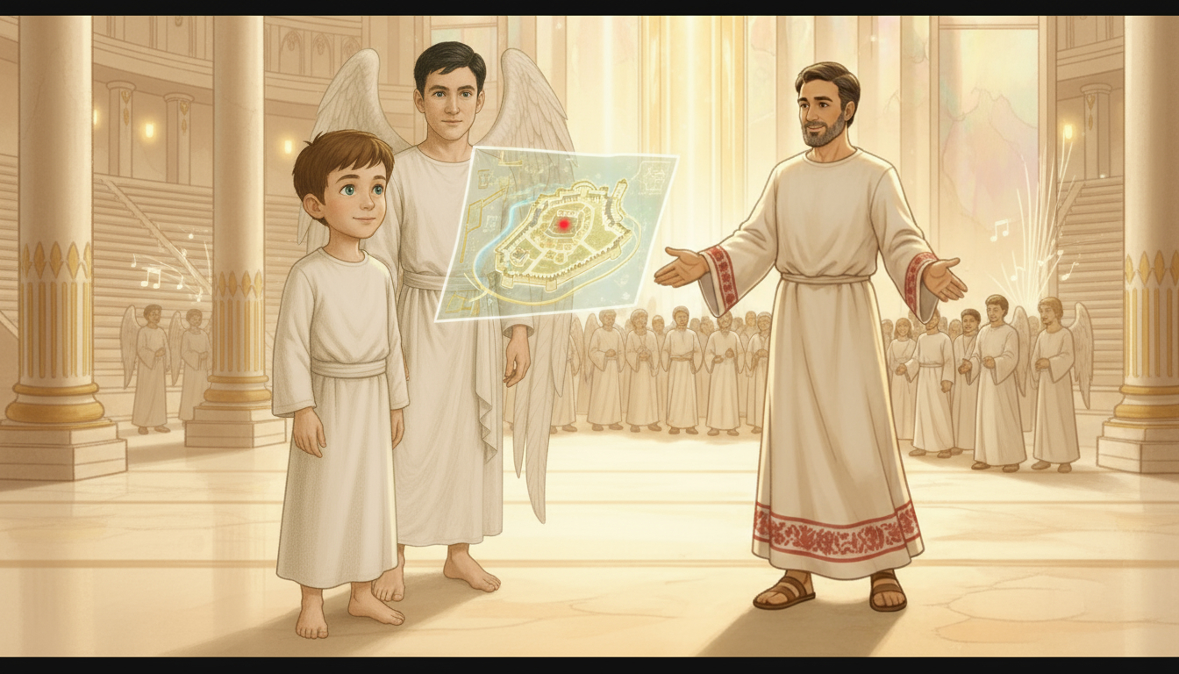
Notes:
“Thank you, Paul,” says Orel. “Your words inspire us.”
“Duty calls,” Paul smiles as some redeemed call him back.
“We’ll talk again soon!” says Luca.
“Go in peace,” Paul says. “Never forget—the Spirit makes us part of God’s family.”
Paul walks back toward the amphitheater as songs rise in the plaza.

Slide 7
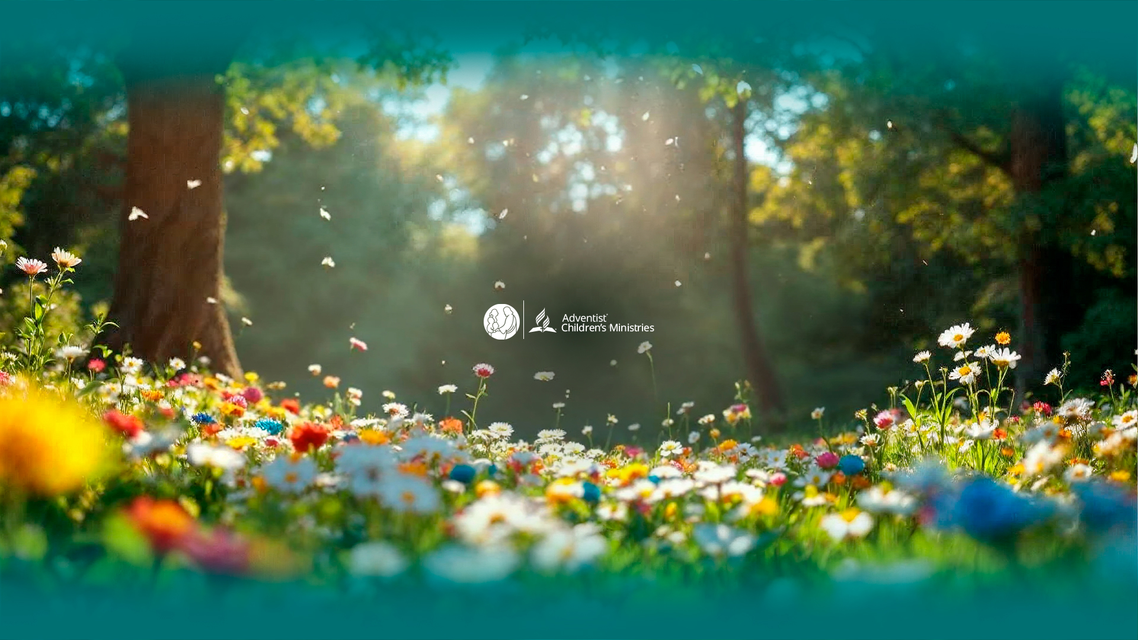
Notes:
The Spirit makes us children of God.
Let’s Get to Work!
Color a drawing of Paul preaching in the New Jerusalem.
In the box, write: “In Heaven I will meet my favorite Bible characters.”
Let’s Pray!
Thank the Spirit for making you part of God’s family.
Ask Him to help you live as a faithful child of Jesus.

